Slide 1
To the Instructor
Modify this presentation to fit your company.
Brand it with your company’s logo.
Delete slides referring to features you do not offer.
Hide or delete slides that are for your use only, like this one or the Instructor Training Checklists.
To ensure you cover all material, use the Instructor Training Checklist.
The presenter notes section provides key points.
Presenter notes
Notes:
[Hide or delete this slide if you are projecting this presentation as a slide show for driver training.]
To Hide a slide from presenting, right click on the slide thumbnail in normal view and choose Hide Slide.

Slide 2
Instructor Training Checklist: CER
Explain how CER works
Describe the types of critical events your company captures.
Describe what the driver sees when a CER is triggered.
Describe when your company expects drivers to manually trigger a CER.
Describe the information your company receives for a CER.
Manually trigger a CER
Tap the CER home screen menu button.
Notes:
[Print this slide to help you cover all of the important topics. Hide or delete it if you are projecting this presentation as a slide show for driver training.]
[Find out in advance which sensors and events your company uses.]

Slide 3
IVG Driver Training
Critical Event Reporting

Slide 4
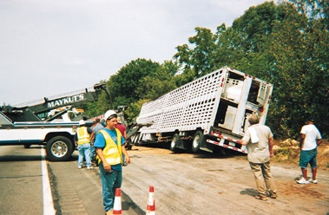
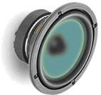
Safety Information
You cannot use the IVG to read or type messages while moving.
Exception: a logged in, non-driving co-driver may use the IVG without restriction.
You can listen to messages while driving.
Notes:
Review safety procedures.
Text-to-speech improves the driver’s productivity and safety as they can safely listen to all or part of the message and determine its importance. They only need to pull off the road if it needs immediate response.
The team’s non-driver can safely operate the IVG while the truck is moving.

Slide 5
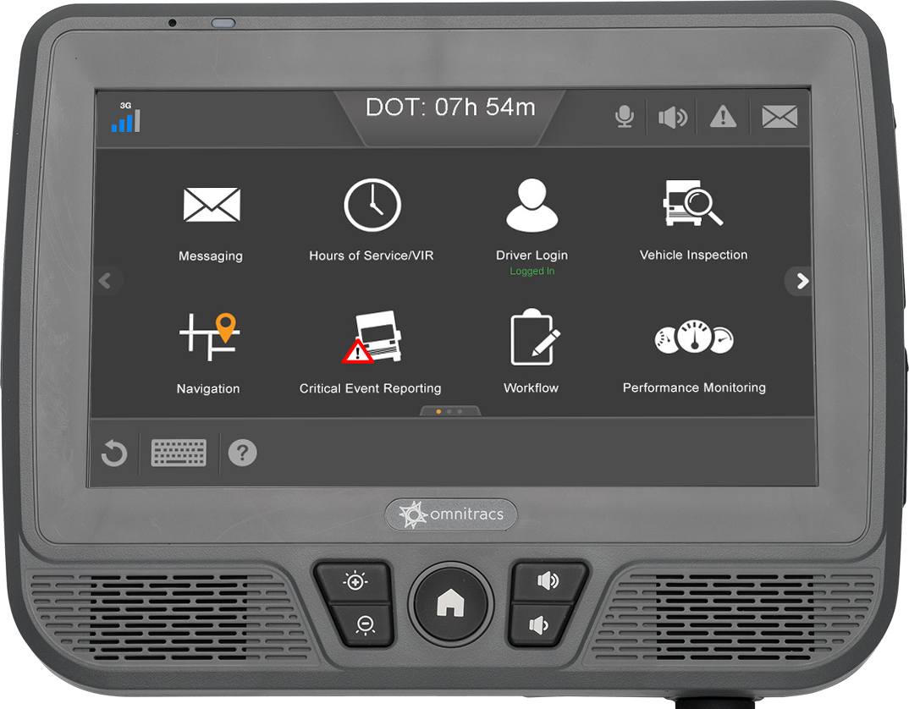
Goals
This presentation covers how to manually trigger a Critical Event.
Notes:
The goal above corresponds to an IVG application covered in this presentation. Each application section has an instructor training checklist (found at the beginning of this presentation) to help you train the application in detail. If your company doesn’t use all of the applications in this presentation, remove the section slides and adjust the goal statements. Add your own goals if desired.

Slide 6
Critical Event Reporting
Safety and Compliance Services

Slide 7
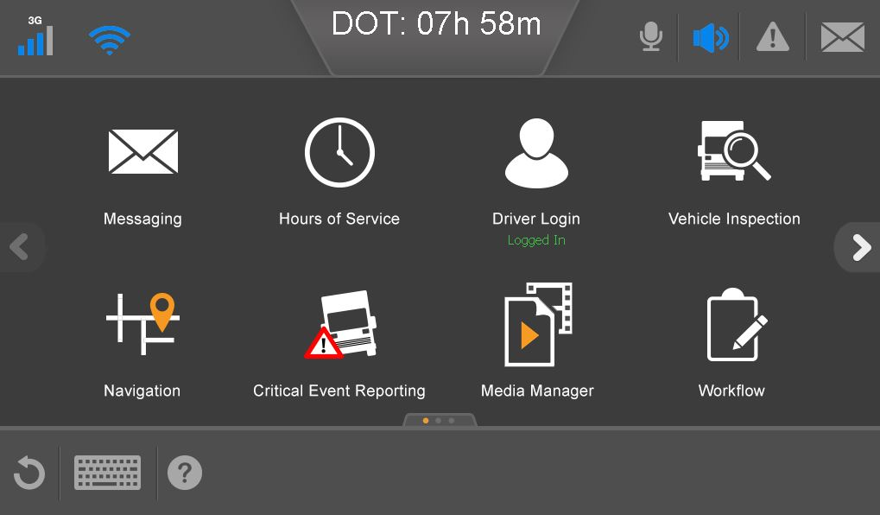
Critical Event Reporting (CER)
CER reports events that could affect safety. These include:
Hard braking
Lane departure*
Roll stability*
Forward collision warning*
Following time violation*
Overspeed and excessive overspeed*
Manually-triggered events*
*These events require special sensors on the truck. Find out whether your company uses them.
Notes:
Important: Lane departure, roll stability, FCW, and FTV require special sensors. Determine whether your company uses those sensors, and remove them if you do not want to discuss them.]

Slide 8
Critical Event Reporting (CER)
You need to understand:
When critical events are triggered
What information is sent when a CER is triggered
You need to know how to:
Manually trigger a critical event
Know when the IVG has automatically generated a critical event report

Slide 9
When Does the IVG Send a CER?
The system sends a critical event report when:
A sensor detects an event affecting safety. Depending on your company, these could include: hard braking, roll stability, lane departure, and overspeeding.
You manually trigger a CER.

Slide 10
CER Information Sent
Information sent includes:
The vehicle’s location when the CER was triggered
The vehicle’s location when the information about the CER was delivered
The vehicle’s speed and other pertinent information for the period starting five minutes before and ending two minutes after the CER was triggered
The type of event generated (hard braking, manual, etc.)

Slide 11
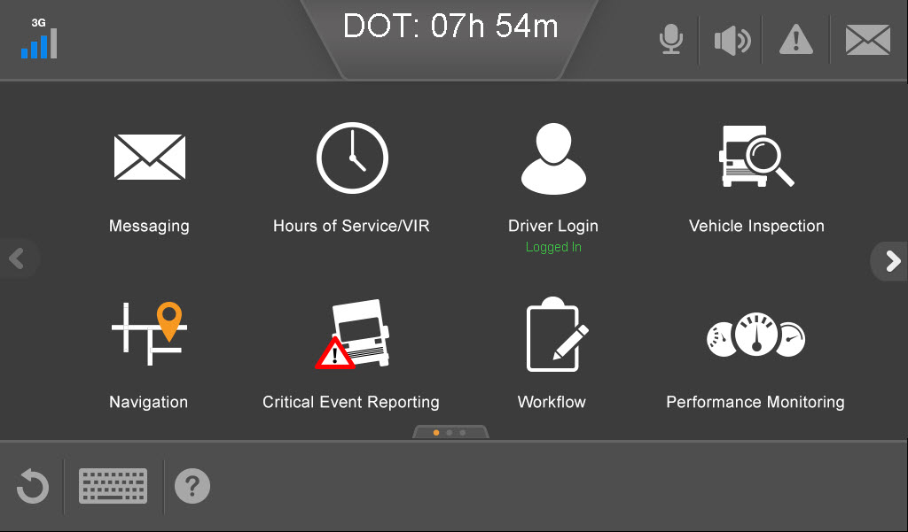
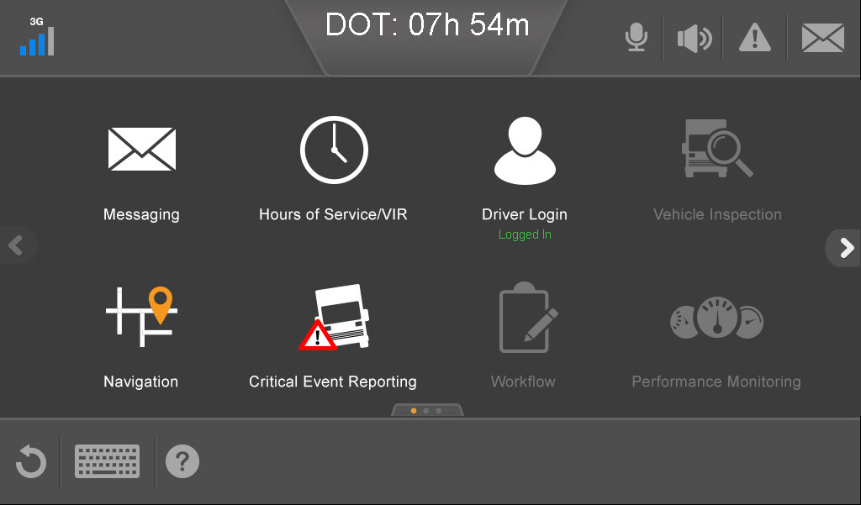
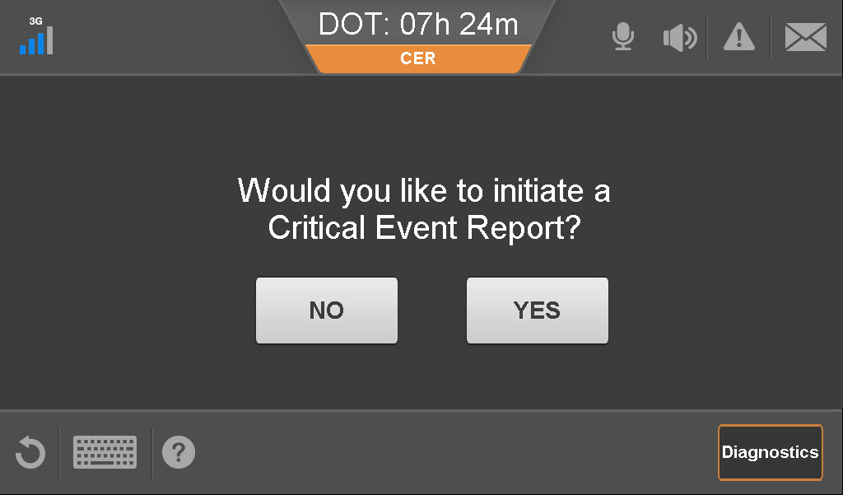
Manually Trigger a CER
The CER button is available whether you are moving or stopped.
Home screen when stopped Home screen when moving
From the Home screen, tap the Critical Event Reporting button.
Tap Yes.

Slide 12
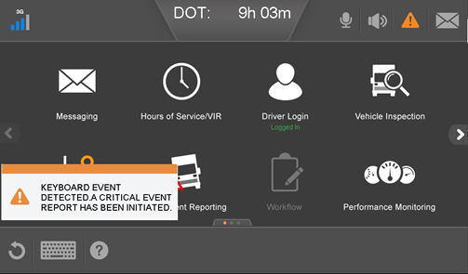
When a CER Is Triggered
Notes:
Important: Discuss how your company follows up on CERs with drivers.

Slide 13
IVG Driver Training
This concludes the Critical Event Reporting training.

