Slide 1
To the Instructor
You are encouraged to modify this presentation to fit your company.
Brand it with your company’s logo.
Delete slides referring to applications or features you do not offer.
Hide or delete slides that are for your use only, like this one or the Instructor Training Checklists for each application.
The notes area often has additional information to help you communicate key points.
There are driver handouts included with the training package that you can modify and distribute to your drivers.
Notes area
Notes:
[Hide or delete this slide if you are projecting this presentation as a slide show for driver training.]
To Hide a slide from presenting, right click on the slide thumbnail in normal view and choose Hide Slide.

Slide 2
IVG Driver Training
Enhanced AOBRD
Hours of Service
Notes:
;

Slide 3
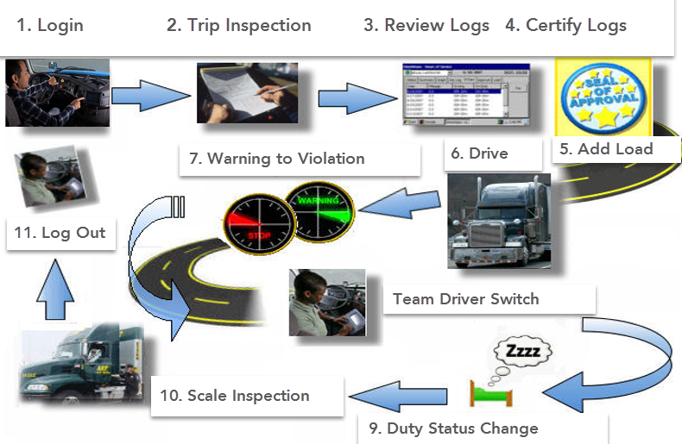
A Day in the Life of the Driver

Slide 4
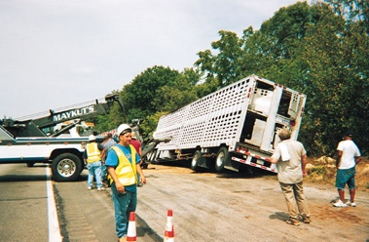
Safety Information
You cannot use the unit to read or type messages while moving.
Exception: a logged in, non-driving co-driver may use the unit without restriction.
You can listen to messages while driving.
Notes:
Distracted Driving Compliant

Slide 5
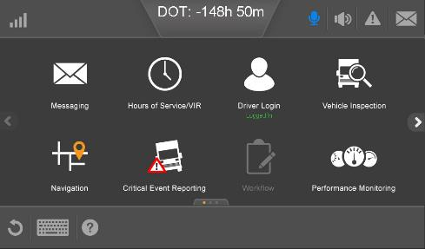
Access Intelligent Voice Interface (IVI)
The IVG is constantly listening and when the driver says “Hello, Omnitracs,” the IVG responds with, “Hello, Please state a command.
When activated, the IVI icon in the header turns blue and IVI actively listens for one of the supported commands.

Slide 6
Omnitracs IVI Commands
After the IVG responds asking for a command, the driver can say any of the following:
Home screen
Go Back
Brightness Up
Brightness Down
Brightness Off
Volume Up
Volume Down
Mute Volume
Scroll Up
Scroll Down
Available hours
Hours of service
Inbox
What can I say
Workflow
Vehicle Inspection
Next Turn
Tire Status
Miles per Gallon
Read Message

Slide 7
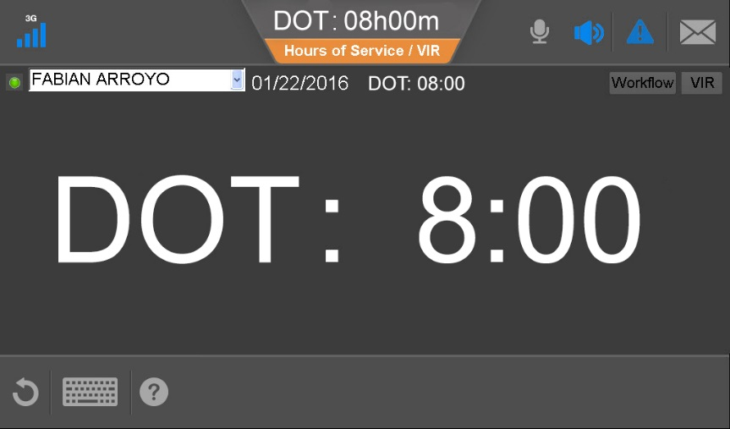
Hours of Service Availability While Driving
If you open HOS before driving, the drive time remaining until you are in violation displays after the wheels move. This considers all of your HOS clocks.

Slide 8
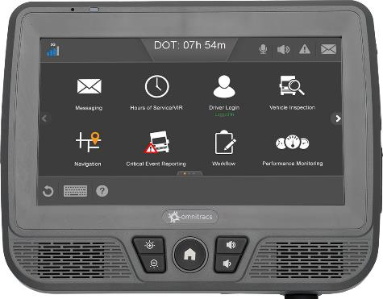
IVG

Slide 9
Enhanced AOBRD Regulation 395.15
A driver should understand what is required of them by MTO and DOT Officers during an inspection.
Drivers operating an AOBRD in the USA must carry in the vehicle:
Visor Card – Instructions that tell enforcement how to retrieve logs in the appropriate format, Canadian or USA.
AOBRD Certificate of Compliance – Downloadable from the Customer Portal or orderable directly from Omnitracs.
Blank Logs – Enough for the driver to recreate previous 8 days (USA only) or 14 Days (Canada)
Drivers MUST declare to the officer that they are operating an AOBRD (Automatic On-Board Recording Device) in the USA in accordance with the grandfather clause 395.15.
Canadian officers refer to this type of equipment as an EOBRD (Electronic On-Board Recording Device).
Notes:
A driver should have a general understanding of how the system works prior to leaving on their first trip.

Slide 10
Overview
Benefits
Hours of Service (HOS) detects driving time automatically using vehicle sensor data from the vehicle’s ECM (electronic control module).
Many of the required fields are completed automatically
Your available hours are calculated automatically
You receive an audible notification when you’re running out of drive time!
Notes:
The system plugs into the trucks ECM and uses the trucks sensors to detect motion and record driving on the log, the speedometer captures required odometer readings, and the GPS automatically adds location info. in the logs remarks at each change of duty status automatically.
All information for the drivers log is stored on the unit so they will always have access to real time data.
The system transmits the data every 15 minutes to our servers where the information is then stored for 6 months and is viewable on the web portal.
If the drivers unit is unable to communicate the portal will not receive the update until the system is able to communicate, but the drivers unit will still be compliant.

Slide 11
Overview
Enhanced AOBRD Driving Status – How it works
Hours of Service relies on two triggers to update a driver’s duty status:
BOT: Beginning of Trip (Driving) – The IVG detects when the vehicle moves and indicates that the trip started based on movement/time thresholds that are configurable in the host software.
The defaults are 0.7 of a mile (1 kilometer) OR reaches 25 mph (35 kph)
EOT: End of Trip trigger (On Duty) – The vehicle is stationary for 5 minutes
Notes:
Let’s start by reviewing the threshold for BOT and EOT (End of Trip).
BOT Distance – Default is .7 mile (1 KM) After reaching this threshold, the driver status will be automatically be changed from ON-DUTY to DRIVE and will back date the driving to when the wheels started moving. (This is Configurable between 0 and 2 miles.)
BOT Speed – *** BOT is defaulted to Distance unless a change is requested by the Carrier ** Configurable between 0 and 25 MPH. After reaching this threshold, the driver status will be automatically changed from ON-DUTY to DRIVE. Driving status is back dated to when the wheels started moving.
EOT Time – Hard coded to 5 minutes. After 5 minutes if no wheel movement is detected, the driver status is automatically switched from DRIVE to ON-DUTY
EOT Reset BOT – Hard coded to 5 minutes. This timer resets the BOT distance counters and the EOT timer. If a driver is ON-DUTY and has driven for ½ km, stops for 5 minutes the KM counter for BOT calculation resets back to zero kms.
EOT Reset – In the same way if a driver is driving and stops in traffic for 4 ½ minutes and starts driving again, the EOT timer resets back to zero minutes and continues to log driving.
Ignition Off – This resets all the BOT and EOT counters back to zero.
*** A driver can override the EOT by selecting driving Manually in the event the driver is stuck on the highway behind the wheel in major traffic to avoid erroneous changes is status, but they have to remember to change their status manually when they stop driving again.

Slide 12
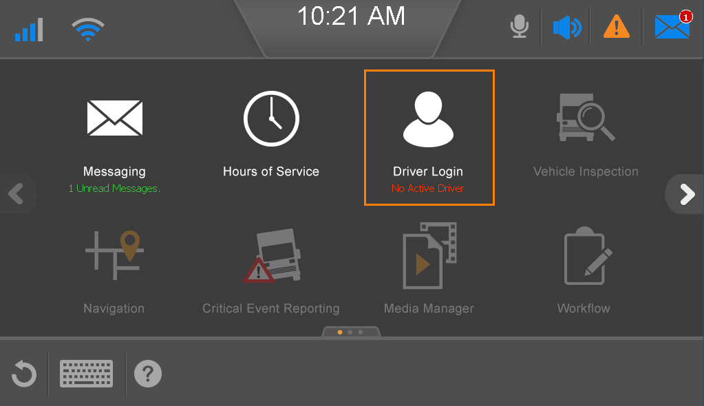
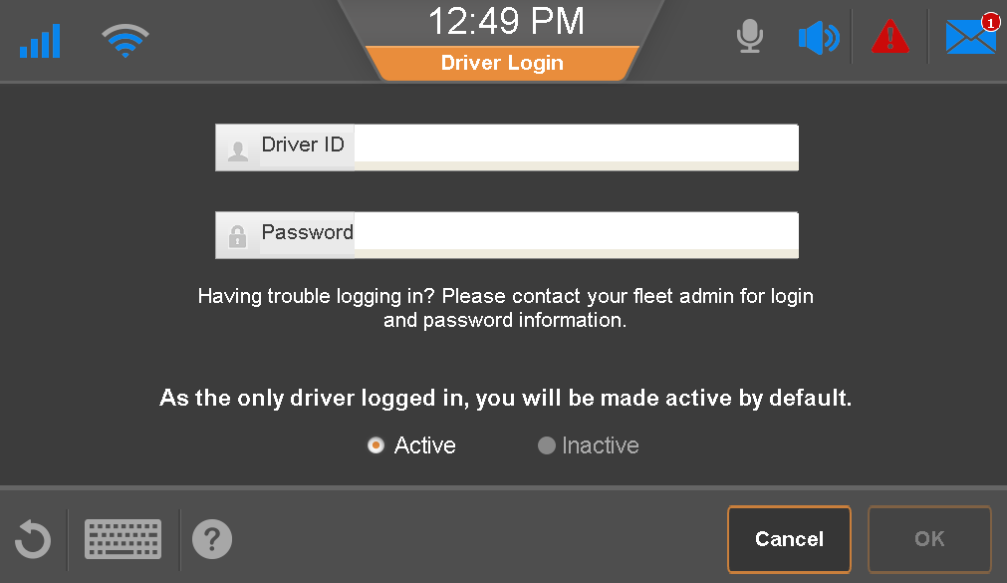
Logging In - Home Screen
From the Home Screen tap Driver Login.
To open the on-screen keyboard, tap in the Driver ID box.
Notes:
To Login You will need your Driver ID and Password, this should be provided by your administrator.
Single drivers will be defaulted to Active at login.
Active and Inactive options are for Team drivers only. Inactive allows you to identify yourself as the codriver on the log.

Slide 13
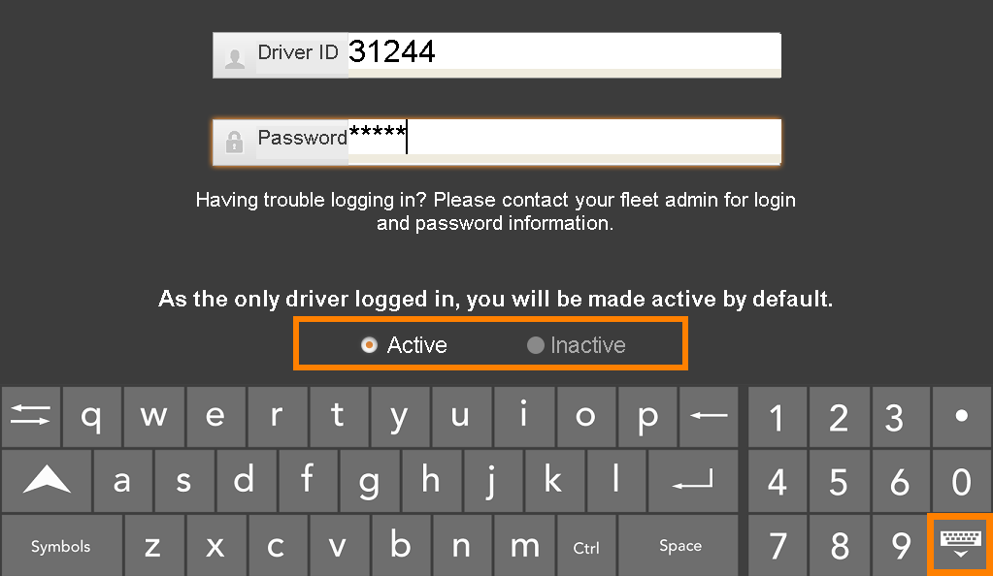
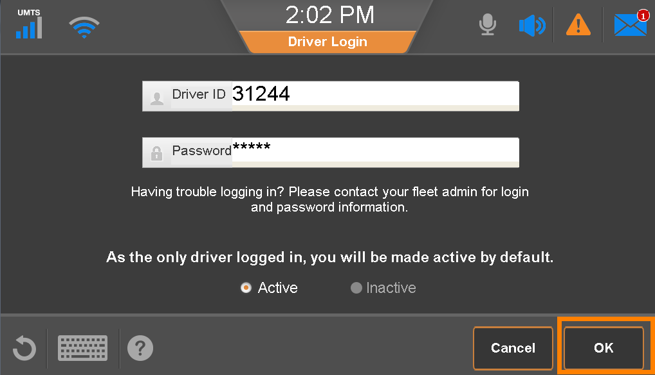
Logging In
Enter your Driver ID.
Tap the Password box and enter your password.
The first driver to log in is the Active driver. If logging in as the second driver, identify as Active or Inactive (driving, not driving).
Close the keyboard and tap OK.

Slide 14
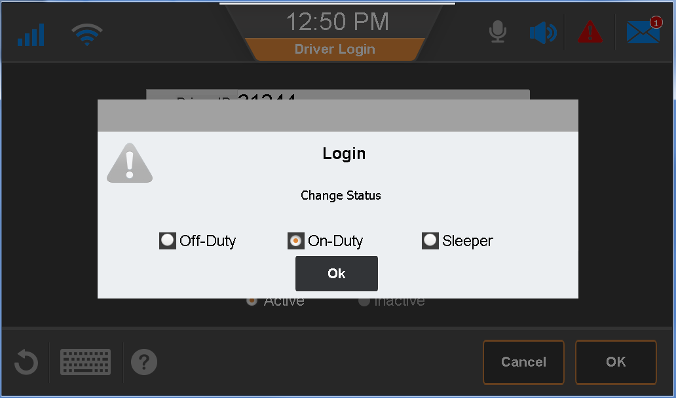
Logging In
Select your current duty status and tap OK.
Notes:
The system will automatically prompt the driver to identify their current duty status.

Slide 15
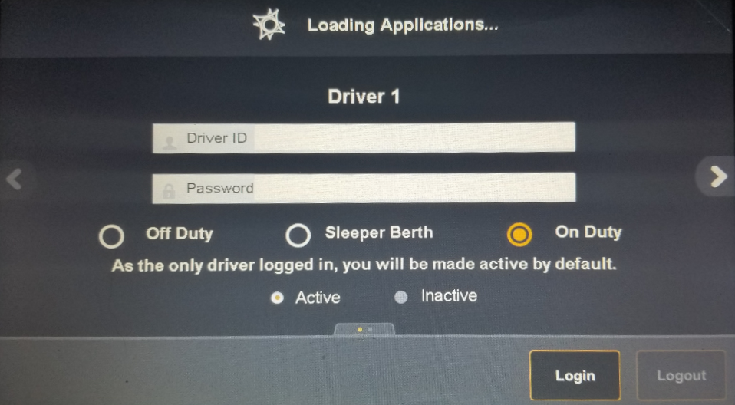
Logging In – Splash Page
Tap in the Driver ID box and enter your driver ID.
Tap on Password and enter your password.
Select current duty status.
The first driver to log in is the Active driver. If logging in as the second driver, identify as Active or Inactive (driving, not driving).
Close the keyboard and tap Login.
Notes:
As soon as you turn on the ignition the Omnitracs system will prompt you and your co-driver if applicable to login.
This splash page allows the driver to login and identify their current duty status without waiting for the applications to finish loading.

Slide 16
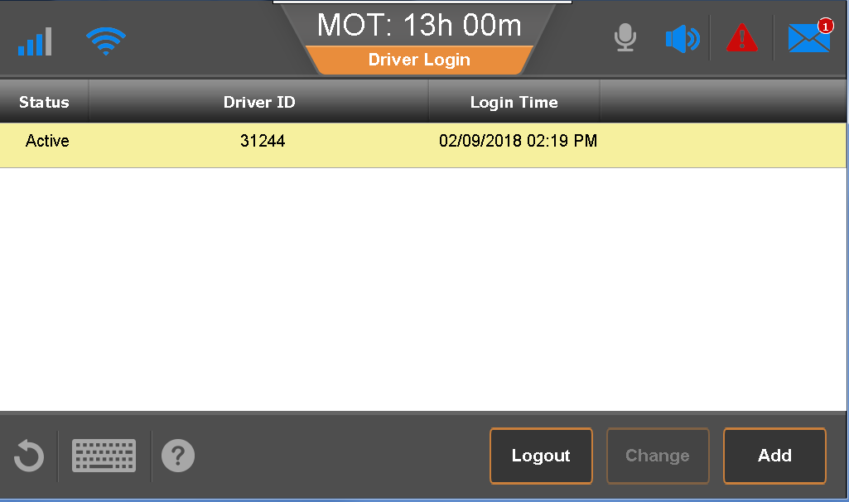
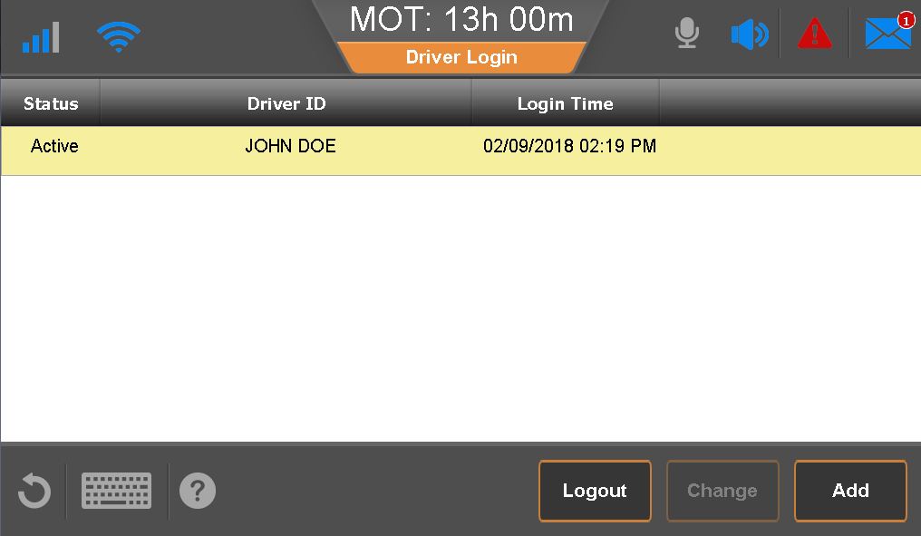
Login Confirmation
After you login, your driver ID displays until your login is verified over-the-air with the server.
When your credentials are verified, your full name displays and your Hours of Service logs are downloaded.
You can use the back button on the screen or home button on the IVG to access the Home screen.

Slide 17
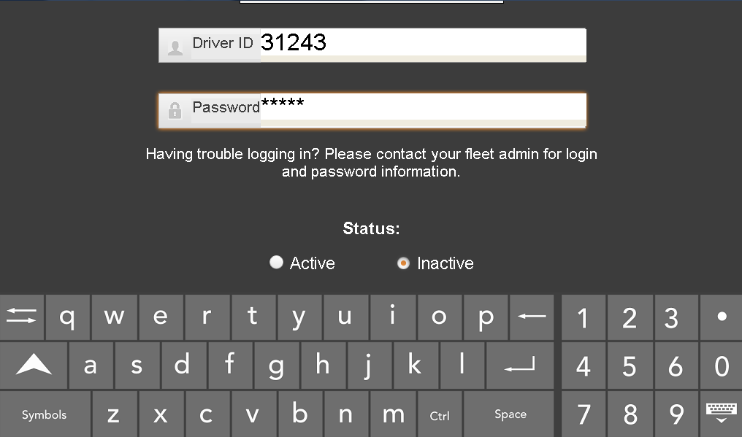
Team Drivers Login
Both drivers must login prior to leaving on their trip.
The co-driver logs in as Inactive as they are not the current driver.
The co-driver logs in as follows:
From the Driver Login screen, tap Add.
Type your Driver ID and Password.
Verify that Inactive is selected.
Close the keyboard.

Slide 18
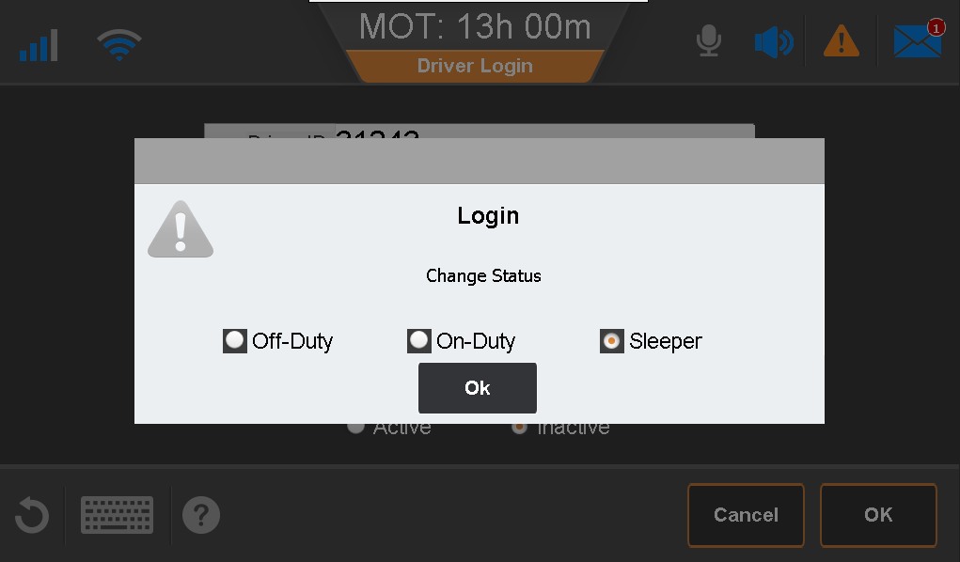
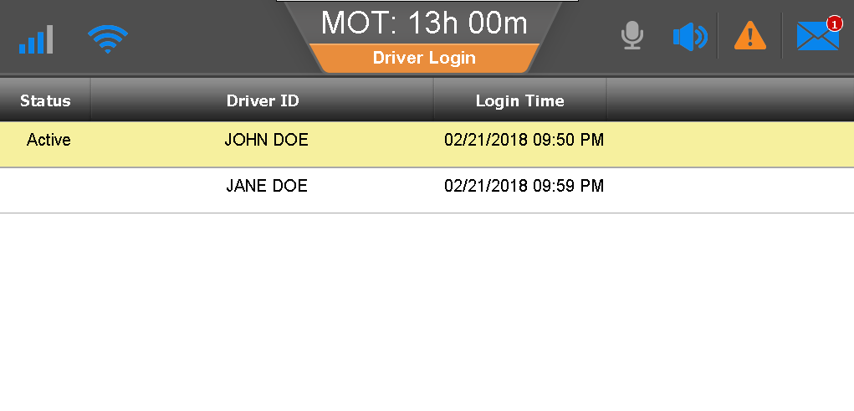
Team Login
Select your current duty status.
Tap OK.
When your Driver ID resolves to your full name, press the Home button to return to the Home screen.

Slide 19
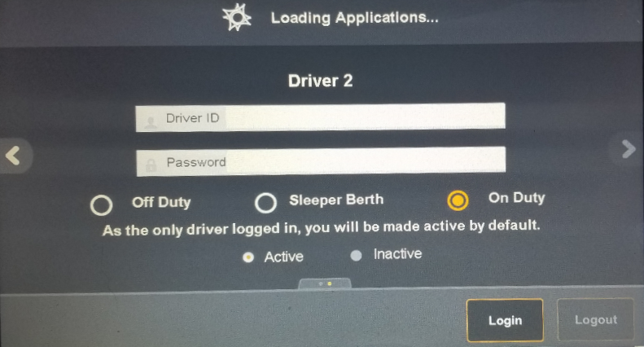
Team Login – Splash Page
After a system reboot, you may log in on the splash screen. The first driver logs in and the co-driver taps the right arrow to log in.

Slide 20
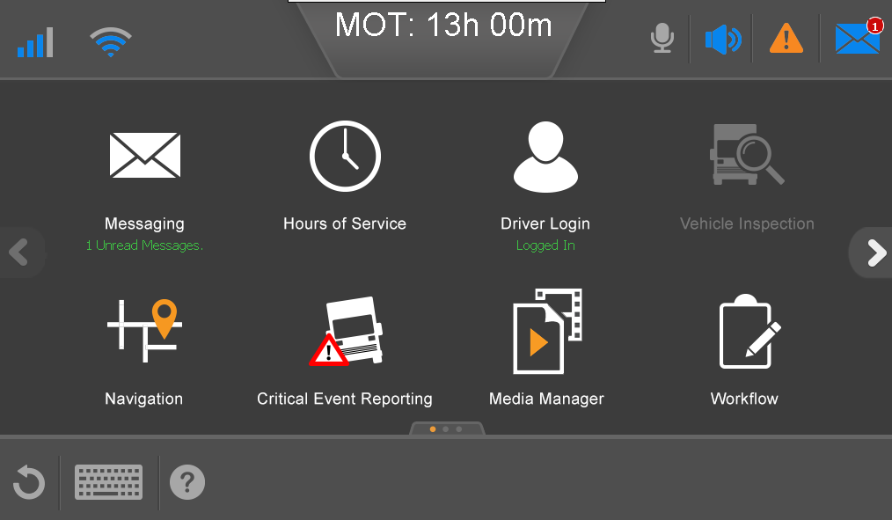
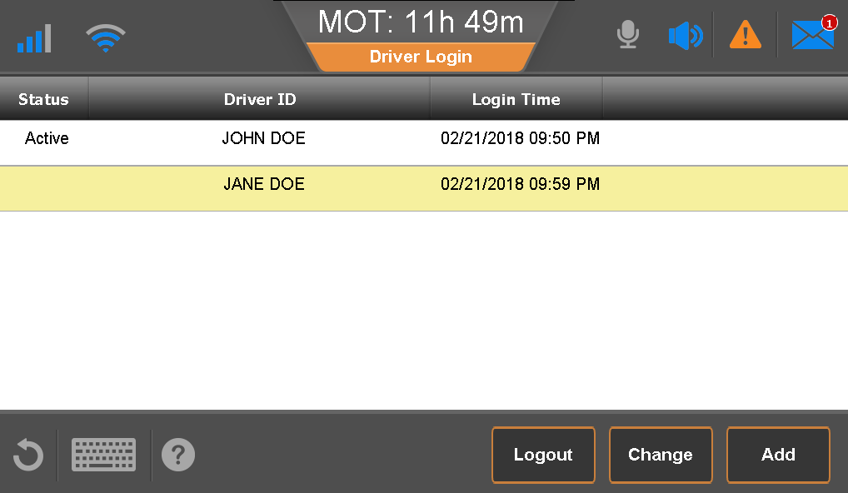
Team - Switch Active Driver
Tap Driver Login.
Tap to select the inactive driver.
Tap Change.

Slide 21
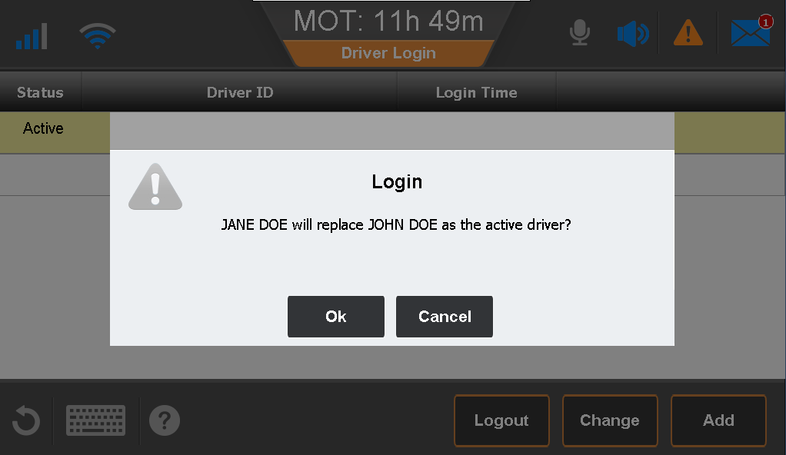
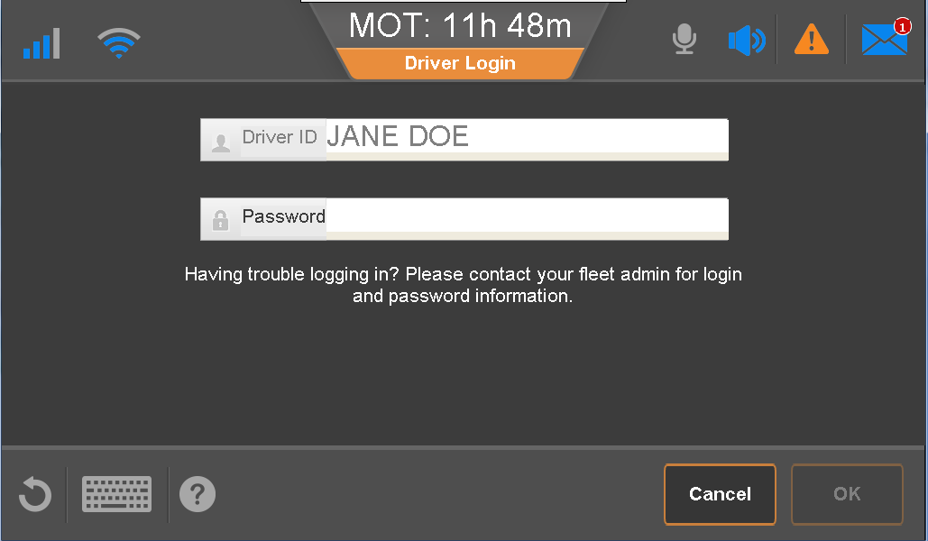
Team - Switch Active Driver
Tap OK.
Type your Password, close the keyboard, and tap OK.

Slide 22
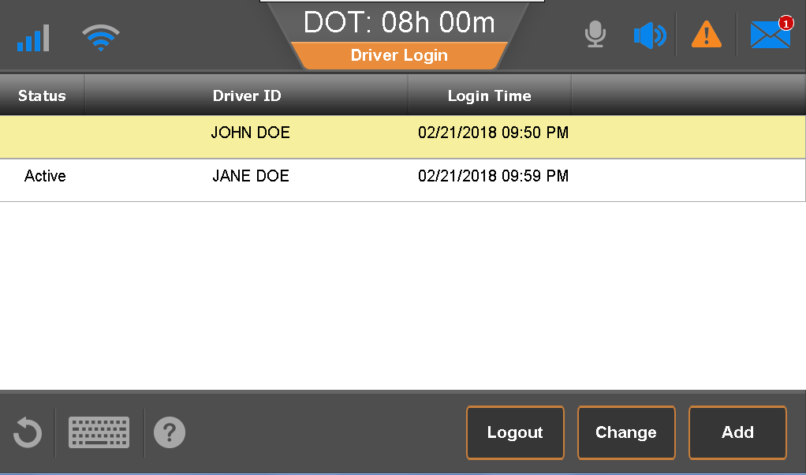
Team - Switch Active Driver
When the driver swap is complete, the second driver shows as Active and all future driving events will be logged on your log.

Slide 23
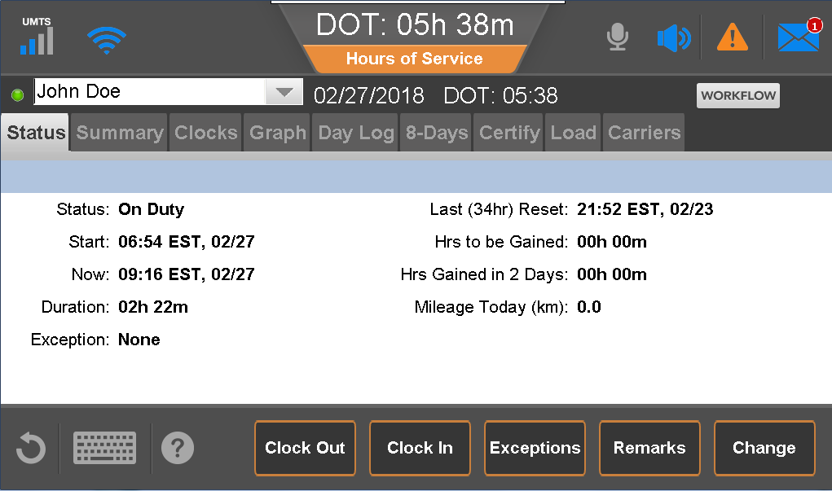
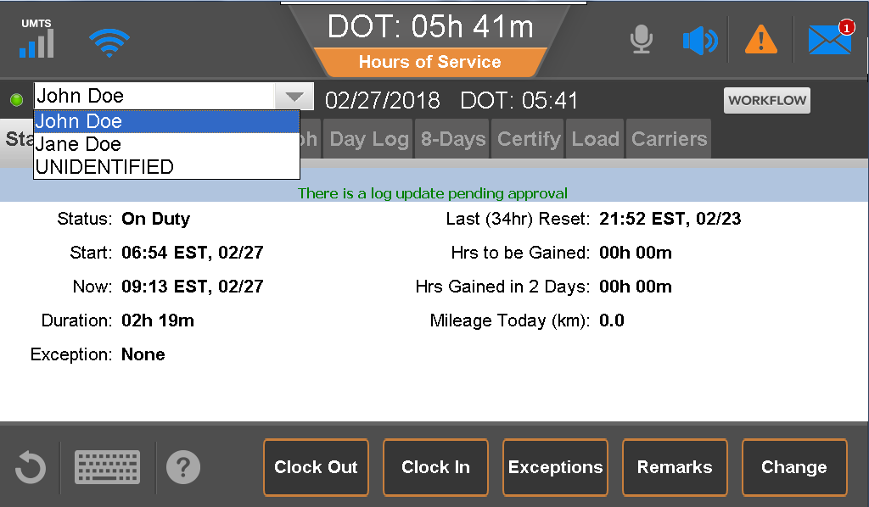
Team – Accessing Your Logs
The active driver can view/edit logs without a second login. The co-driver must provide a password to view HOS logs.
From the Status tab, tap the drop down beside the current drivers name and tap your name.
Type your Password, close the keyboard, and tap OK.
After your name displays, you can view/modify the logs as needed.
Notes:
The current driver’s logs will appear and can be altered if the status needs to change or log needs to be modified.

Slide 24
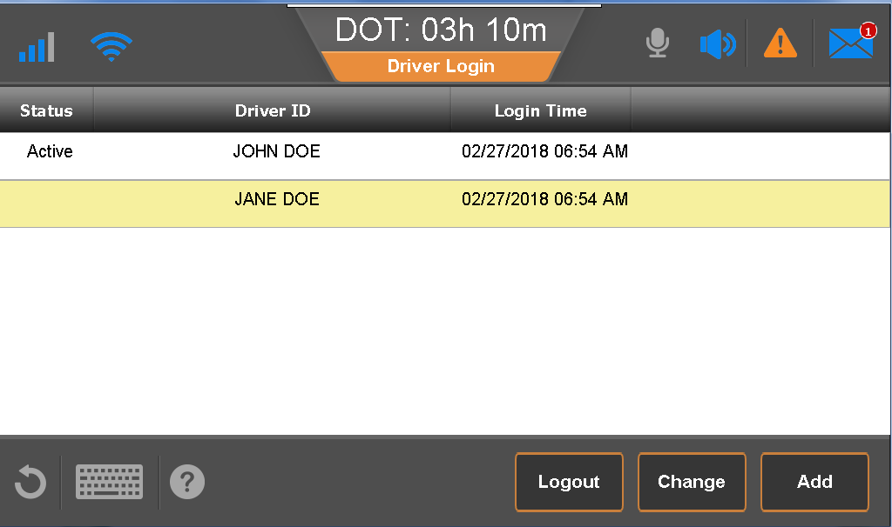
Team - Log Out
On the Home screen, tap Driver Login.
Tap to select the driver to log out.
Tap Logout.

Slide 25
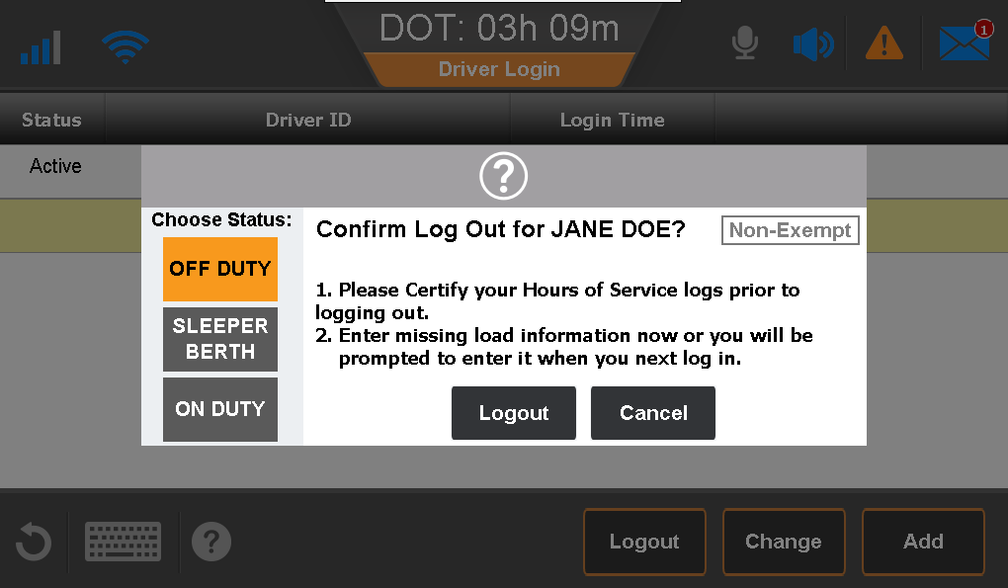
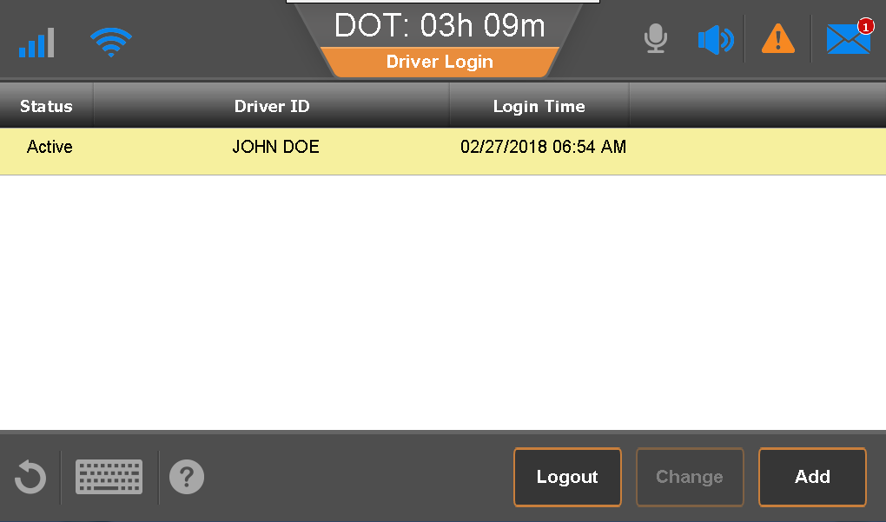
Team - Log Out
Tap a duty status and tap Logout.
When done, the second driver follows the same process.

Slide 26
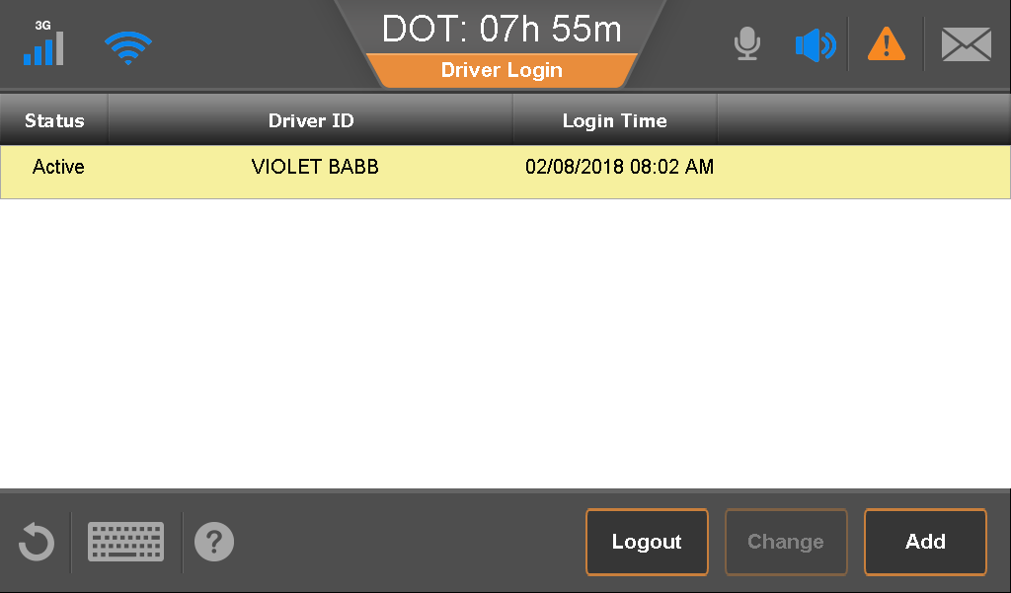
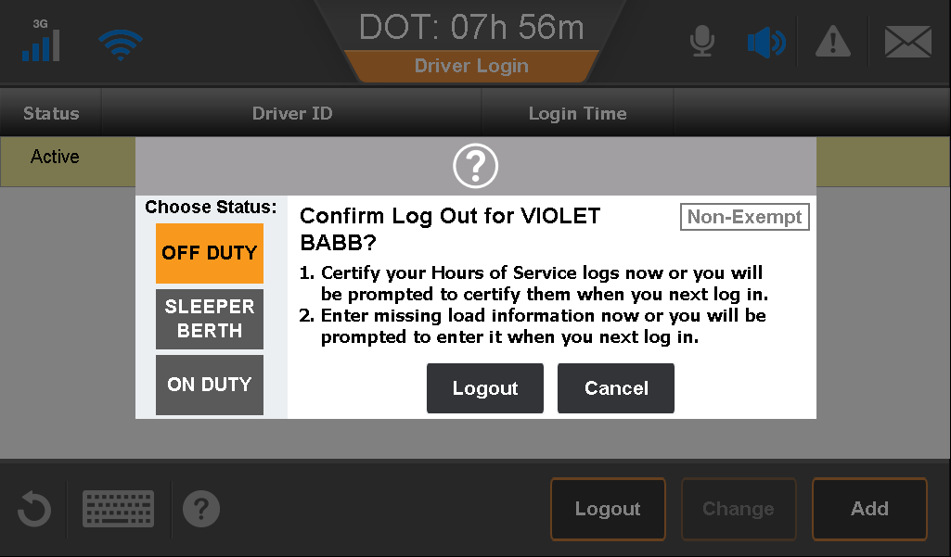
Logging Out
Be sure to log out after each trip or end of day.
Tap a name and tap Logout.
If only one driver is logged in, your name is selected automatically.
Select a duty status and tap Logout.

Slide 27
Login Prompts
After you log in, you may be prompted to review or resolve:
Performance Monitoring
Unassigned Driving
Missing load information for prior days
Log Certification
It is imperative to read and understand the prompts and the potential impact to your logs.

Slide 28
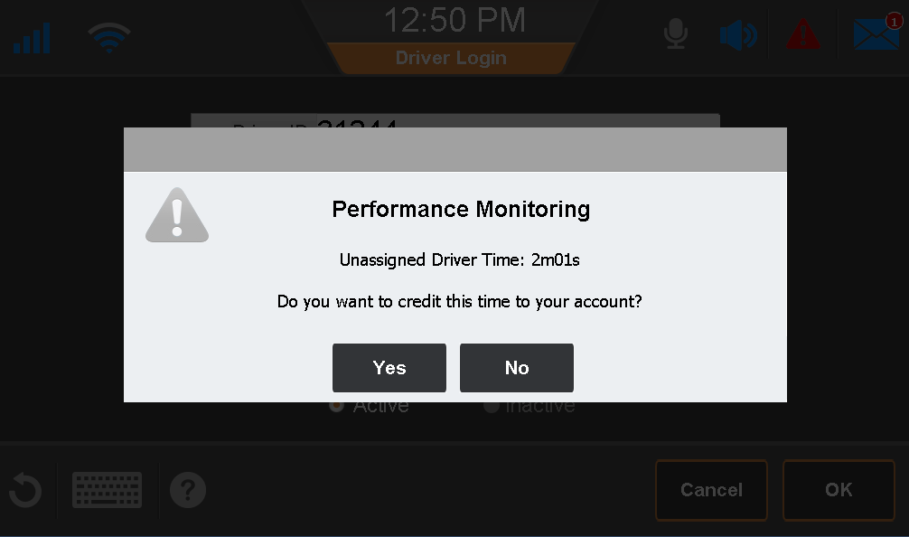
Login Prompts – Performance Monitoring
If the IVG detects that the engine is on while no driver is logged in, the next driver to log in is prompted to claim that engine-on time. Accepting this time does not affect your Hours of Service logs.
Notes:
After selecting your duty status you may receive a prompt from the Performance Monitoring application.
Remember to look for the Performance Monitoring at the top of the prompt if Performance monitoring will not change or impact duty status’s in hours of service records.
(Hide this slid if you do not subscribe to Performance Monitoring)

Slide 29
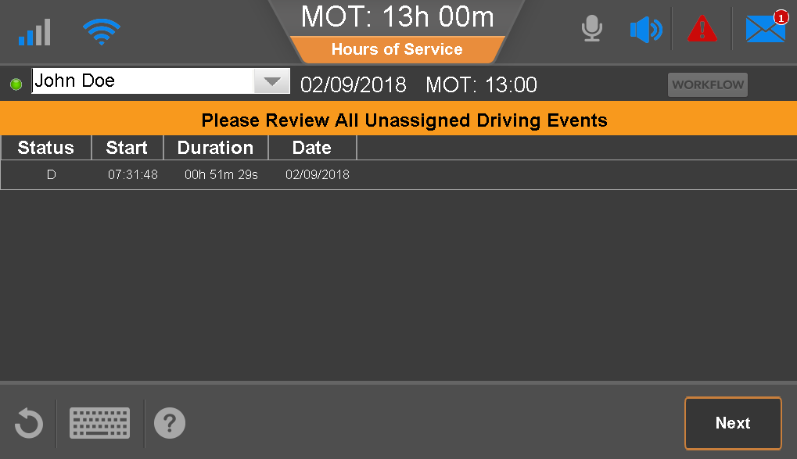
Login Prompts – Unassigned Driving
If a vehicle moves when no driver is logged in, that movement is recorded and must be assigned to a driver.
When a driver logs in to an IVG that accumulated unassigned drive time, the driver is prompted to review the unassigned driving and accept or reject those driving events.
Be aware that when you accept this drive time, it is added to your log!

Slide 30
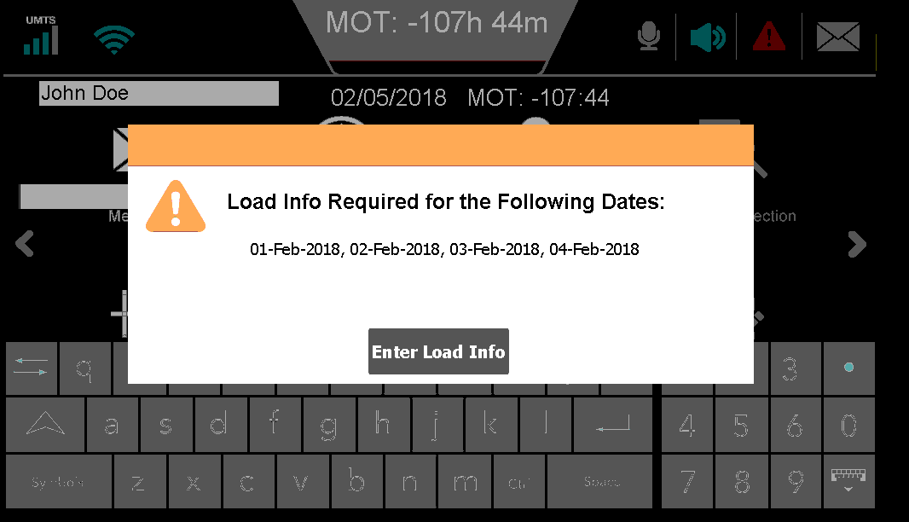
Login Prompts – Missing Load Info.
If you didn’t enter load information for prior days, you are prompted to update those historical records upon login.
Notes:
If the driver was off duty and is prompted for load info, the driver can enter “off duty” as the load and trailer IDs. Be sure that if the driver is deadheading or bobtailing that they enter “deadhead” or “bobtail” for the trailer ID.

Slide 31
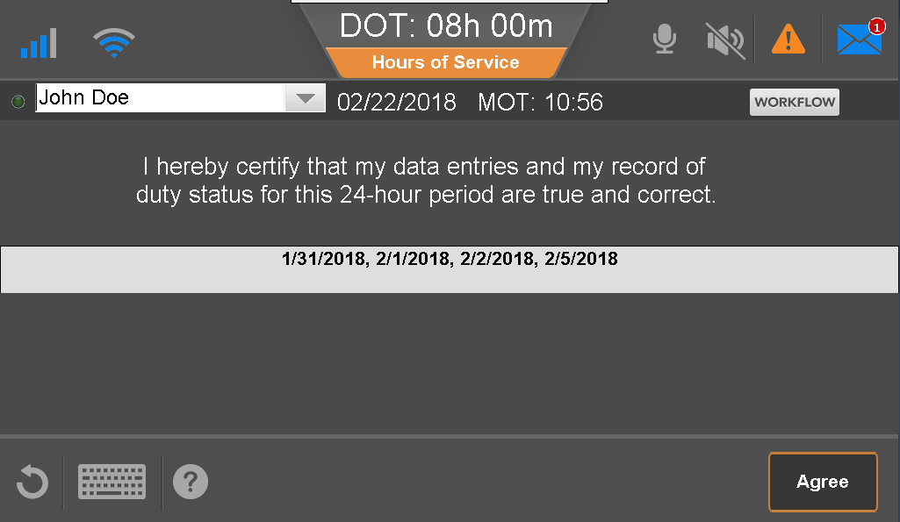
Login Prompts – Certify Logs
Upon login, you are prompted to certify your uncertified logs or any logs that were modified by the carrier.
Notes:
Carrier edits may include assigning unassigned drive time, swapping drive time between drivers, or log edits. In all instances, the log edits are displayed as “Pending” on the host side until accepted by the driver. Additionally, when drive time is swapped between drivers, the changes are displayed as “Pending” on the host side until BOTH drivers accept the changes.

Slide 32
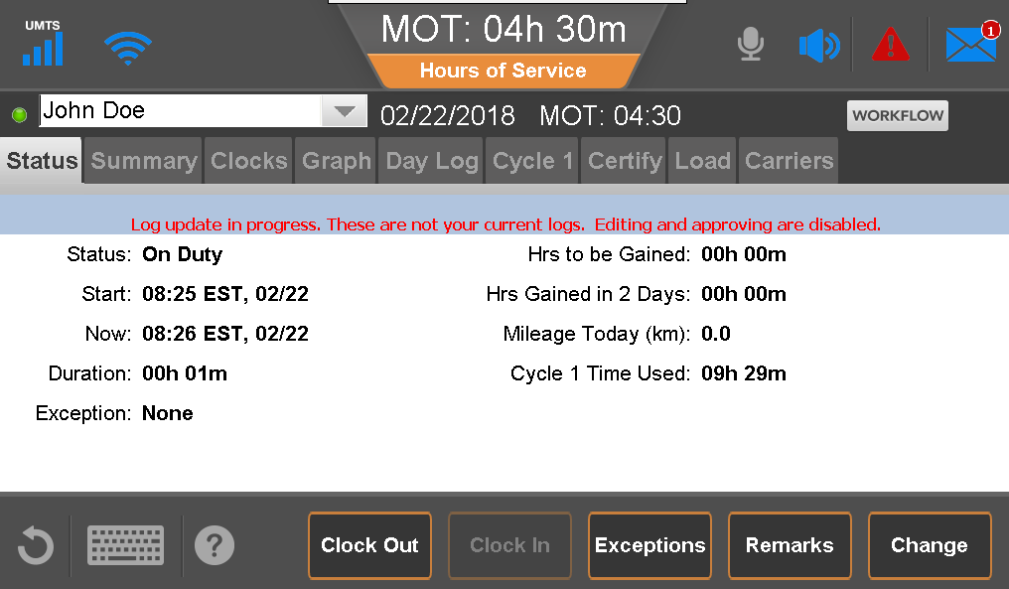
Hours of Service
Tap Hours of Service on the Home screen.
The Status tab displays when HOS opens.
Notes:
On the status tab the driver can see the current duty status
What time it started, current time and duration of current status
If the driver is using an exception
Hours to be gained is a recap of the hours worked based on the drivers current duty cycle
Mileage driven today
Cycle time used so far this cycle

Slide 33
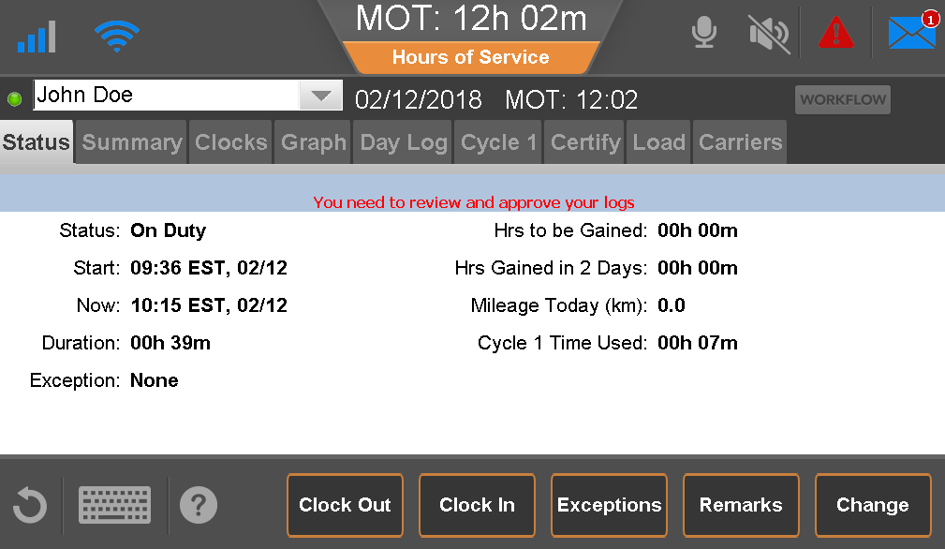
Hours of Service
If your logs haven’t downloaded, you’ll see a message indicating the download is in progress. Until they’re downloaded, you cannot edit or certify your logs.
You available hours may not be accurate until download of logs has completed.
After the logs completely download, you are prompted to review and certify your logs.
Depending on your settings, you may see additional prompts.

Slide 34
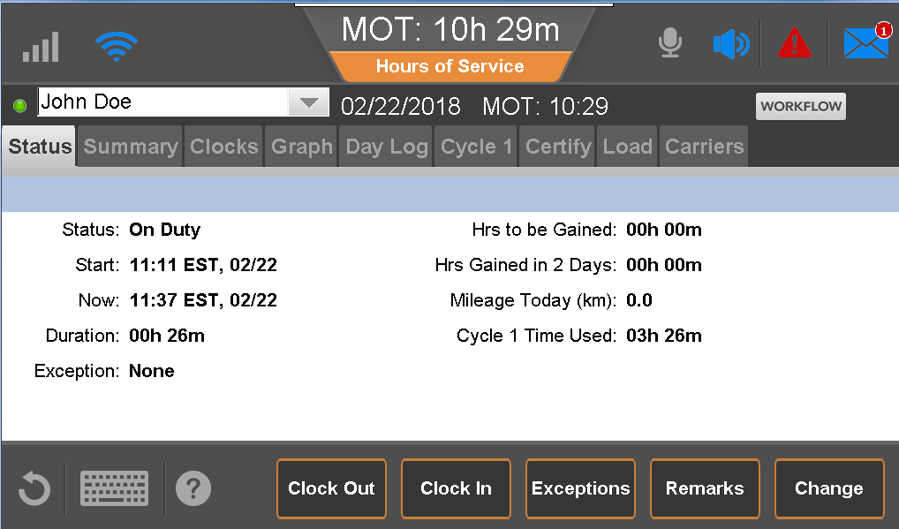
Status Tab
Statuses include:
Sleeper Berth
Off Duty
On Duty, not driving
Driving
Personal Conveyance
You must select a duty status when you login and logout.
Unless you indicate that vehicle movement should be off duty driving, when the vehicle moves, the driver is placed in Driving duty status automatically.
When the truck is stationary for 5 minutes the IVG prompts the driver for a status change.
If the driver doesn’t respond, the IVG sets the driver to On Duty.
A green dot indicates the active driver, the driver who has driving time applied to his/her logs.
Minimum duty status time = 5 min.
If status changes within 5 min, previous status is replaced with the new status.
Notes:
Off Duty Driving is now Personal Conveyance

Slide 35
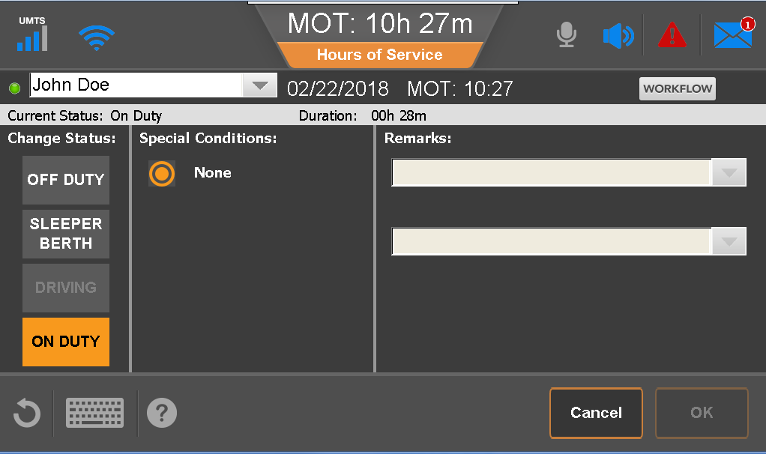
View/Change Current Status
On the Home screen, tap Hours of Service.
Tap Change.
Tap a desired status.
Type or select Remarks about the new status.
Tap OK.
You can only add remarks to a new duty status.
Notes:
Off Duty Driving and Yard Move must be enabled by your carrier before drivers can select them on the IVG.

Slide 36
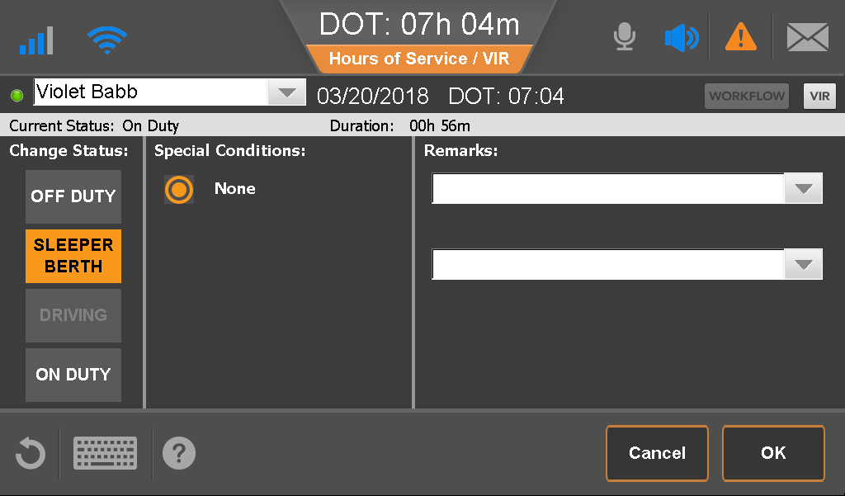
View and Change Current Status—Rest Break
For non-hazmat drivers who take a rest break every 8 hours they must ensure that the rest break is 30 min or more in duration in Off Duty or Sleeper Berth.
From the Status tab, tap Change.
Tap Off Duty or Sleeper Berth.
Select or type one or two remarks explaining what happened during the status.
Tap OK.
Notes:
Non-hazmat drivers take rest breaks in an off duty status (Off Duty or Sleeper Berth)

Slide 37
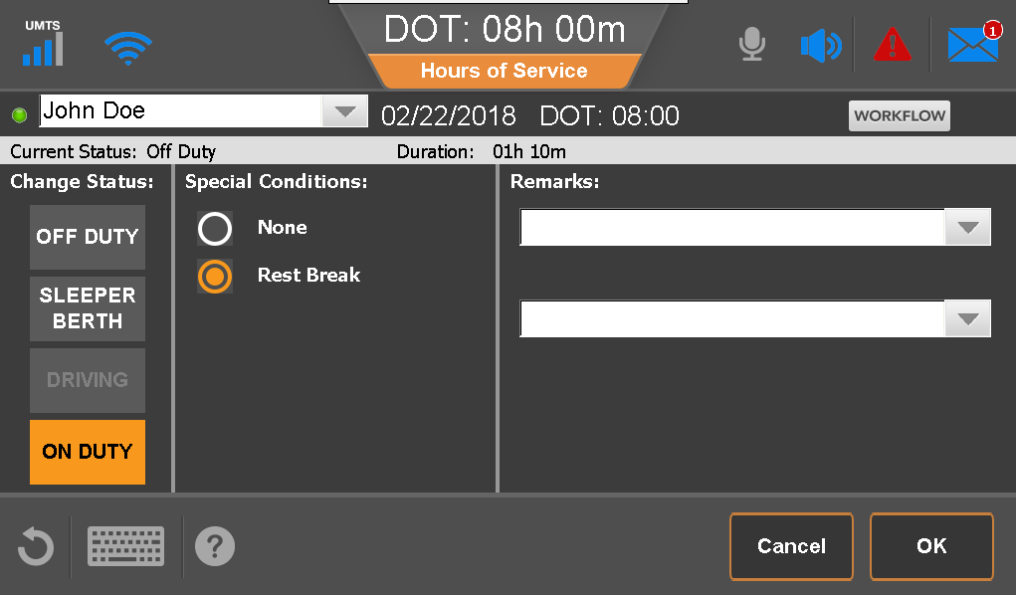
View and Change Current Status—Rest Break
Hazmat drivers who take a rest break every 8 hours must ensure that the rest break is 30 min or longer while On Duty.
Drivers carrying 1.1, 1.2 or 1.3 class explosives, who are required to stay with their vehicle, can be set up to take rest breaks while on duty.
From the Status tab, tap Change.
Tap On Duty and tap the Rest Break option.
Select or type one or two remarks explaining what happened during the status.
Tap OK.
Notes:
The Special Condition “Rest Break” is available while the driver is On Duty only if:
Your company is enabled for Hazmat loads under HOS > Administration > HOS Setup
You identified that you Allow Hazmat Loads for this driver under HOS > Administration > Driver
All other drivers take rest breaks in an off duty status (Off Duty or Sleeper Berth)

Slide 38
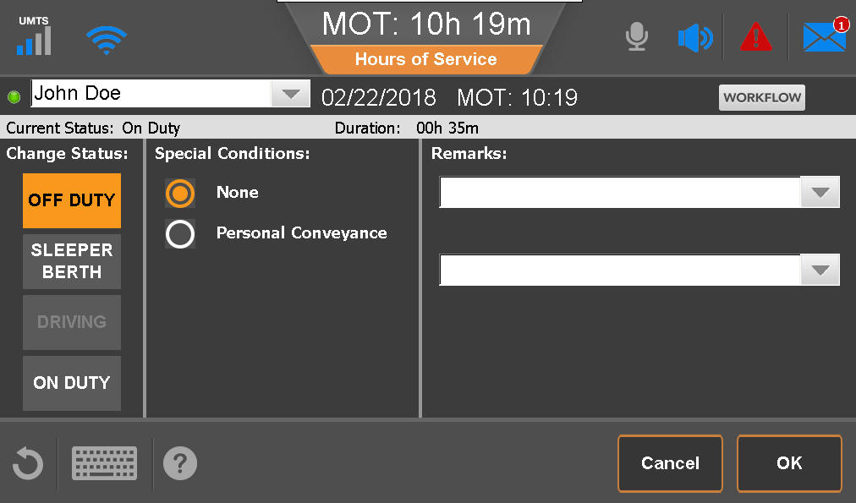
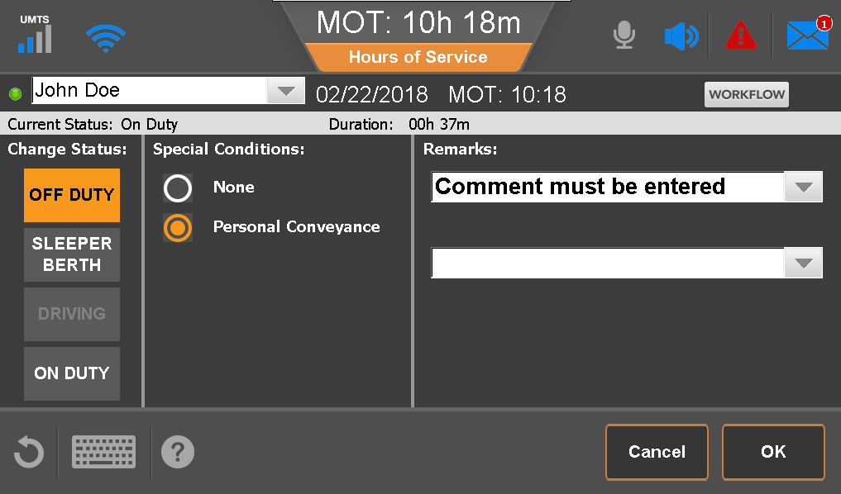
Personal Conveyance
From the Change screen:
Tap Off Duty.
Under Special Conditions tap Personal Conveyance.
Add a remark to document what you’re doing while in this status (mandatory).
Tap OK.
Personal conveyance is reflected as off duty on your logs and must be selected prior to moving the vehicle.
Notes:
Remove or hide this slide if you haven’t enabled Personal Conveyance

Slide 39
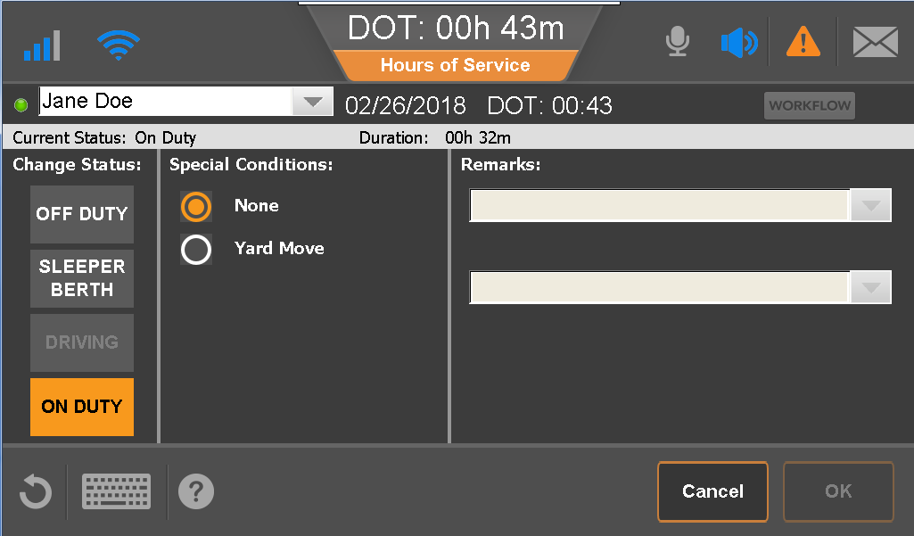
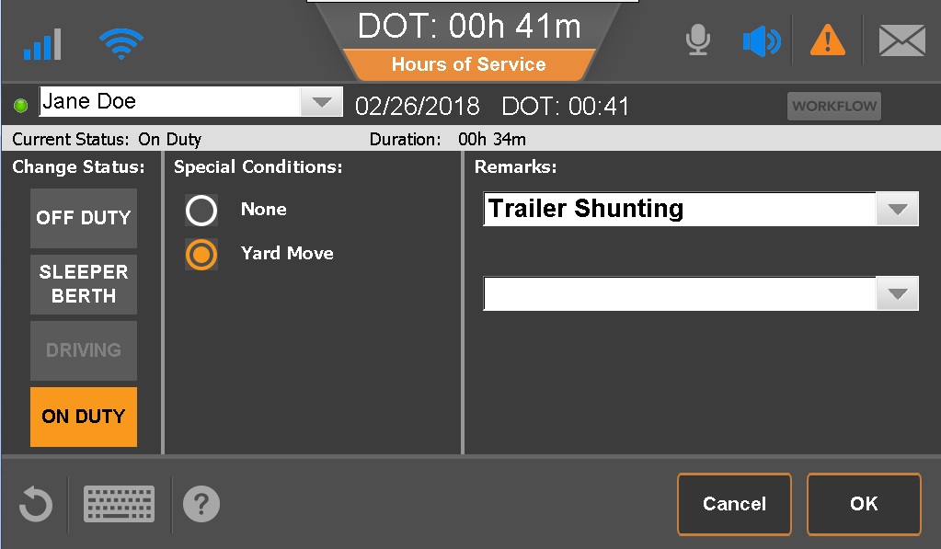
Yard Move
From the Change screen:
Tap On Duty.
Under Special Conditions tap Yard Move.
Add a remark to document what you’re doing while in this status (mandatory).
Tap OK.
Yard move is reflected as on duty on the log and must be selected prior to moving the vehicle.
Notes:
Remove or hide this slide if you haven’t enabled Yard Move. This duty status is only available when the driver is in the USA Region setting.

Slide 40
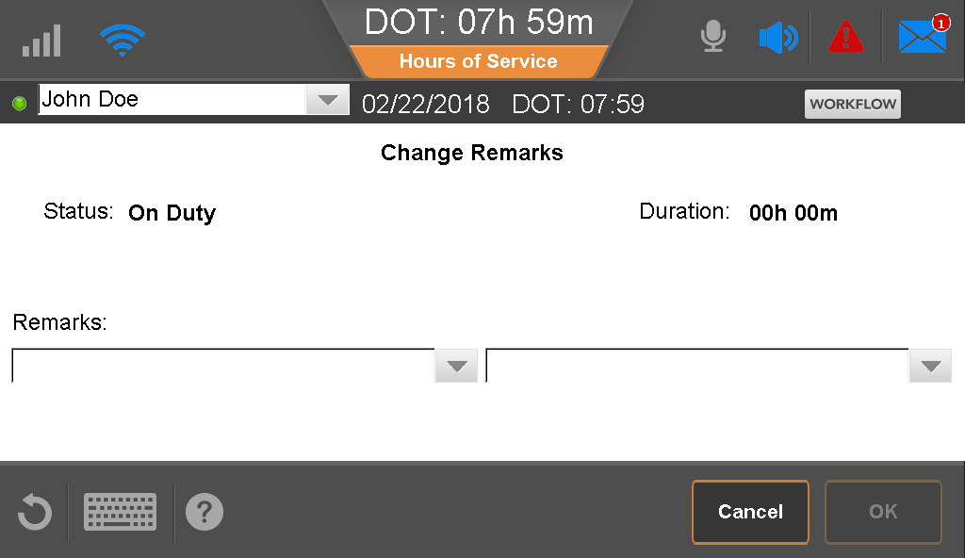
Add/Change Remarks on Current Status
To change or add remarks on your current duty status:
From the Status tab, tap Remarks.
Enter a new remark or select a different pre-defined remark from the drop-down list to explain what happened during the status.
Tap OK.

Slide 41
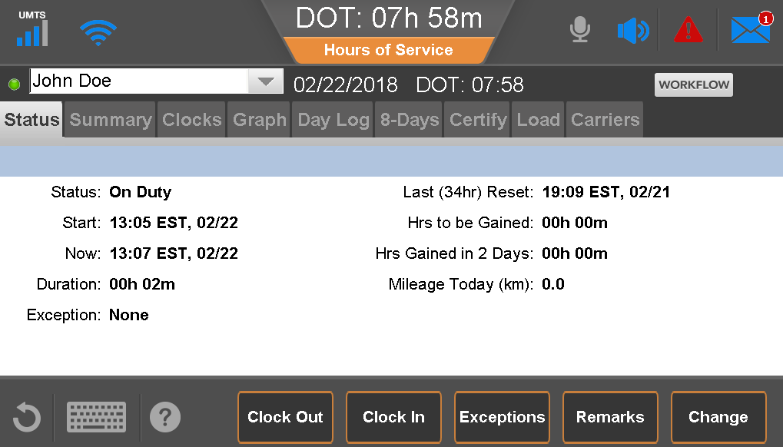
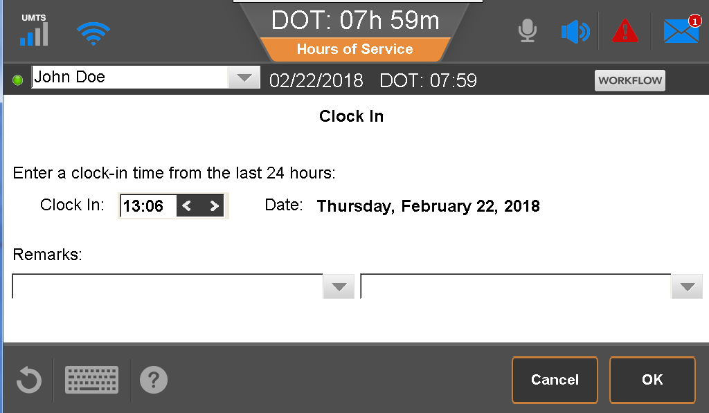
Clock In/Clock Out
On the Status tab, tap Clock In or Clock Out.
Set the time.
Select or type one or two remarks explaining what happened during the status.
Tap OK
Notes:
This feature is available only if enabled by the carrier.

Slide 42
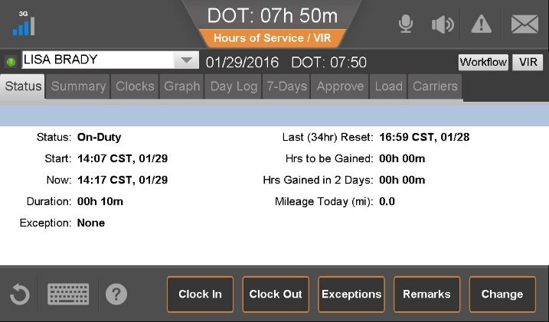
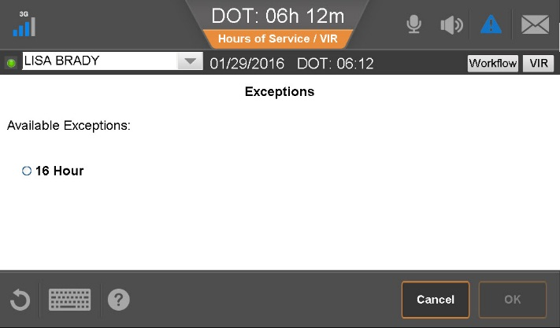
Request Exception
From the Status tab, tap Exceptions.
Tap the Exception to take, and tap OK.
Tap OK to confirm.

Slide 43
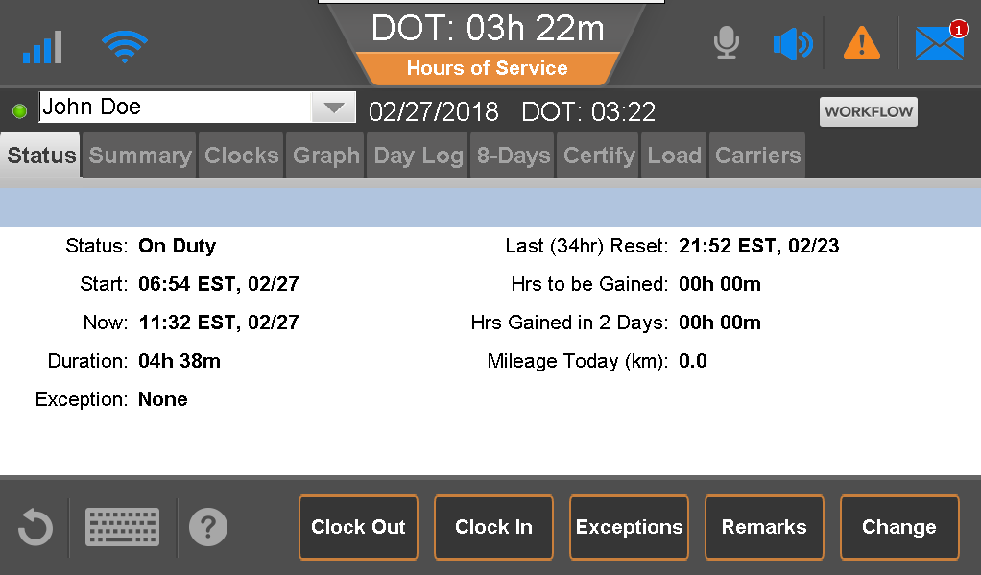
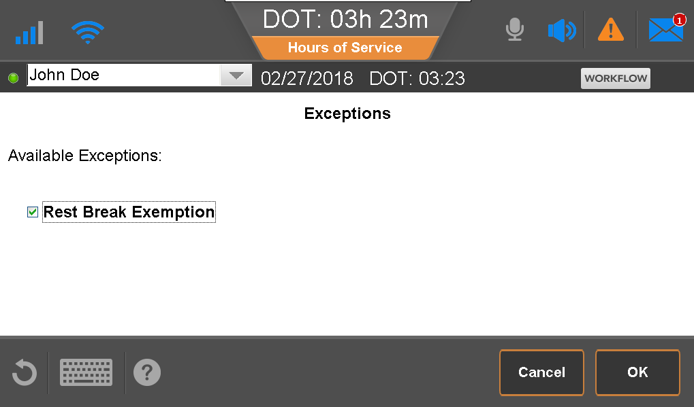
Rest Break Exemption
When loaded, go to the the Status tab, and tap Rest Break Exemption.
Tap OK.
Tap OK to confirm.
After unloading, return to the Status tab, tap Exception.
Tap the Rest Break Exemption again to deselect the check box
Tap OK.
Notes:
Ensure drives are aware that they may select this option only if qualify to use the exception and after they’re loaded.

Slide 44
Region Clocks & Changing Current Rule Sets
You can view your available hours for both USA and Canadian Federal Regulations on the Clocks tab.
To change your current rule set, tap Region.
Select a Region, and tap OK.
You must use the Can North region when driving north of Latitude 60°N.
Notes:
The Region Change will be flagged in the portal for the Administrators in the Driver details.

Slide 45
Record a Border Crossing
From the Clocks tab, tap Border.
Tap Yes.
If necessary, change your rule set by changing your Region setting

Slide 46
Display Summary - US Rules
The Summary tab shows your available hours in the current ruleset. You may review the available times for the four clocks.
The DOT clock always displays the available driving hours to the driver based on all the available hours clocks.
The DOT clock is always less than 8:00 since the least available hours clock is the rest break.
Drivers who are not subject to the rest break rule see available time on all three clocks.

Slide 47
Display Summary - Canadian Rules
The Summary tab shows your available hours in the current ruleset. You may review the available times for the five clocks.
The MOT clock is 13:00 hours or less since the shortest clock is the 13-hour driving clock.

Slide 48
Display Summary-Canadian North Rules
The Summary tab shows your available hours in the current ruleset. You may review the available times for the five clocks.
The MOT clock is 15:00 hours or less since the shortest clock is the 15-hour driving clock.

Slide 49
Using Split Sleeper - Canadian Rules
From the Clocks tab, tap Will Pair SB to have the IVG calculate available hours using the Canadian Split Sleeper Regulations.
Notes:
For the system to calculate available hours when using split sleeper in Canada the driver must select the Will Pair SB button during use. As these regulations are different than the USA rules the driver has to indicate when they want to utilize this regulation.
This is not required for the system to calculate split sleeper in the USA

Slide 50
Display Graph View and Info
From the Graph tab, tap the arrows to change the day you are viewing.
Tap a horizontal bar to see details for that duty status segment.
Tap Remarks to see details about what was happening during that segment.
Tap Info to show a DOT or MOT officer your carrier information and declaration of start of day.
For drivers carrying 1.1, 1.2, 1.3 explosives who are set up to take rest breaks while on duty, the time appears with a medium blue within ON bar.

Slide 51
Day Log – Viewing A Previous Status
Driver’s View
From the Day Log tab, tap the arrows to change days.
Certified duty status are indicated with a green check mark.
Tap a duty status and tap Info to view carrier information.
Tap a duty status, and if a remark were entered on that status, the remark button is active. Tap it to display remarks.
After you view your carrier information, tap Done.

Slide 52
Day Log – Viewing Prev. Status’s
Inspector view
An inspection officer may choose to see your logs in Inspector mode to view additional information on the Day Log tab.
The inspection officer may tap Header to view additional required information and tap Done when finished.

Slide 53
View 24-hour and Current Duty Cycle Logs
From the duty cycle (7-Days ,8-Days, Cycle 1, Cycle 2) tab, you may view a summary of hours worked within the current duty cycle
Tap Log Request to sync your logs manually to the server and update location data.
Duty cycles:
U.S.: 7-day or 8-day
Canada: Cycle 1 or Cycle 2
Notes:
Log Request should be selected by the driver prior to displaying logs to an Officer at the scale.
This will force a sync of location data with the server updating locations that may have a closer reference point than the one identified by the drivers unit.

Slide 54
Display Vehicle Information
From the duty cycle tab (7-Days, 8-Days, Cycle 1, Cycle 2), tap Vehicle Info button at bottom of screen
By date, view Vehicle ID and start of trip and end of trip odometer readings.
Tap OK.

Slide 55
Provide Logs to an Inspector or Officer
Provide the officer with the IVG, DOT/MOT quick reference card, and the Certificate of Compliance or send the files electronically.
Tap the duty cycle tab (7-Days, 8-Days, Cycle 1, Cycle 2) and tap Fax/Email.
Enter the fax number and/or email address.
Enter a unique identifier in the Attention line.
Tap Request.

Slide 56
Unassigned Driving
If a vehicle is moved when no driver logged in, the driving time is stored on the IVG.
The next driver to log in IVG is prompted to review the unassigned driving and accept or reject the drive time.
If the driving is rejected, the your office administrator must assign the time to a driver manually.

Slide 57
Accepting Unassigned Driving
If prompted to accept unassigned drive time, tap Next.
Review the changes and if correct, tap Confirm.

Slide 58
Rejecting Unassigned Driving
If the unassigned driving event does not belong to the driver, they can reject the driving.
If you reject the drive time, you must provide add a note explaining why you rejected the driving time.
Your carrier will then assign the time to the appropriate driver.

Slide 59
Certify Logs
You are prompted to review each day of uncertified duty statuses.
When prompted, tap Agree to review logs for certification
Notes:
Remind drivers to certify their logs every 24 hours and to log out of the IVG at the end of every day.

Slide 60
Certify Logs
IVG displays each uncertified day. Tap Agree to certify or tap Not Ready if you must make edits.

Slide 61
Log Edits
You edit your logs on the Certify tab.
Drive time cannot be edited. Only on duty, sleeper berth, or off duty status that are not certified may be changed.
Certified or Please Certify displays next to the date to indicate days that need to be reviewed.
Notes:
Drive time that may not be edited includes off duty driving (personal conveyance) and yard moves.

Slide 62
Editing Logs
In this example, the driver was left on duty all night from 21:59 on Feb 21st until 7:19 am on the 22nd.
Even though the duty status is one consecutive status it is displayed in two separate status’s as it occurred over midnight
Tap the status from the starting point on Feb 21st at 21:59 and tap Edit.

Slide 63
Editing Logs
The entire duty status segment is now editable.
Tap Duty Status and change the status.
Add remarks if required by selecting or typing a remark.
Confirm the location; or modify it if required.
Close keyboard and tap Save.

Slide 64
Editing Log- Split
In some cases a duty status may need to be split to accurately reflect what you were doing.
From the edit screen, tap Split.
The system automatically splits the duty status in half and duplicates the location and duty status.
Tap the drop down to select a new status.
Modify the clock to identify when you started the next status.
Add remarks if desired.
Confirm or update the location and tap Next.
Notes:
Using the same example the driver who was left on duty all night may need to show some off duty time and some on duty time to accurately reflect what the were doing.

Slide 65
Log Edits
After the edit is complete, you are prompted to add an edit reason. The edit reason is required is reflected on your logs.
You are then prompted to certify the log updates.
All changes on a log are displayed in accordance with the regulations. This includes the original duty status along with annotations and the new status.

Slide 66
Create a New Load
From the Load tab, tap New Load.
Enter Load ID (Trip / Pro Number) and Trailer information as required by the regulations.
Enter a B/L (bill of lading), if available.
Close the keyboard and tap OK.

Slide 67
Display Load History
From the Load tab, tap History.
Tap a load, then:
Tap Details to view it
Tap Edit to make a change.
Your logs must be completely downloaded before you may edit load history.
When you are finished, tap Done.

Slide 68
Edit an Existing Load
From the Load tab, tap Edit.
Make your changes.
Close the keyboard and tap OK.

Slide 69
Load Information
After logging in, you are prompted to enter any missing load/trailer information for prior days. You must enter the information for each day

Slide 70
Load Information
If you were hauling the same load for several days, you may update the start and end date, and the load information entered is populated automatically for the logs in the specified date range.

Slide 71
Carrier Tab
From the Carrier Tab you may identify which carrier you are hauling for.
Tap the Carriers tab and tap the appropriate carrier from the list.
Tap OK.
This list of companies is maintained by your company’s HOS administrators.
Notes:
The carrier tab allows drivers to identify for what carrier they’re hauling if your company is an environment where you have more than one Operating Authority

Slide 72
Driver Portal
From the driver portal, you may:
View your current duty status and a summary or your HOS clocks.
Run and save your logs as PDFs or print your driver logs to keep for your records.
Be aware that logs are kept for 6 months. If you need them for tax purposes, run your reports monthly!
Use Clock In / Clock Out to account for time away from the truck.
Notes:
This portal is optional for AOBRD drivers and can be activated on the HOS Admin tab under HOS(Driver)
Clock in option can be enabled or disabled for the fleet on the HOS Driver tab

