Slide 1
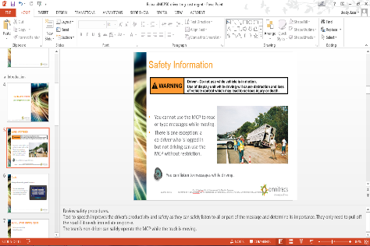
To the Instructor
Modify this presentation to fit your company.
  Brand it with your company’s logo.
  Delete slides referring to features
  you do not offer.
  Hide or delete slides that are for your
  use only, like this one or the Instructor
  Training Checklists.
To ensure you cover all material, use the Instructor Training Checklist.
The presenter notes section provides key points.
Presenter notes
Notes:
[Hide or delete this slide if you are projecting this presentation as a slide show for driver training.]
To Hide a slide from presenting Right click on the slide thumbnail in normal view and choose “hide slide”.

Slide 2
Instructor Training Checklist: IVG Overivew
Describe
How and what information is exchanged between driver and back office
Hardware installed on the truck
What you can and cannot do while moving
  How that’s different when team-driving
Demonstrate hardware buttons
Home button
Adjust volume/brightness.
Demonstrate on-screen buttons/icons
Communication method/strength
Identify when Intelligent Voice Interface is enabled and active
Volume
View the alerts list
View your list of messages
Navigate among screens
Return to the home screen
Open/Use the virtual keyboard
Open driver help
Application buttons
  Dimmed applications are not available
Notes:
[Print this slide to help you cover all of the important topics. Hide or delete it if you are projecting this presentation as a slide show for driver training.]

Slide 3
Instructor Training Checklist: Logging In and Out
Define what it means to be
Logged in to the IVG
The active driver
On Duty/Off Duty
Log in and out
If possible, have drivers log in with their driver ID and password. Login info is not cAse SensiTivE.
Log in as the driver (active status)
  Select a duty status
  Verify login was successful (driver ID replaced by name)
Log in another driver if driving as a team
Log out
  Select a duty status
Change Active Driver
Select your name and tap Change
Change the active driver – provide a password

Slide 4
Instructor Training Checklist: Messaging
Messaging Overview
Explain how messages are received.
Show the different ways to tell that a message has arrived, including important or emergency messages.
Explain how to listen to the message if driving.
Read and reply to messages
Use the message list.
Read a message.
Reply to a freeform and macro message.
Send messages
Create and send a macro message.
Create and send a freeform message.
If using macros, explain how your drivers must use the ones your company has set up.
Notes:
[Print this slide to help you cover all of the important topics. Hide or delete it if you are projecting this presentation as a slide show for driver training.]
[Use the discussion about macros to instruct your drivers about your company policies about when they are expected to send information about their load. You can customize the last slide in this section with your macros and print it as a handout. If your company has a driver handbook with the information, use that resource.]

Slide 5
Instructor Training Checklist: On-board Support
Accessing on-board support
Demonstrate how to open on-board support.
Show the main support menu and topic menus, such as Hours of Service.
Describe and demonstrate how to find What’s New after a firmware upgrade.
Notes:
[Print this slide to help you cover all of the important topics. Hide or delete it if you are projecting this presentation as a slide show for driver training.]

Slide 6
Instructor Training Checklist: Settings
View and change settings
Calibrate the display
Adjust the time zone
If asked by a technician
  View settings
  View status of ancillary devices
Notes:
[Print this slide to help you cover all of the important topics. Hide or delete it if you are projecting this presentation as a slide show for driver training.]

Slide 7
IVG Driver Training
Hardware, Initial Tasks, Settings / Troubleshooting

Slide 8



Safety Information
You cannot use the IVG to read
or type messages while moving.
Exception: a logged in, non-driving co-driver may use the IVG without restriction.
    You can listen to messages while driving.
Notes:
Review safety procedures.
Text-to-speech improves the driver’s productivity and safety as they can safely listen to all or part of the message and determine its importance. They only need to pull off the road if it needs immediate response.
The team’s non-driver can safely operate the IVG while the truck is moving.

Slide 9
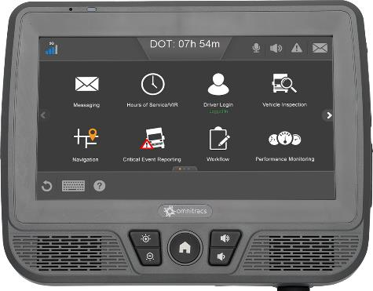


Goals
This presentation covers:
Log in and out of the Intelligent
Vehicle Gateway
Send and receive messages
Listen to messages while
driving
Access the IVG through
Intelligent Voice Interface
Access applications to track
driver hours
Change the settings on the unit
Locate onboard help to learn the applications
Notes:
Each goal above corresponds to an IVG application covered in this presentation. Each application section has an instructor training checklist (found at the beginning of this presentation) to help you train the application in detail. If your company doesn’t use all of the applications in this presentation, remove the section slides and adjust the goal statements. Add your own goals if desired.

Slide 10
IVG Driver Training Topics
IVG Hardware Overview
Logging in and out
Messaging
Intelligent Voice Interface
Mobile Reset
On-board Support
Settings
System
Notes:
Remove the topics from the presentation that your company is not using. Each application name is a link to that section of the presentation.

Slide 11
IVG Overview
Hardware

Slide 12
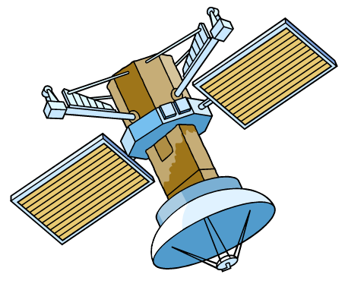


IVG Overview
The IVG provides an integrated suite of software and hardware that shares information between your vehicle and your back office over the cellular data network. ¹
GPS provides positions.
The IVG delivers information
through the Network Operations
Center (NOC) to your office.
Your back office information
is sent through the NOC,
over-the-air, and down to
vehicles.
Satellite*
communication
GPS
Cellular/WiFi*
communication
IVG
Network Operations
Center (NOC)
Landline
connection
Your office
¹ WiFi and satellite communication supported in future release.
Notes:
IVG is a two-way information transmission and unit tracking system.
It allows the company’s dispatch center to send information to their drivers and the drivers can send information back to the dispatch center.
It monitors vehicle location with GPS satellites.
Primarily used on moving units such as tractor/trailers or any kind of vehicle that hauls cargo, but is also used on boats, trains, and other types of transportation.

Slide 13
What Kinds of Information?
Common communications include:
  Load acknowledgement
  Arrived at shipper
  Bump the dock
  Daily check call
Vehicle position reports and other automatic updates
Vehicle and driver information from applications including: Performance Monitoring, Fault Monitoring, Critical Event Reporting, Hours of Service, and Vehicle Inspection
  Load assignment
  Directions
  Trailer switch
  Yard information
    Idle time
    RPM
    Speed
    Engine faults
  Hours of Service logs
  Reports of critical events such
  as hard braking
  Vehicle inspection reports

Slide 14
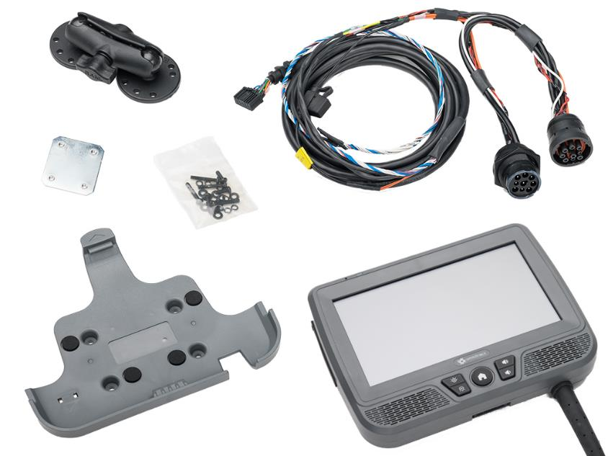
Intelligent Vehicle Gateway (IVG) Hardware
Power I/O Cable *
3” RAM Mount
Display Unit
Holster
* Different cables may be required for your vehicle.
Notes:
The IVG applications include information transmission, text-to-speech, and positions.
The IVG receives GPS signals, receives and sends terrestrial communications, and connects with vehicle interfaces to the data bus, power, and ground through the Power/IO cable. The IVG gets power from the truck battery.
* 6 versions depending on truck configuration
6 pin (J1708)
9 pin (J1708 + J1939) * see installation guide for all version supported

Slide 15
Stopped vs. Moving
While stopped in a safe location:
  Tap icons on the Home screens to use application that are enabled on the IVG
While moving, IVG functions are limited to:
  Messaging via text-to-speech
  Hours of Service available hours display on-screen and may be read aloud through the Intelligent Voice Interface
  Navigation displays a map and announces aloud the next turn
Notes:
Intelligent Voice Interface is a new feature that should be highlighted. Explain that it is covered in more detail in a section below.

Slide 16
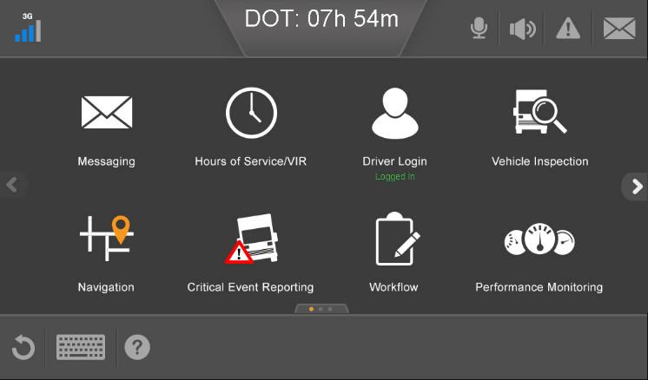
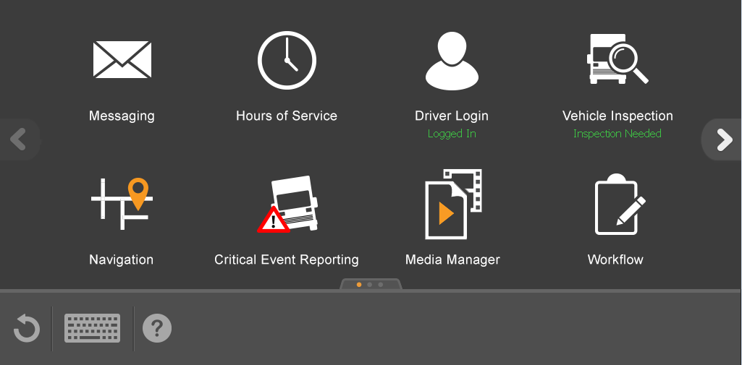
Screen Layout
* These signal indicators only appear on the device when supported (future release)
Cellular and WiFi* signal strength, Bluetooth connection*
Rule set and time until next violation
Volume on/off toggle
Intelligent Voice Interface
Alert waiting
Message waiting
Previous screen
Next screen
Return to Home screen
Support
Tap active button to open an application
Virtual Keyboard
Notes:
You can tap:
A highlighted button to go to that application (for example, Messaging or Driver Login)
Back to go back to the previous screen
The keyboard icon to open a virtual keyboard. It takes over the bottom part of the screen.
Volume icon goes from blue (on) to light gray (off) when toggled
Icons on the top left show cellular signal strength, WiFi, and Bluetooth.
Icons on the right let you change the volume or tell you that you have alerts and/or messages.
The top, center shows the system time. If you are using hours of service it shows your remaining driving time.
Use the arrows to the left and right of the buttons to move among screens.
Icons at the bottom let you go back one screen, open Help, or open the keyboard.
* Disclaimer: some application icons on the actual device may be in a different order than pictured.

Slide 17
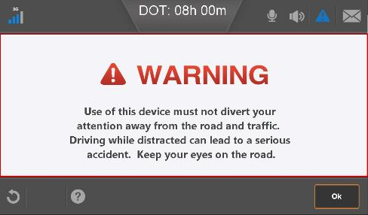

Home Screen
Notes:
The warning displays when the IVG first powers on and after a reboot. Tap OK to close it.
If your company is not using an application, its icon is gray and you cannot select it. They may also be grayed out before a driver logs in.

Slide 18
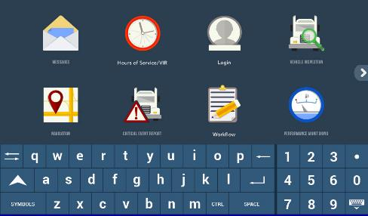
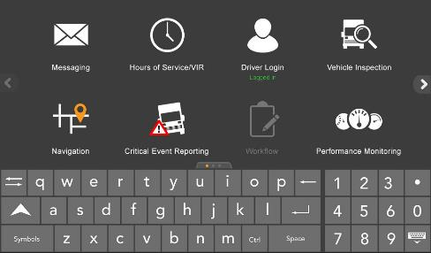
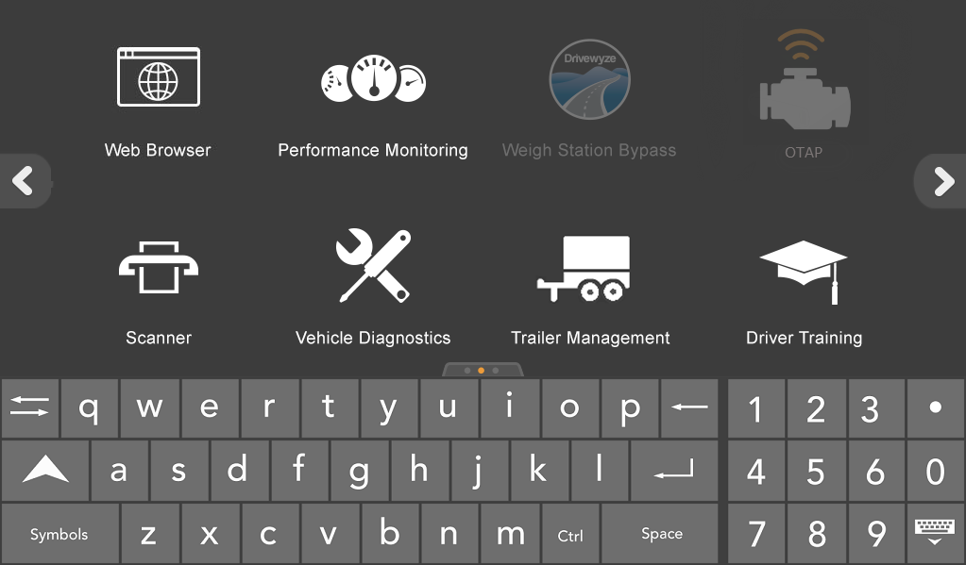
Using the IVG
You may use applications to exchange information with your back office.
Use the virtual keyboard when stopped in a safe location.
After you log in, unlicensed applications are greyed out/have a muted appearance.

Slide 19
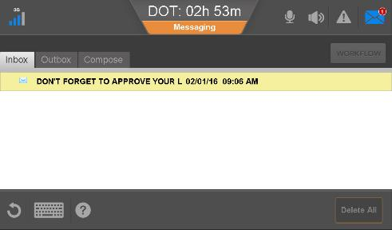
Using the IVG
While driving, you cannot read messages, but you can listen to them.
Tap Messaging, then tap the play button.
Use the scroll bar to select another message.
The play button becomes a pause button during playback. Tap it to pause and restart the playback.

Slide 20
Logging In and Out
Basic Driver Applications

Slide 21
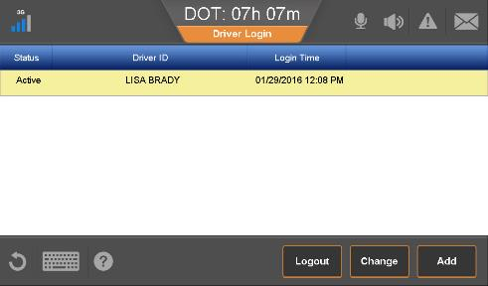
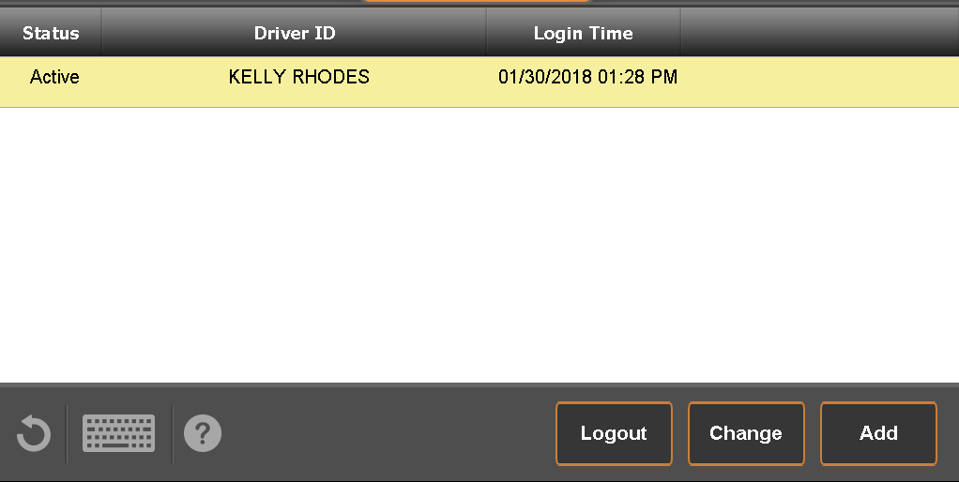
Log In and Out
Applications including Hours of Service and Navigation, need to know who’s in the cab and who’s driving.
You’ll learn how to:
Log in to the IVG
  Select a duty status
Identify as driving/not driving
  Driving = Active
  Not driving = Inactive
Log out of the IVG
  Select a duty status

Slide 22
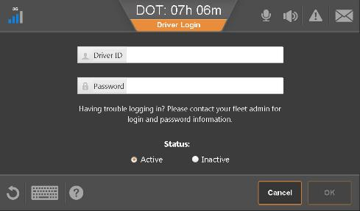
Log In
Tap Driver Login.
  If logging in as a second driver, tap Add.
Tap the Driver ID field and the virtual keyboard opens.
Notes:
You can also tab between fields.
The default status is Active, but may be changed if a second driver is logged in.

Slide 23
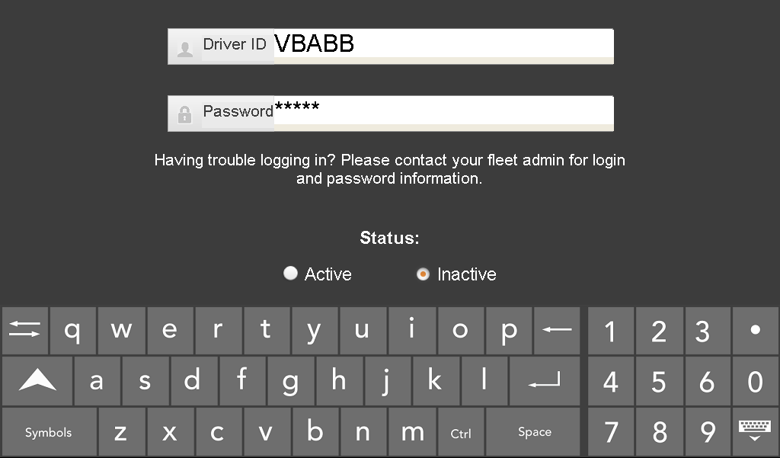
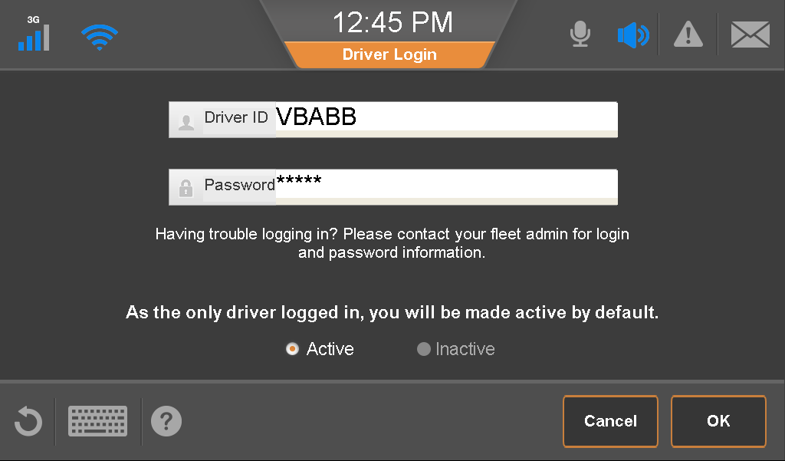
Log In
Type your ID and password.
If logging in as the second driver, identify as Active or Inactive (driving, not driving).
Tap the virtual keyboard icon at the bottom right to close it.
Tap OK.
Notes:
Your driver manager provides you with a user ID and password.

Slide 24
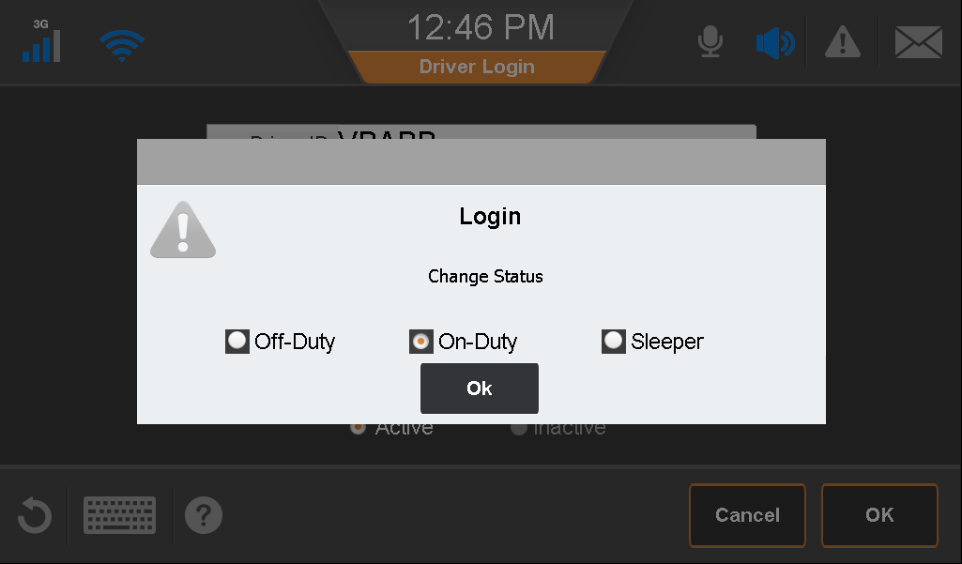
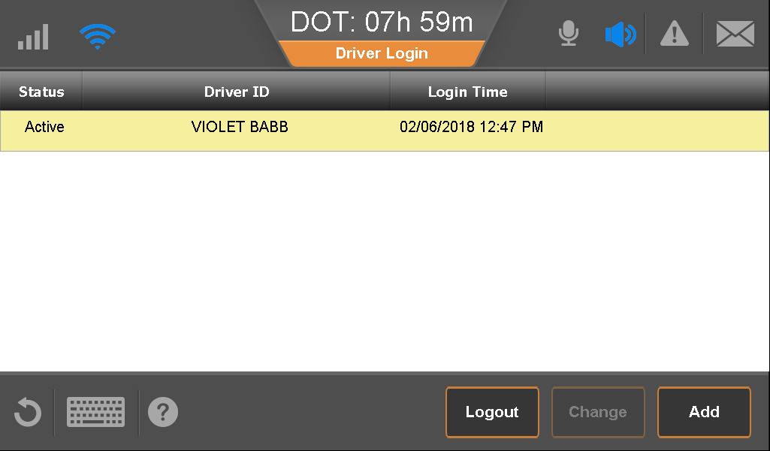
Log In
Identify a duty status and
tap OK.
Your full name displays when your login information is confirmed over-the-air.
Notes:
Until your login is verified, your user ID appears instead of your name.
If the login information is incorrect, an error message appears and you can try again.

Slide 25

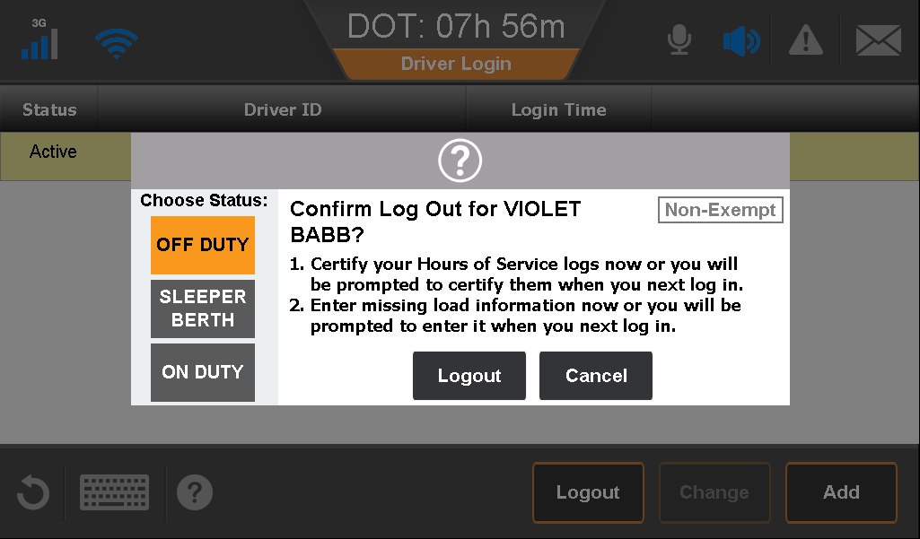
Log Out
Be sure to log out after each trip or end of day.
Tap a name and tap Logout.
If only one driver is logged in, your name is selected automatically.
Select a duty status and
tap Logout.

Slide 26
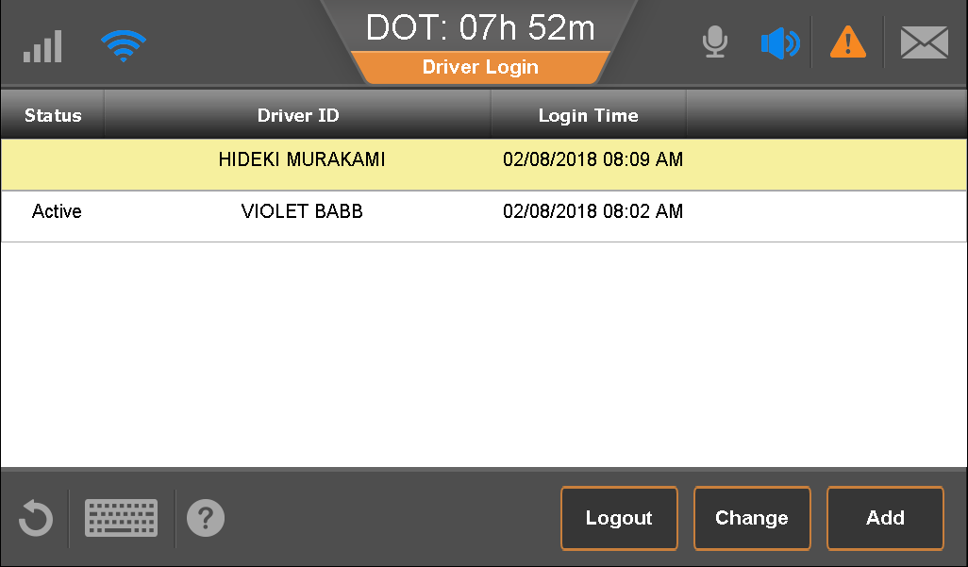
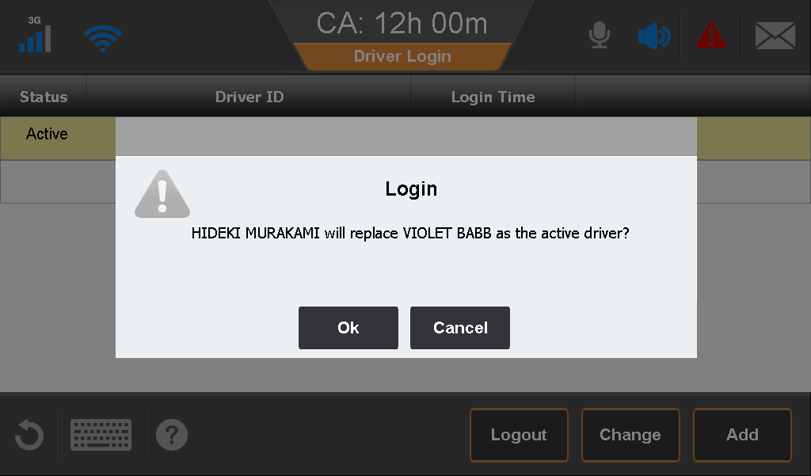
Change Active Drivers
When tandem driving, be sure you identify as the active driver when you’re driving.
Tap the inactive driver’s name.
Tap Change.
Tap OK.
Notes:
it will always ask for the password for a driver to become active. it will not ask if becoming an inactive.

Slide 27
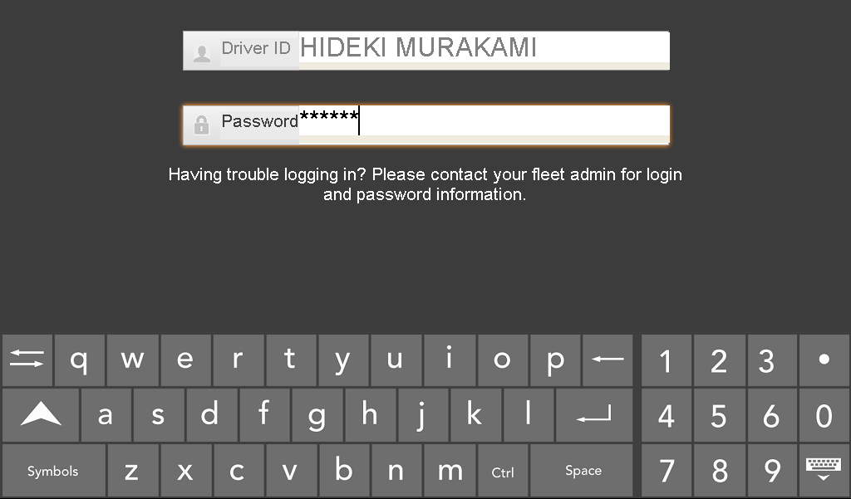
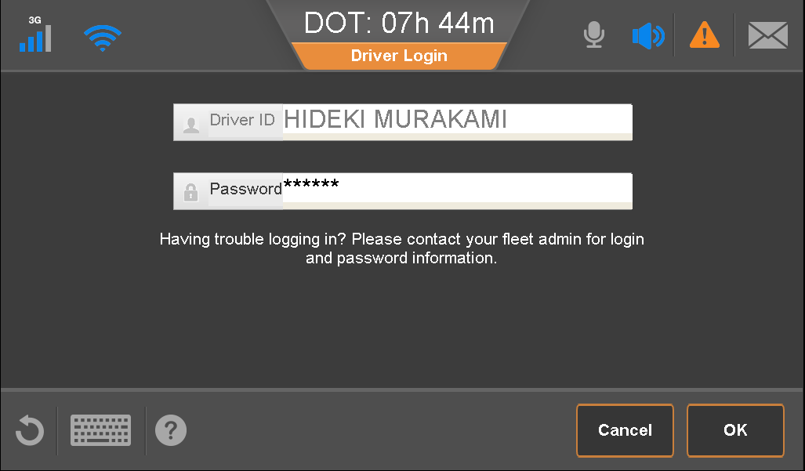
Change Active Drivers
Type your password.
Close the keyboard.
Tap OK to confirm the driver swap.
Notes:
it will always ask for the password for a driver to become active. it will not ask if becoming an inactive.

Slide 28
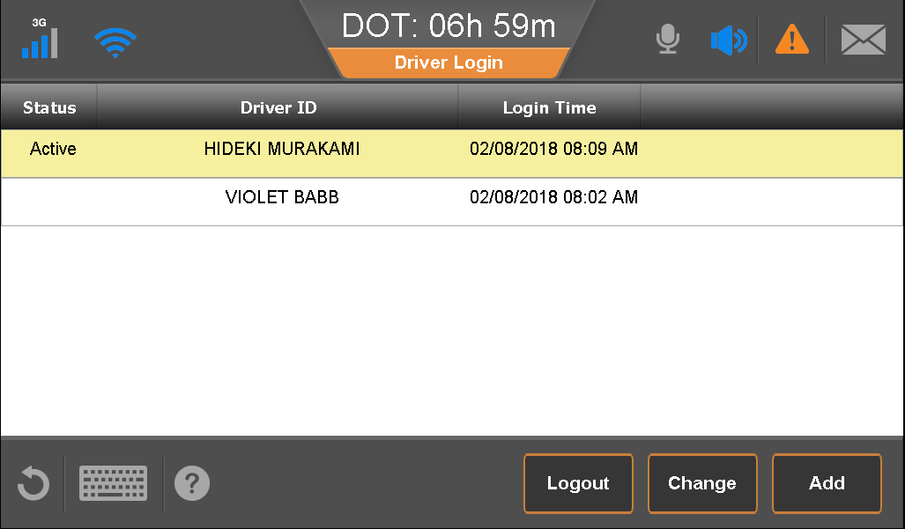
Change Active Drivers
Hideki is the active driver.
Notes:
it will always ask for the password for a driver to become active. it will not ask if becoming an inactive.

Slide 29
Messaging
Basic Driver Services

Slide 30
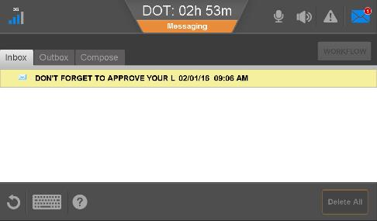
Messaging and Macros
Messaging is the most common task performed on the IVG.
You need to know how to:
  Recognize that new
  information has arrived.
  Read the information.
  Reply to it.
  Use macros to save time
  and improve accuracy.

Slide 31
Receiving Messages/Information
Communication occurs when the ignition is on and for a short time after the ignition is turned off.
  You don’t need to start or idle your vehicle.
  Information is stored until you are ready to read it.
You can turn the volume down completely for both alerts and voice while you sleep.
  Be sure to turn the volume back up when you’re behind the wheel!
Notes:
The IVG does not wake up every hour and check for messages, like our other systems do.
Important: Turn the volume back up when you get behind the wheel!

Slide 32
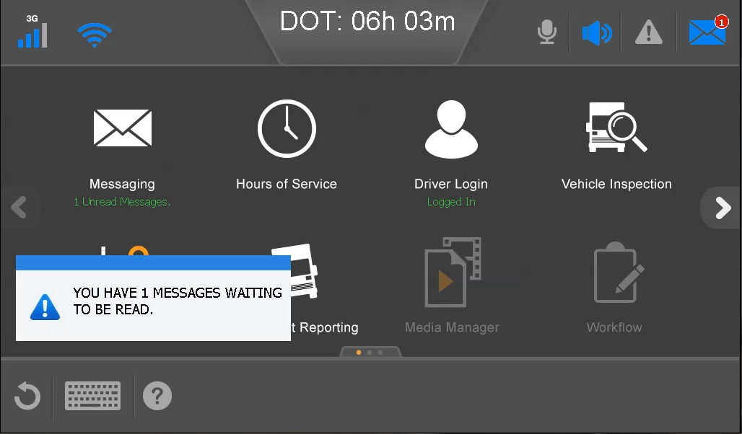



Message Notification
The IVG plays an alert and
text-to-speech announces it.
The Messaging button shows
“N Unread Messages.”
A popup displays.
The message alert icon
shows the number of new
messages and the highest priority of new messages:
  Blue = Normal
  Orange = Important (example: a CER alert)
  Red = Emergency
  The halo around the home button lights matching the priority of the highest alert.
Notes:
The IVG alert sounds when you get a message. You are notified once of priority and emergency messages.
The dispatcher can send you a message with “Attention” or “Emergency” status. You hear them as “Important” or “Emergency.”

Slide 33
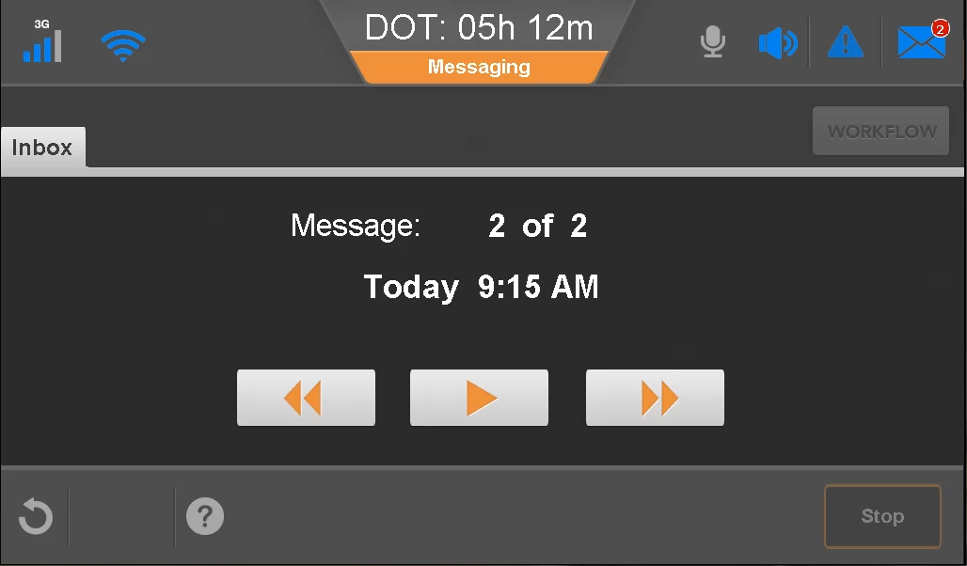
Message Notification while Moving
Tap Messaging to see your inbox. You can:
Tap the play button to listen.
Tap the forward and backward arrows to play other messages.
After you stop, you can:
Read information and reply to it.
Create and send new messages.
Notes:
When you tap the Play button, you hear the last message you read or listened to.
Tap the forward button to open the next message, and then tap Play.
You may need to tap the Forward button more than once.
After you send a message, check your outbox to verify that it sent (green check mark)

Slide 34
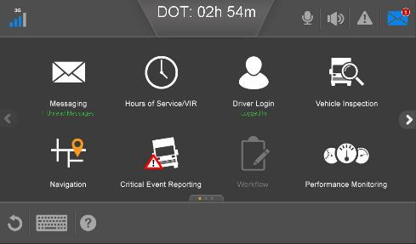


Read a Message
Tap the Messaging button.
Tap the message you want to read.
Notes:
If you have unread messages, they are indicated by a blue icon in the top right corner.
When you open your Inbox, the oldest unopened message is highlighted. So if you’ve listened to or read all your messages when a new one comes in, and you tap
Messages to open your Inbox, the first message at the top of the list is highlighted.

Slide 35
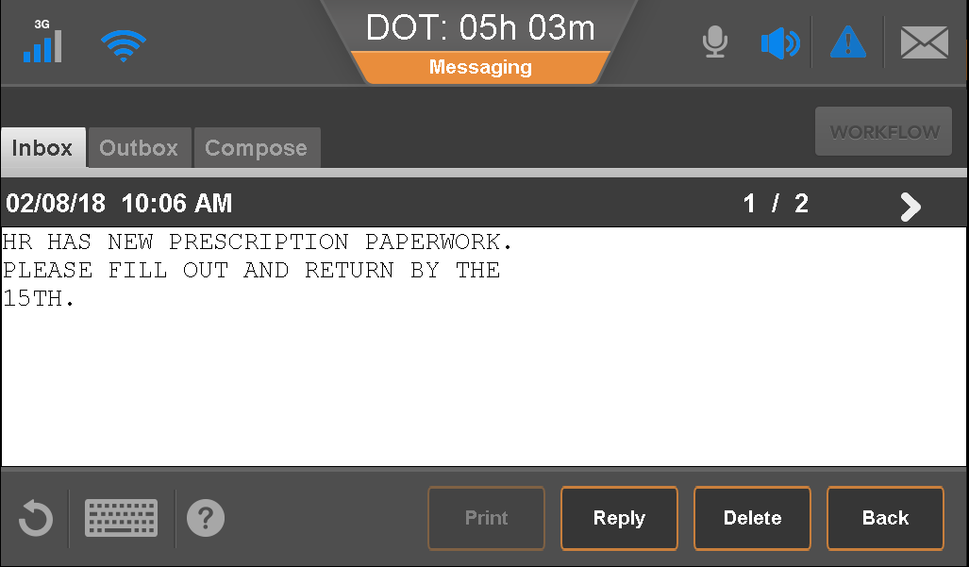
Read a Message
Scroll to read a long message.
To read the next or previous message, tap one of the arrows.
To return to your inbox, tap the Back button.

Slide 36
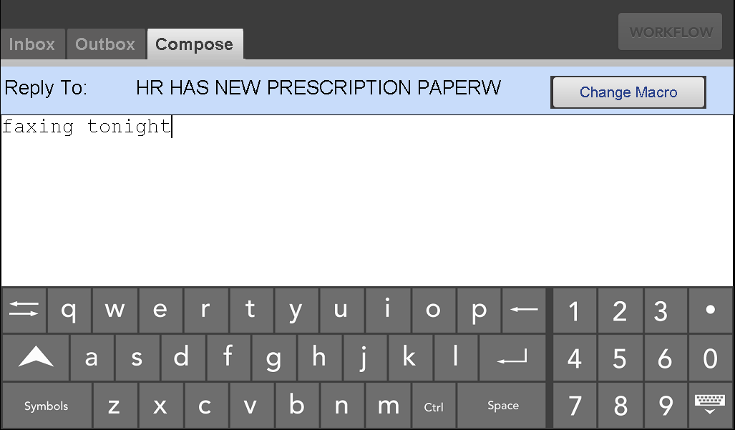
Reply to a Message
Tap Reply.
Open the virtual keyboard.
Type your message.
Close the keyboard.
Notes:
When you tap Reply, select a macro if you would like to respond with a preformatted message.
The Clear button empties the entire message.

Slide 37
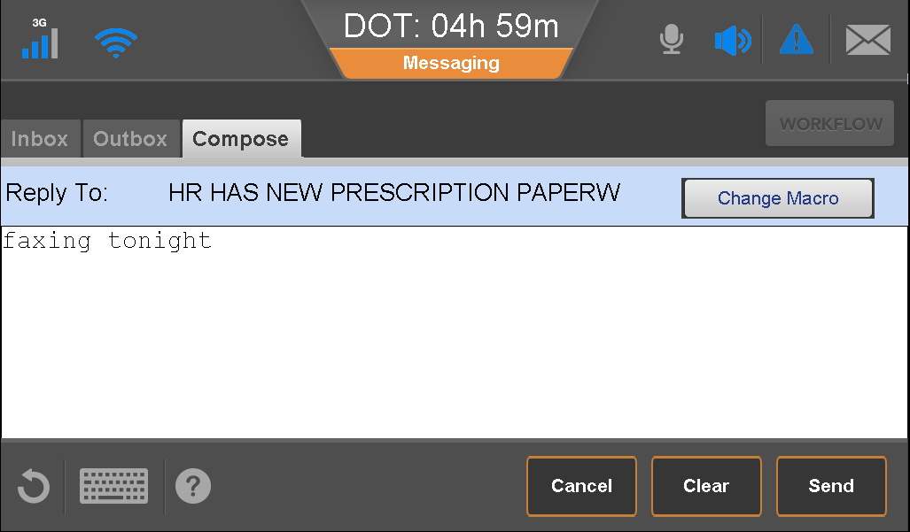
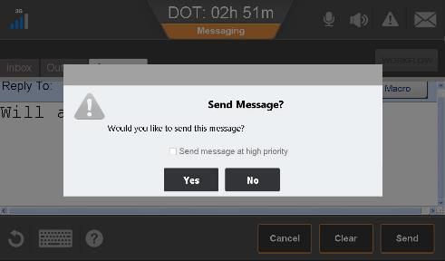
Reply to a Message
Tap Send.
Tap Yes to confirm.
Notes:
Notice that you can mark a message as high priority
The dispatcher may be alerted upon receipt of a high priority message you sent.

Slide 38
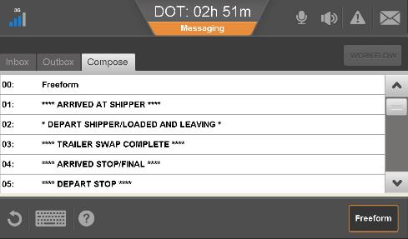
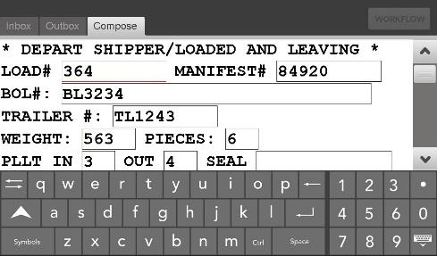
Send a Macro
Tap Compose.
Scroll to and tap a macro.
Tap each field and type your information.
Scroll down to fill in all fields.
When done, tap to close the keyboard.
Tap Send; then tap Yes.
Notes:
You can use the Tab key on the virtual keyboard to move between fields.
Some macro messages include driver instructions to help you understand what is needed.
The Clear button empties all the fields, not just the one you’re in. Cancel closes the macro and returns you to the Compose screen.

Slide 39
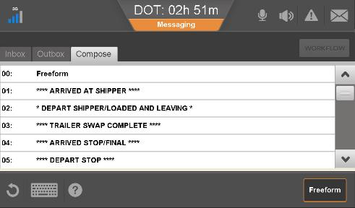
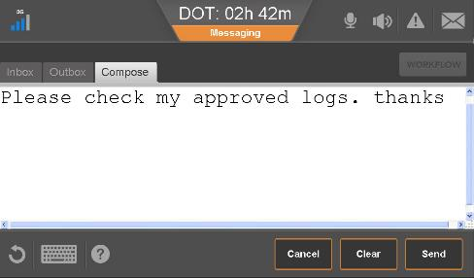
Send a Freeform Message
On the compose tab, tap Freeform button.
Type a message and close the keyboard.
Tap Send, then tap Yes.

Slide 40
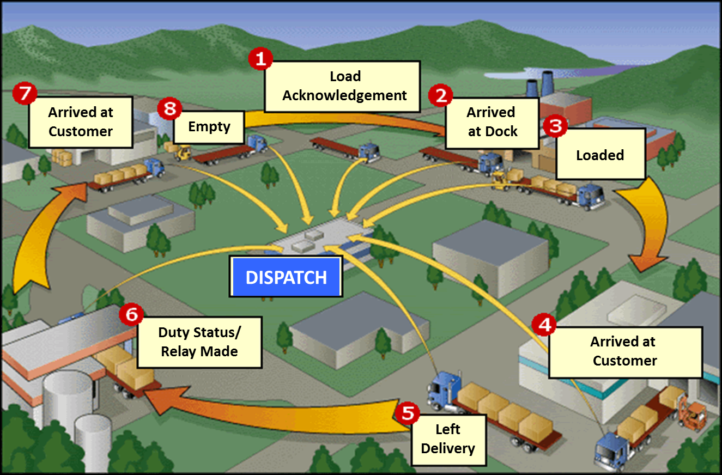
Typical Custom Macros

Slide 41
[Insert Company Name Here] Custom Macros
[insert custom macro]
[insert custom macro]
[insert custom macro]
[insert custom macro]
[insert custom macro]
[insert custom macro]
[insert custom macro]
[insert custom macro]
[insert custom macro]
[insert custom macro]
[insert custom macro]
[insert custom macro]
[insert custom macro]
[insert custom macro]
Notes:
Fill in your company’s key macros. Your numbering may be different.

Slide 42
Intelligent Voice Interface
Basic Driver Services

Slide 43
Intelligent Voice Interface
Intelligent Voice Interface (IVI) is an always-on application that listens for your commands and responds by voice.
To use IVI you need to know:
  How to access the feature
  Learn the commands
  Navigate IVG using your voice
Notes:
Intelligent Voice Interface is designed to allow drivers hands free access to several features of the Intelligent Vehicle Gateway. Commonly used commands can be spoken to the IVG for quick access without having to take your hands off the wheel. To start, say the phrase "Hello Omnitracs". The system will reply with "Hi, please state a command." From here, the driver can state a command and have IVG perform that task.

Slide 44
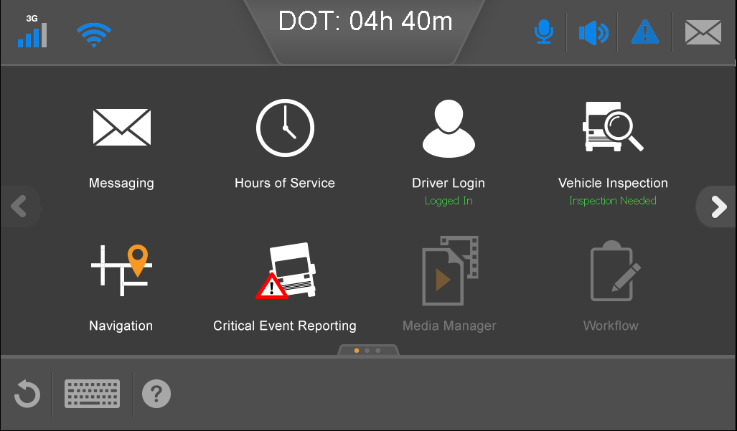
Access IVI
Say, “Hello Omnitracs.”
The IVI icon on the header turns blue and the IVG responds with, “Hello, Please state a command.
State a command.

Slide 45
Omnitracs IVI Commands
When active, IVI is actively listening for one of the specific commands. For current commands, see the on-board support.
Available hours
Brightness Down
Brightness Off
Brightness Up
Go Back
Home Screen
Hours of Service
Inbox
Miles per Gallon
Mute Volume
Read Message
Scroll Down
Scroll Up
Tire Status
Vehicle Inspection
Volume Down
Volume Up
What Can I Say
Workflow
Notes:
Home screen - Takes you back to the home screen
Go Back - Goes back to the previous screen or home screen if no previous screen is available
Brightness Up - Turns the brightness of the IVG up
Brightness Down - Turns the brightness of the IVG down
Brightness Off - Turns the brightness setting to it’s lowest level
Volume Up - Turns the Volume up
Volume Down - Turns the Volume Down
MUTE Volume - Mutes the IVG
Available hours - IVG will speak the number of hours available
Scroll Down - Scrolls the current window down
Scroll Up - Scrolls the Window up
Hours of service - Opens the Hours of service Application
Inbox - Opens the messaging inbox
What can I say - The IVG will begin to speak a list of available commands
Workflow - Opens the Workflow application

Slide 46
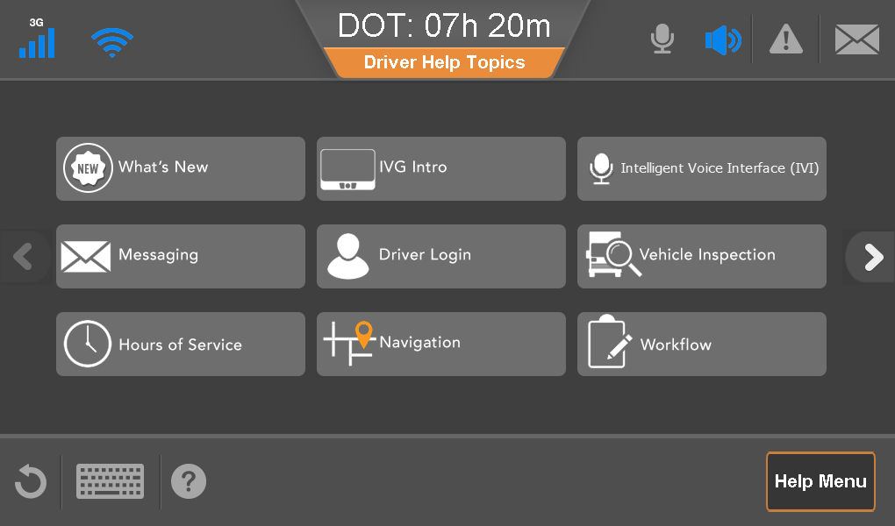
IVI Commands Support
While in the cab, you have two ways to list available commands:
Tap the Support button.
Tap the Intelligent Voice Interface button.
Say, “Hello Omnitracs”.
Say, “What can I say”.
The IVG reads the commands aloud.
Notes:
Home screen - Takes you back to the home screen
Go Back - Goes back to the previous screen or home screen if no previous screen is available
Brightness Up - Turns the brightness of the IVG up
Brightness Down - Turns the brightness of the IVG down
Brightness Off - Turns the brightness setting to it’s lowest level
Volume Up - Turns the Volume up
Volume Down - Turns the Volume Down
MUTE Volume - Mutes the IVG
Available hours - IVG will speak the number of hours available
Scroll Down - Scrolls the current window down
Scroll Up - Scrolls the Window up
Hours of service - Opens the Hours of service Application
Inbox - Opens the messaging inbox
What can I say - The IVG will begin to speak a list of available commands
Workflow - Opens the Workflow application

Slide 47
Mobile Reset
Basic Driver Services

Slide 48
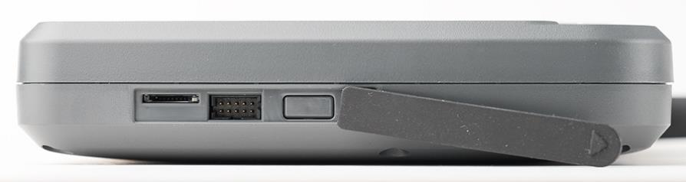
Mobile Reset
Drivers experiencing problems with their IVG may reset it without requesting an over-the-air command from Omnitracs. The IVG cannot be reset while the vehicle is in motion.
Notes:
The new mobile reset button allows a driver who is experiencing problems with their IVG to reset the device without having to wait for support services to send a command over the air. A mobile reset must CANNOT be initiated while the cab is in motion. Mobile reset is a feature that can be turned on or off by the company. If your company does not allow a mobile reset by a driver, be sure to remove this section.

Slide 49
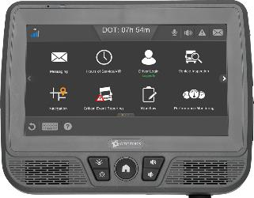
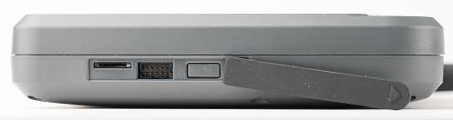
Mobile Reset
When safely parked, remove the protective rubber flap from the left side of the IVG.
Press and hold the reset button for ten seconds.
Release the button and the IVG restarts.
Check the hardware to make sure everything is working properly before driving again.

Slide 50
On-board Support
Basic Driver Services

Slide 51
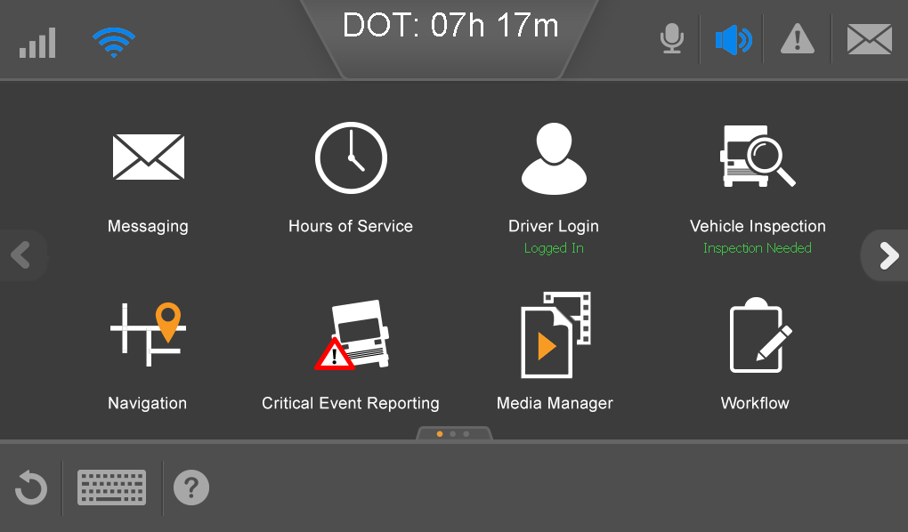
On-board Support
Support for each IVG application is available on the IVG. You need to know how to:
  Access the help menu.
  Navigate through the help topics.
  Locate What’s New after
  your IVG is upgraded.

Slide 52
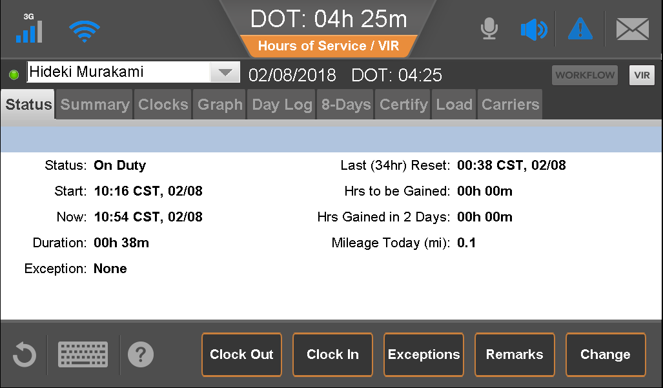
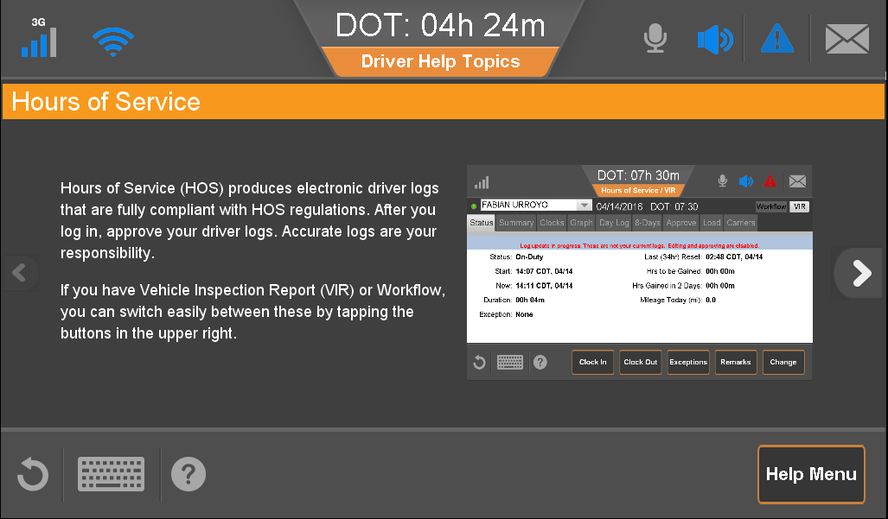
On-board Support
Tap the question mark.
The IVG knows what application you are using and displays help topics for that application.
In this example, the driver sees help about using Hours of Service.
Notes:
The entire help system is available, whether or not your company uses all of the applications.

Slide 53
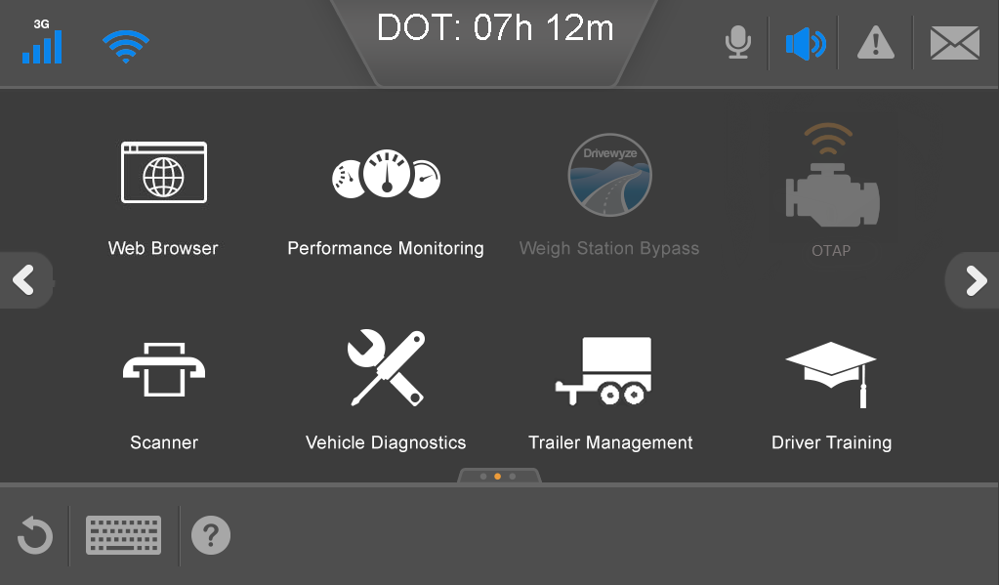
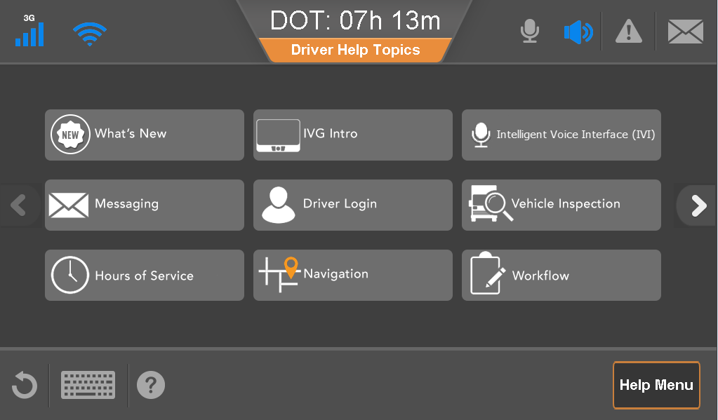
On-board Support: What’s New
When there are software updates to the IVG, you can learn what those changes are.
From the Home screen, scroll to and tap Driver Training.
Tap What’s New.

Slide 54
Driver Settings
Basic Driver Services

Slide 55
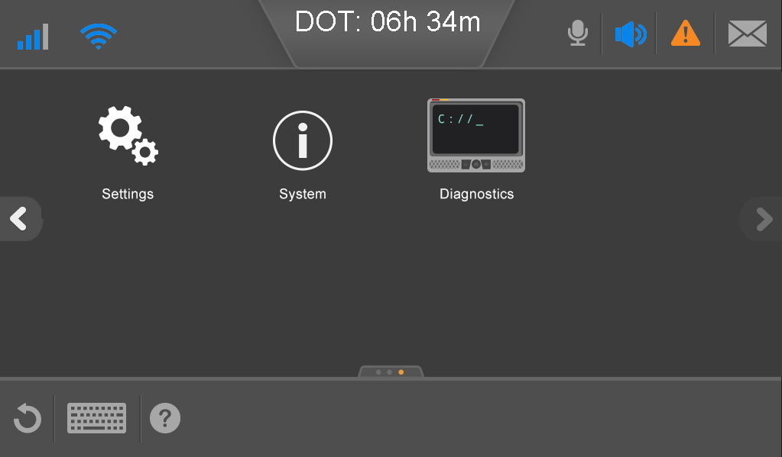
Driver Settings
Some of the settings on the IVG are controlled by your company and cannot be changed. You have permission to set:
  Volume
  Brightness
  Time zone
You may also calibrate the
touchscreen.

Slide 56
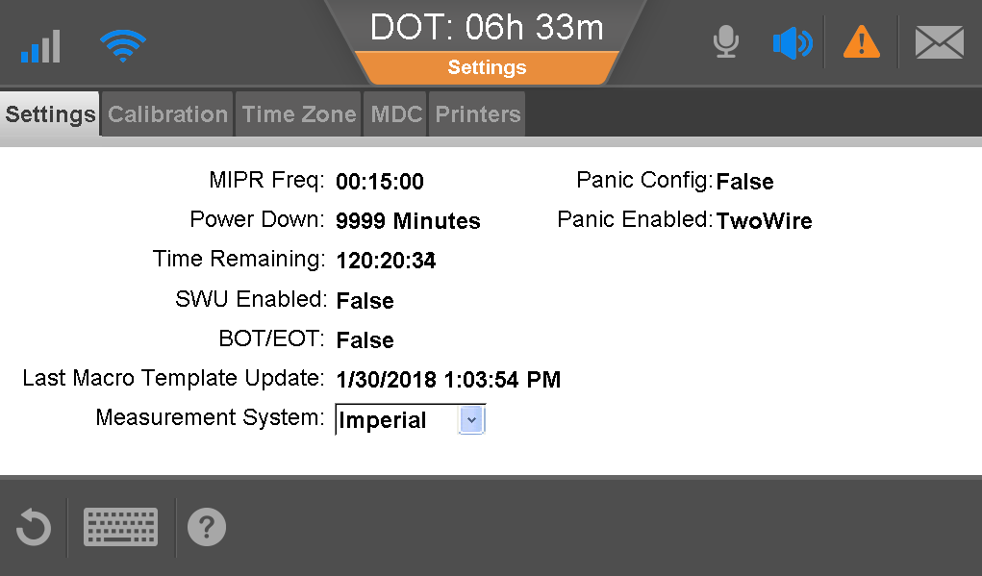
Driver Settings: View IVG Information
If requested by a technician, you may need to provide setting information.
From the Home screen, tap Settings.
Provide information about the IVG to the technician.

Slide 57
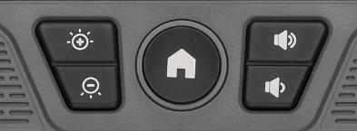
Driver Settings: Set Brightness
Use these button to control the screen brightness.

Slide 58
Driver Settings: Volume
Use these buttons to increase or decrease the volume.

Slide 59


Driver Settings: Set Time Zone
From Settings, tap Time Zone.
Scroll to locate the time zone and tap to select it.
Optionally, select Auto-Adjust for Daylight Saving.
Tap apply.
Tap OK.

Slide 60

Driver Settings: Calibrate Display
Tap OK to dismiss the success notification.
Note: You do not need to calibrate the display unless you are asked to by a technician.
Notes:
The driver needs to calibrate the display when asked to do so by a technician.

Slide 61


Driver Settings: Calibrate Display
From Settings, tap Calibration.
Tap Calibrate.
Tap and hold on each target for two seconds – do not swipe.
You can use the tip of a pen if the ballpoint is retracted.
Release, and tap/hold the next target.
Notes:
Using your finger is just fine. You can also connect a usb mouse to the ivg and use that to calibrate the screen.

Slide 62

Driver Settings: Calibrate Display
When calibration is complete, tap OK.
Notes:
Using your finger is just fine. You can also connect a usb mouse to the ivg and use that to calibrate the screen.

Slide 63
System
IVG Driver Training

Slide 64

System
The System tabs provide basic trouble shooting tools.
Open System only when instructed to do so by an authorized technician.

Slide 65


Getting Assistance
If you have a problem with your unit, contact your fleet manager or dispatcher.
Notes:
[Review company help procedures.]

Slide 66
IVG Driver Training
This concludes the Introduction & Basic Driver Services training.

