Slide 1
To the Instructor
Modify this presentation to fit your company.
Brand it with your company’s logo.
Delete slides referring to features you do not offer.
Hide or delete slides that are for your use only, like this one or the Instructor Training Checklists.
To ensure you cover all material, use the Instructor Training Checklist.
The presenter notes section provides key points.
Presenter notes
Notes:
[Hide or delete this slide if you are projecting this presentation as a slide show for driver training.]
To Hide a slide from presenting, right click on the slide thumbnail in normal view and choose Hide Slide.

Slide 2
Instructor Training Checklist: Vehicle Diagnostics
Check Vehicle Diagnostics
Explain the type of data it collects.
Describe how your company reacts to fault notifications it receives and what the driver is expected to do in different situations.
Notes:
[Print this slide to help you cover all of the important topics. Hide or delete it if you are projecting this presentation as a slide show for driver training.]

Slide 3
IVG Driver Training
Vehicle Diagnostics

Slide 4
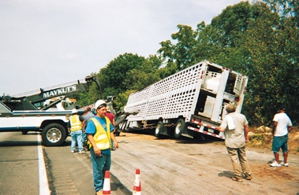
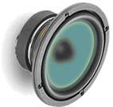
Safety Information
You cannot use the IVG to read or type messages while moving.
Exception: a logged in, non-driving co-driver may use the IVG without restriction.
You can listen to messages while driving.
Notes:
Review safety procedures.
Text-to-speech improves the driver’s productivity and safety as they can safely listen to all or part of the message and determine its importance. They only need to pull off the road if it needs immediate response.
The team’s non-driver can safely operate the IVG while the truck is moving.

Slide 5
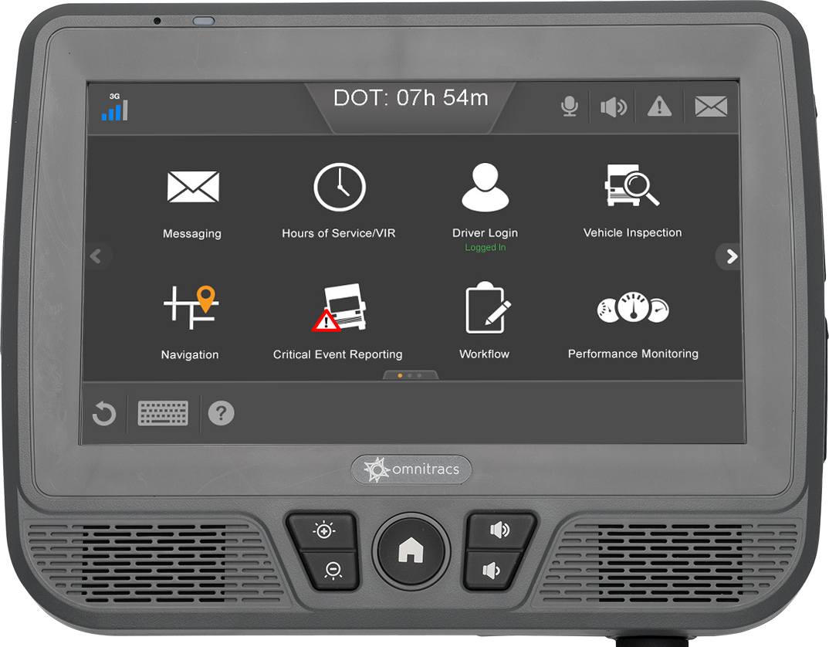
Goals
This presentation shows you how to view fault and tire pressure conditions on your vehicle
Notes:
Each goal above corresponds to an IVG application covered in this presentation. Each application section has an instructor training checklist (found at the beginning of this presentation) to help you train the application in detail. If your company doesn’t use all of the applications in this presentation, remove the section slides and adjust the goal statements. Add your own goals if desired.

Slide 6
IVG Driver Training Topics
Vehicle Diagnostics
Notes:
Remove the topics from the presentation that your company is not using. Each application name is a link to that section of the presentation.

Slide 7
Vehicle Diagnostics
Cost Management Services

Slide 8
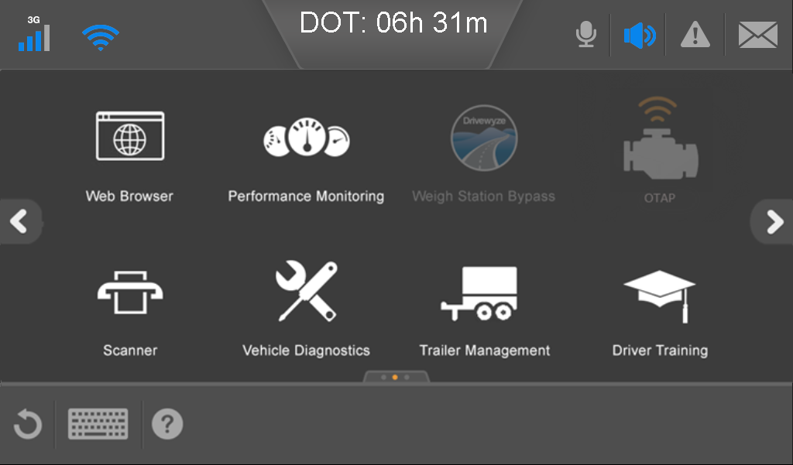
Vehicle Diagnostics
Monitors and automatically reports:
Engine faults from your vehicle
Tire pressure faults from your vehicle and trailer
You need to know how to:
Check current faults and tire pressure
See monitored conditions on your vehicle
Notes:
The Vehicle Diagnostic application provides information on vehicle engine faults. Information about engine faults is used to reduce on-road breakdowns.
If your company uses a tire pressure monitoring vendor, you may also receive tire pressure fault information.

Slide 9
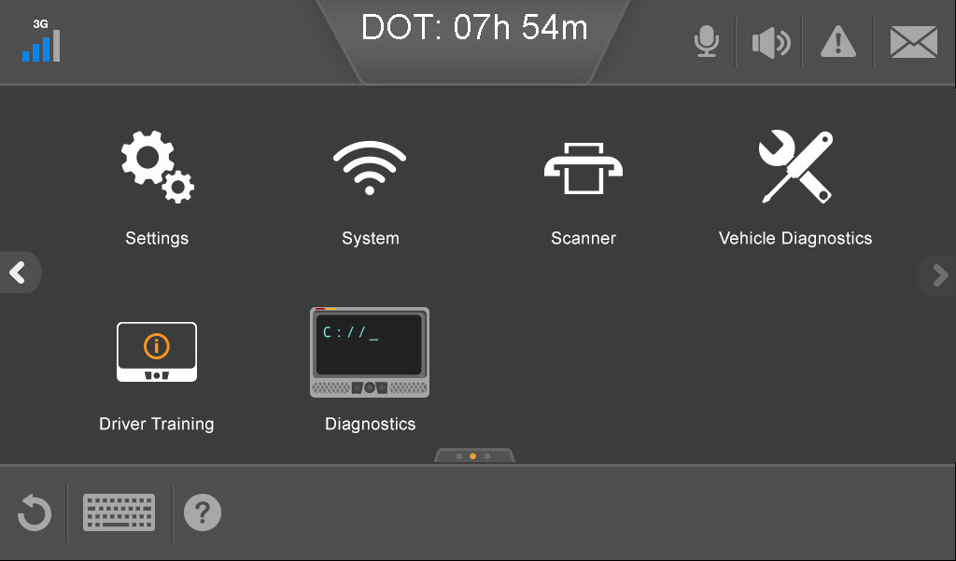
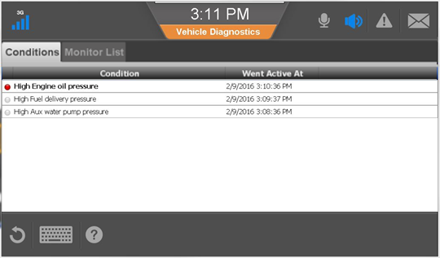
Check Vehicle Fault Conditions
Tap Vehicle Diagnostics.
Review the any fault conditions for your vehicle.
The Fault Monitor List tab shows all conditions that are being monitored.

Slide 10
Check Tire Pressure Conditions
In Vehicle Diagnostics, tap the Tires tab. Tire color indicates:
Green: normal
Yellow: over or under pressure
Red: extreme over or under pressure
Gray: signal missing
White: signal unknown
Tap the right arrow button to see trailer tire pressure.

Slide 11
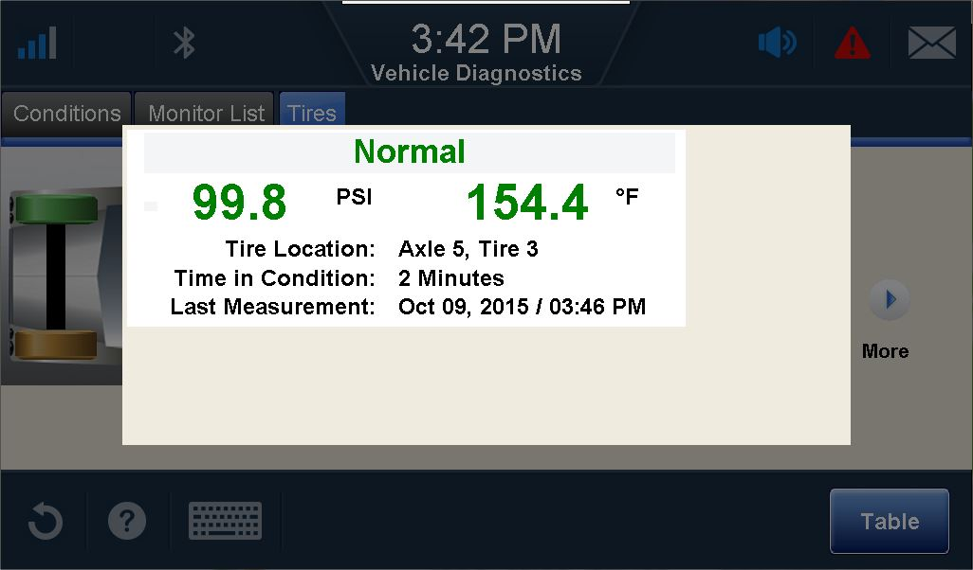
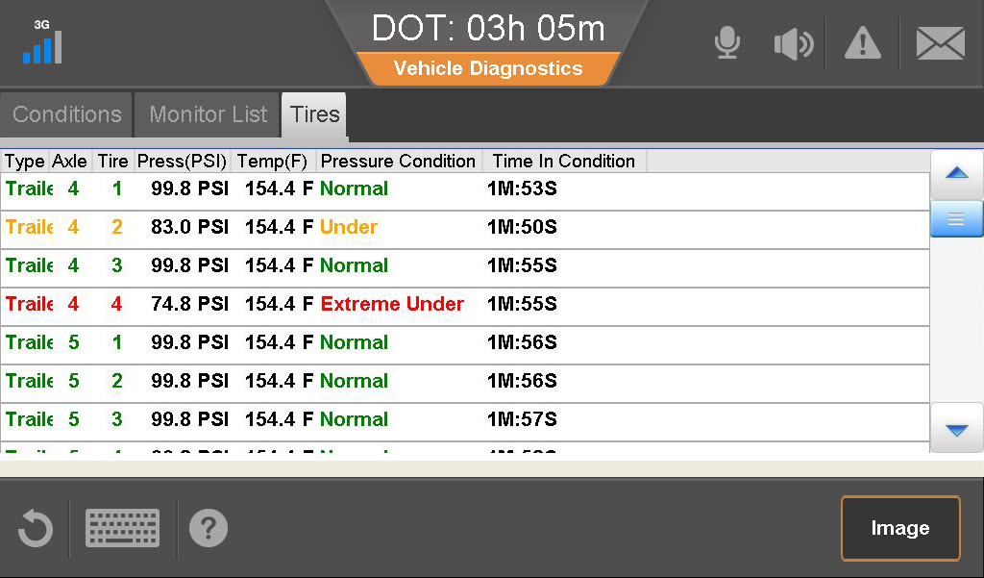
Check Tire Pressure Conditions
To see its most recent information, tap a tire.
Tap OK to close the pop-up window.
With the pop-up window closed, tap the Table button to see the information in a list.
To return to the trailer image, tap the Image button.

Slide 12
IVG Driver Training
This concludes the Vehicle Diagnostics training.

