Slide 1
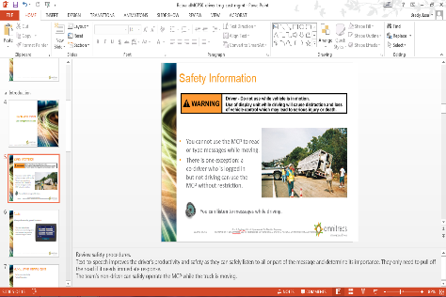
To the Instructor
Modify this presentation to fit your company.
  Brand it with your company’s logo.
  Delete slides referring to features
  you do not offer.
  Hide or delete slides that are for your
  use only, like this one or the Instructor
  Training Checklists.
To ensure you cover all material, use the Instructor Training Checklist.
The presenter notes section provides key points.
Presenter notes
Notes:
[Hide or delete this slide if you are projecting this presentation as a slide show for driver training.]
To Hide a slide from presenting, right click on the slide thumbnail in normal view and choose Hide Slide.

Slide 2
Instructor Training Checklist: VIR
Create vehicle and trailer inspection reports
Show how to access VIR
  Hours of Service/VIR button (home screen)
  Vehicle Inspection button (home screen)
  VIR button from within any HOS screen
Create a VIR with no defects.
Create a VIR with defects.
Complete the defect process
View defect VIR when waiting for a maintenance response.
Acknowledge and close the VIR
Note: If the defect is not repaired, the driver must close the defect and create a new defect. If a vehicle defect is pending, the driver cannot create a new defect. If a trailer defect is pending, the driver can choose another trailer and send a new trailer inspection report.

Slide 3
IVG Driver Training
Vehicle Inspection Report

Slide 4

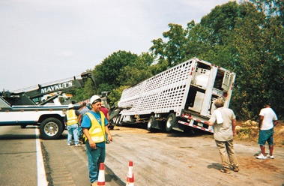
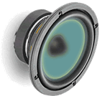
Safety Information
You cannot use the IVG to read
or type messages while moving.
Exception: a logged in, non-driving co-driver may use the IVG without restriction.
    You can listen to messages while driving.
Notes:
Review safety procedures.
Text-to-speech improves the driver’s productivity and safety as they can safely listen to all or part of the message and determine its importance. They only need to pull off the road if it needs immediate response.
The team’s non-driver can safely operate the IVG while the truck is moving.

Slide 5
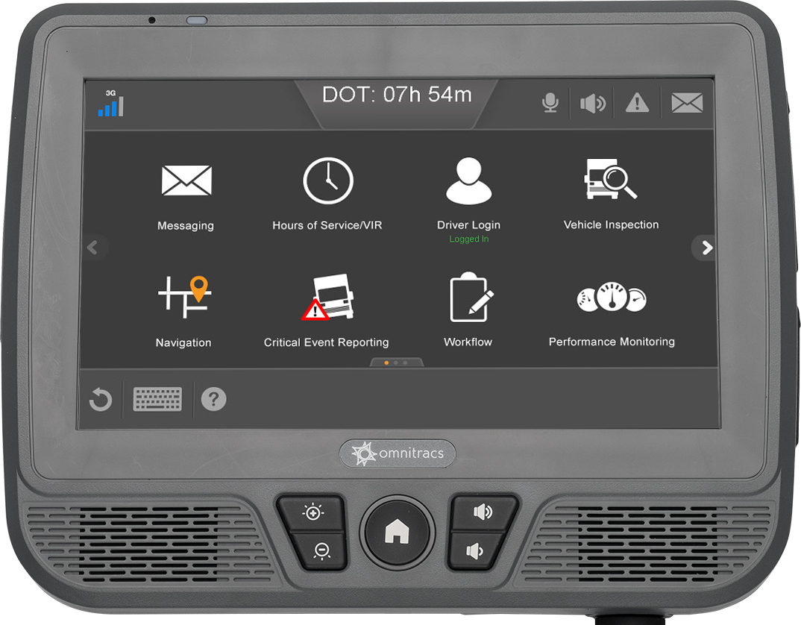
Goals
This presentation shows you how to perform vehicle and trailer inspections.
Notes:
Each goal above corresponds to an IVG application covered in this presentation. Each application section has an instructor training checklist (found at the beginning of this presentation) to help you train the application in detail. If your company doesn’t use all of the applications in this presentation, remove the section slides and adjust the goal statements. Add your own goals if desired.

Slide 6
IVG Driver Training Topics
Creating an inspection report
Notes:
[Remove the topics from the presentation that your company is not using. Each application name is a link that that section of the presentation.]

Slide 7
Vehicle Inspection Report
Safety and Compliance Services

Slide 8
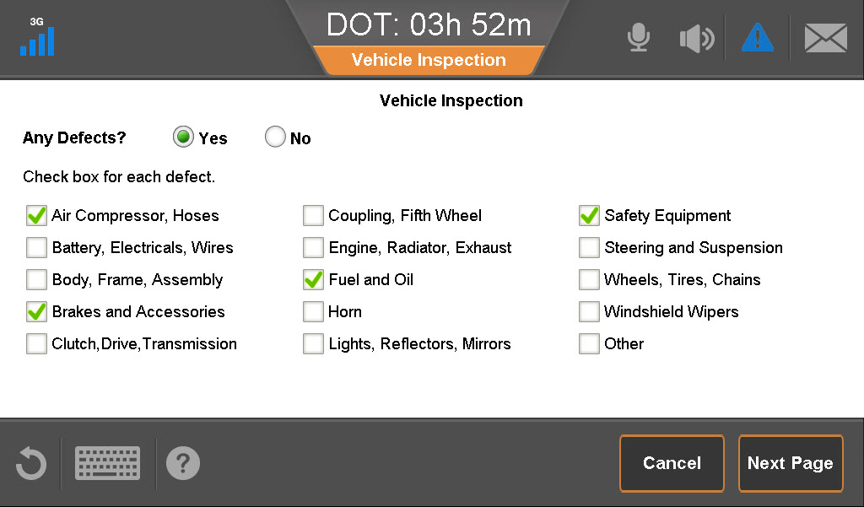
Vehicle Inspection Report (VIR)
Regulations require that you inspect your truck and trailer every day. VIR lets you complete these inspections paperlessly on the IVG.
You need to know how to:
  Access the VIR application.
  Create vehicle and trailer
  inspection reports.
  Fill out defect information and
  sign and submit your reports.
  View previous inspections.
  Acknowledge and close existing
  reports after verifying defect
  corrections.
Notes:
Your company may require pre-trip and post-trip inspections.
VIR prompts you to record an inspection once every 24 hours.
Contact your driver manager regarding how to indicate pre-trip vs. post-trip inspections.

Slide 9
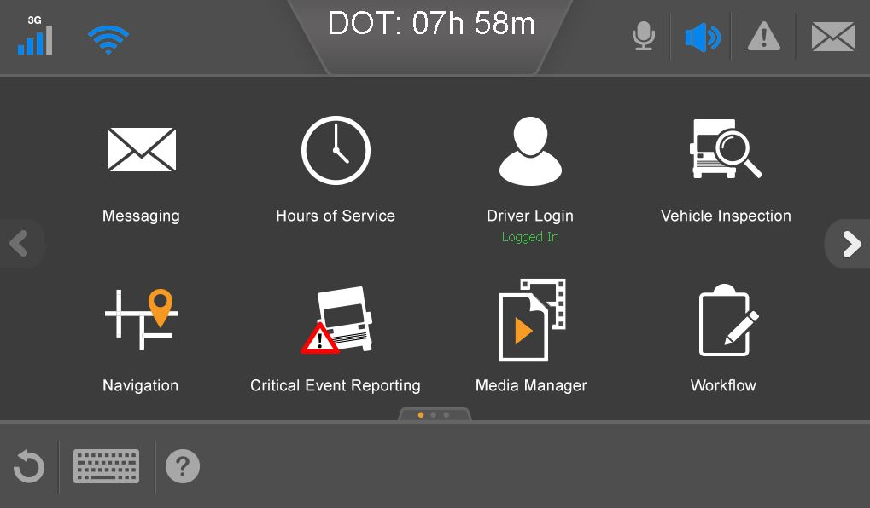
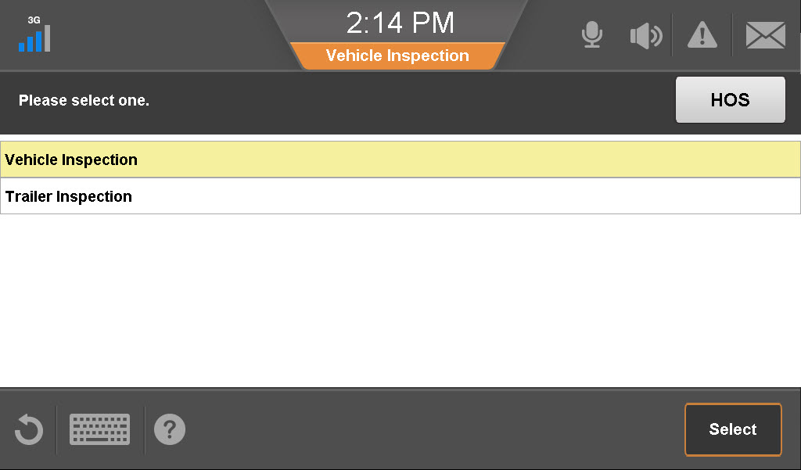
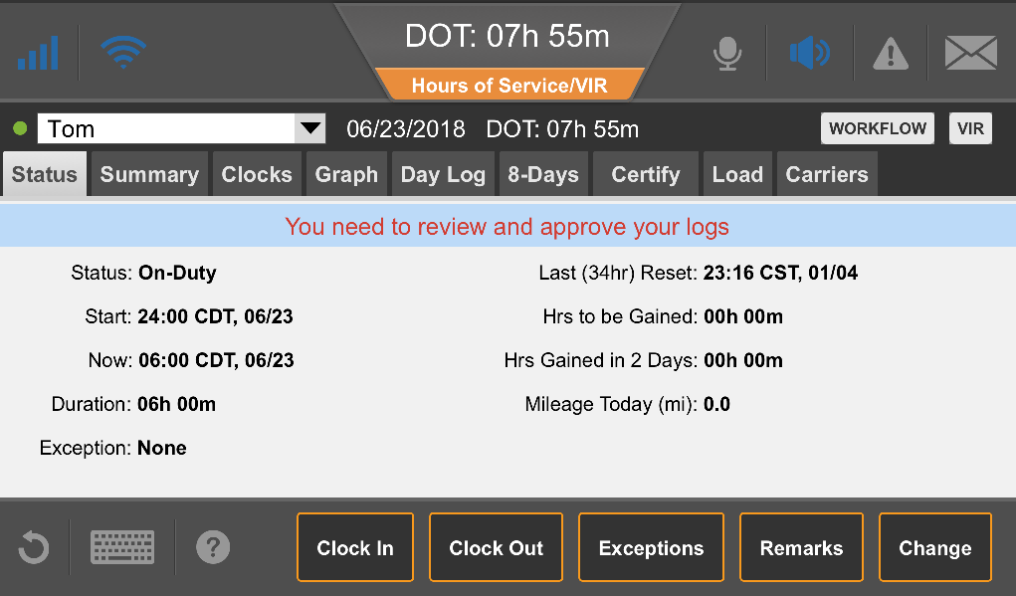
Accessing the VIR Application
If your company uses Hours of Service (HOS), both application names appear on the Hours of Service menu button.
You can switch between VIR and HOS from within either application.
Notes:
If your company does not use HOS, you must tap the Vehicle Inspection button on the home screen to submit an inspection report.

Slide 10
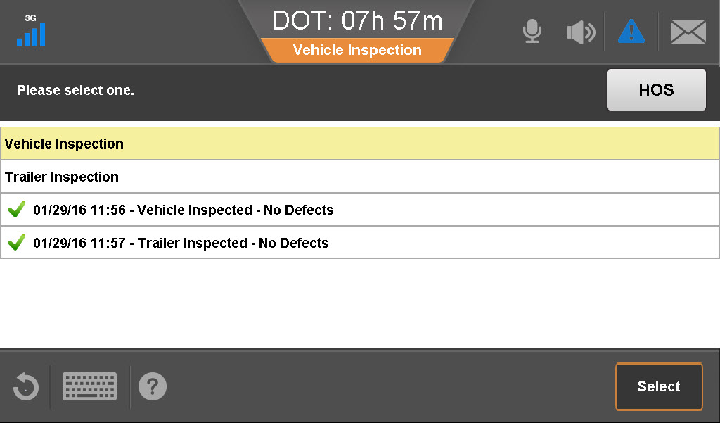
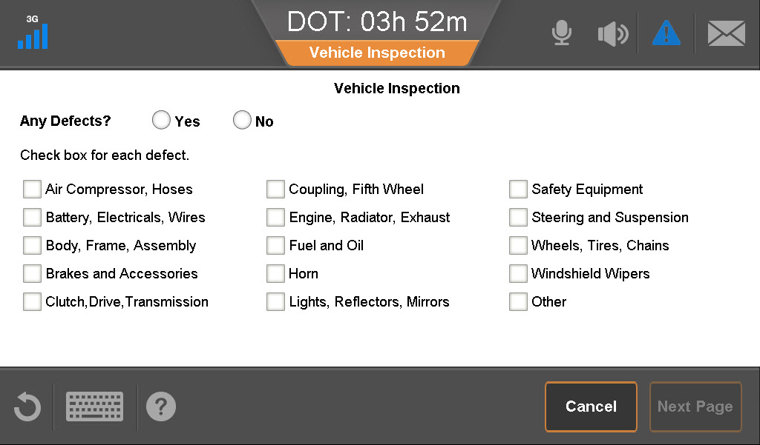
Send Vehicle Inspection
Open Vehicle Inspection Report:
  From within the HOS application (VIR button).
  From the “Hours of Service/VIR” button on the home menu.
  From the “Vehicle Inspection button on the home menu.
Tap an inspection report.
Tap Select.
Tap:
No if there are no defects found.
OR
Yes to create a defect report.
Notes:
The first time you open VIR, no previous inspections are listed. You see only “Vehicle Inspection” and “Trailer Inspection.”

Slide 11
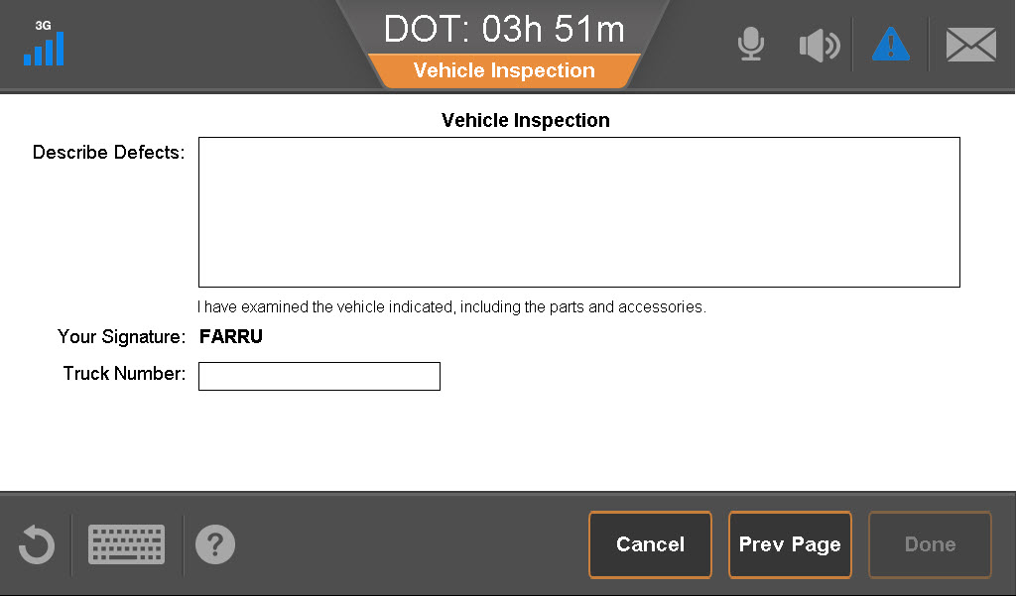
Send Vehicle Inspection
If there is a defect, check one or more boxes to indicate the problems you found.
Tap Next Page.
If you are reporting a defect, type information to describe the defect found.
Notes:
You can check as many boxes as needed. If you select “Yes,” you cannot go to the next page until at least one box is checked. The text box on the second page only appears if there is a defect. It expands if needed to contain all of the typed information.

Slide 12
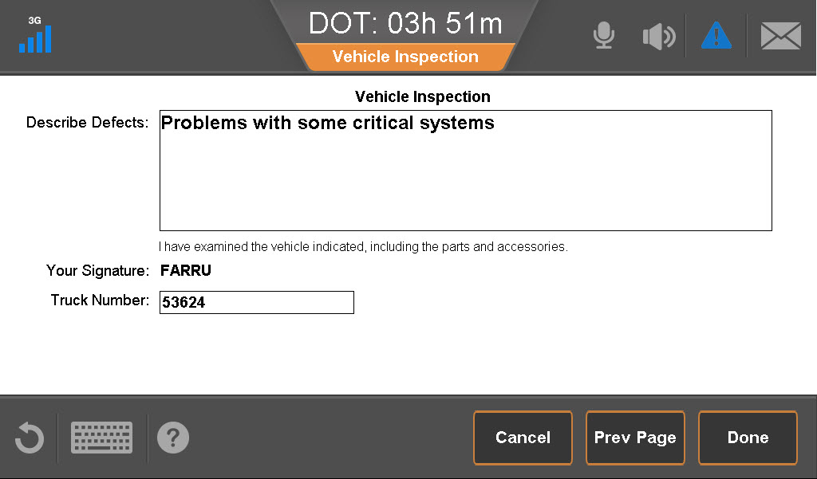
Send Vehicle Inspection
The logged-in driver’s ID displays as the signature for the report.
Type the truck number for which this VIR is being completed.
Tap Done.
Notes:
After completing a vehicle inspection, VIR asks you to complete a trailer inspection (next topic).

Slide 13
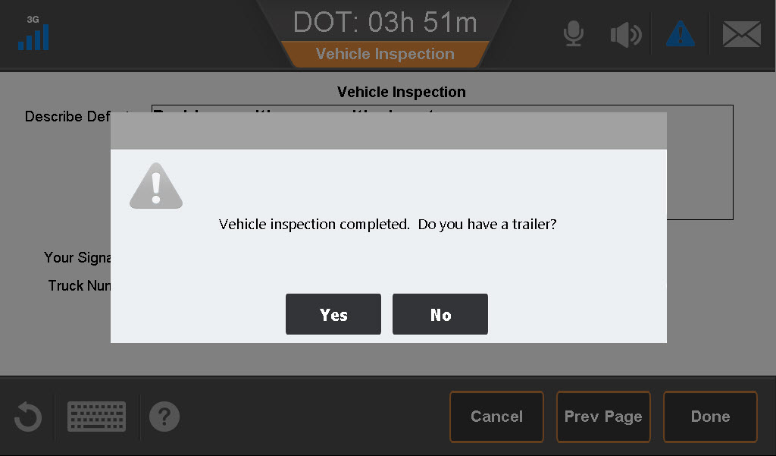
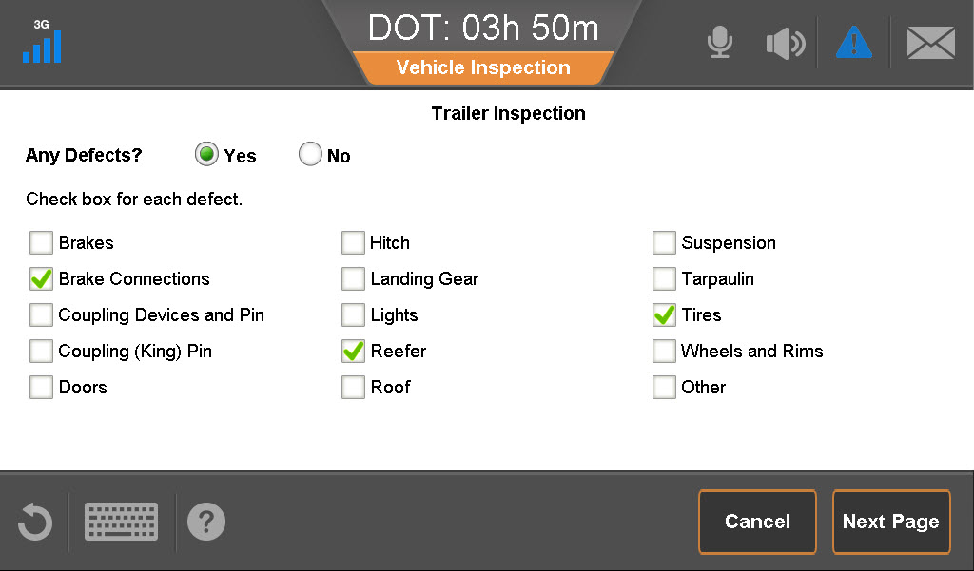
Trailer Inspection
After completing the inspection, VIR asks if you have a trailer.
In this example, you have a trailer with a defect.
Tap Yes.
Tap Yes and then tap the check box(es) to indicate the problems you found.
Tap Next Page.
Notes:
The trailer inspection form works exactly as the vehicle inspection form works.

Slide 14
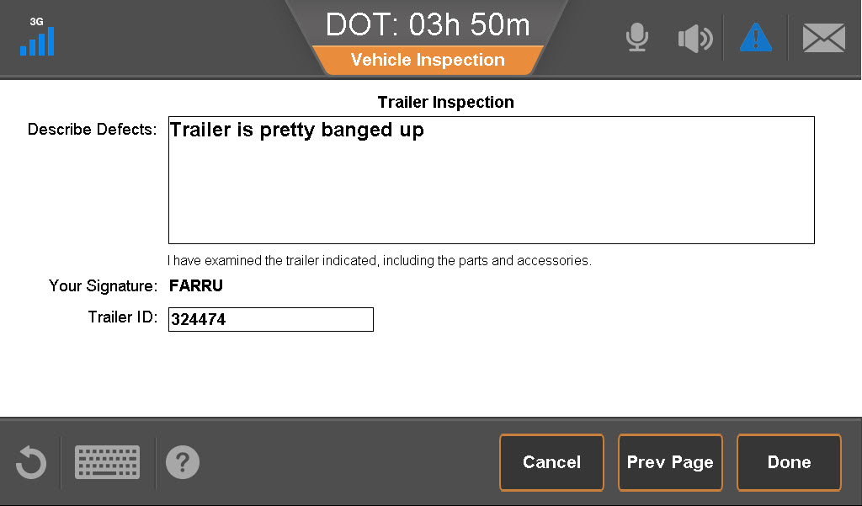
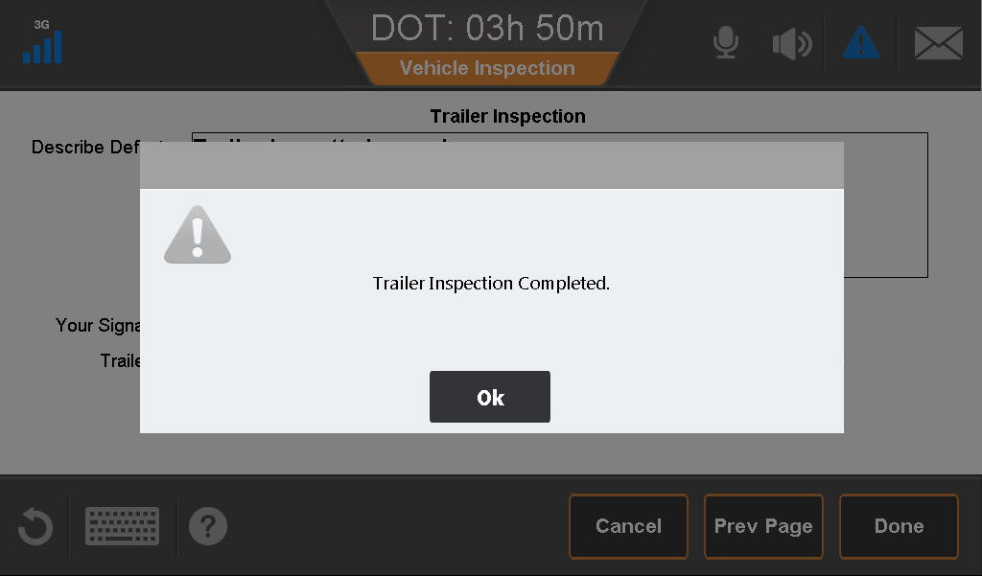
Submit and Inspection with a Defect
Enter a description of the defect.
“Sign” the form by entering the Trailer ID.
Tap Done.
Tap OK to acknowledge completion.
Note: Reporting defects from a vehicle inspection is the same process. The result is an open VIR that your company needs to address.

Slide 15
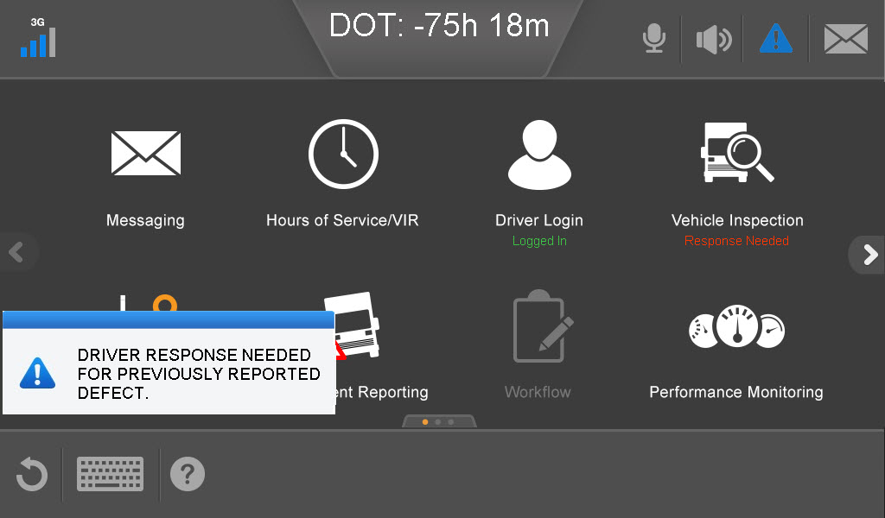
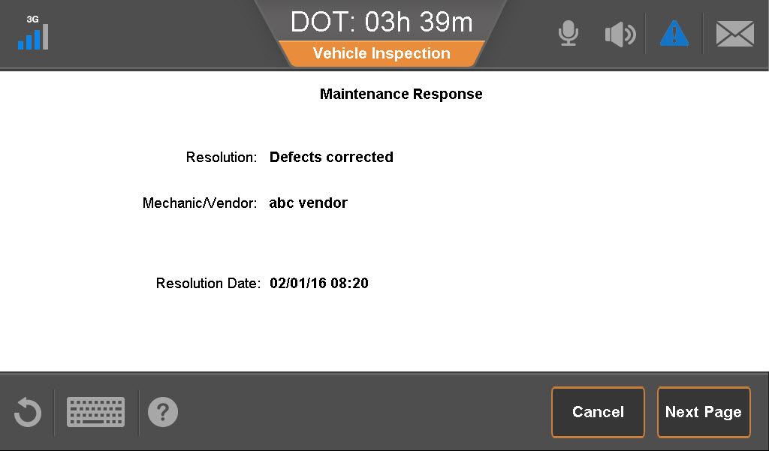
Closing an Open VIR
After sending an inspection report with a defect, the Alert Manager notifies you when Maintenance responds.
Tap the Alert to open the VIR.
Read the response, check its accuracy, and then tap Next Page.

Slide 16
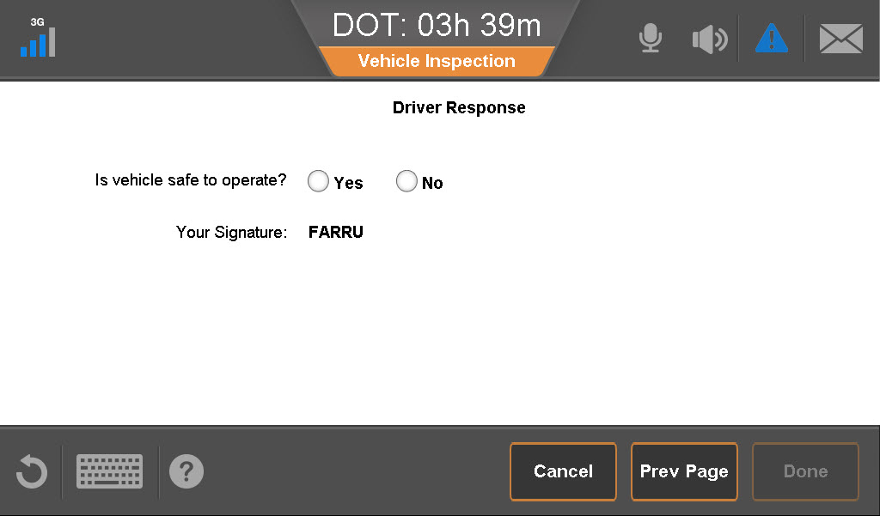
Closing an Open VIR
You must close the VIR; it is unlawful to drive with an open defect.
Tap Yes or No to answer the safety question.
Select your name from the drop-down list.
Tap Done.
Notes:
You cannot create a new vehicle VIR if an open defect exists.
You can create a new trailer VIR with a pending defect trailer VIR.
If the repairs are not satisfactory, say “No” to the safety question and then create a new defect VIR.
Notes:
Maintenance may indicate that no repair is needed under “Resolution.”
If an inspector wants to see the latest inspection report, hand him the unit and the DOT quick reference card.

Slide 17
IVG Driver Training
This concludes the Vehicle Inspection Report training.

