Slide 1
To the Instructor
Modify this presentation to fit your company.
Brand it with your company’s logo.
Delete slides referring to features you do not offer.
Hide or delete slides that are for your use only, like this one or the Instructor Training Checklists.
To ensure you cover all material, use the Instructor Training Checklist.
The presenter notes section provides key points.
Presenter notes
Notes:
[Hide or delete this slide if you are projecting this presentation as a slide show for driver training.]
To Hide a slide from presenting Right click on the slide thumbnail in normal view and choose “hide slide”.

Slide 2
Instructor Training Checklist: Workflow
Overview
Replaces paper checklists and forms and prompts to complete tasks at the right times
Dispatcher sends a stop list in a trip plan
Trip plans have stops. Stops have tasks. Some tasks have forms.
Definitions
Trip plan: go over stop types and status indicators
Stop Details: explain type of stops, customer ID and address; may include contact and phone number
Stop tasks: driver may have to scroll to see all of them
Mandatory tasks are bold
Arrivals/departures are automatically detected if geocoded in the trip plan; driver is prompted to confirm arrivals
If task has a form it appears when task is selected
Forms: similar to company paper forms, may contain mandatory fields and fields may already be filled in. May have a second screen; use Next Page.
Messages are not tied to a stop
Can send notifications of trip events between stops, such as break/meal, fuel purchase, report accident/breakdown/delay/weight, request trip plan
Demonstration
Log in
Request a trip plan if needed or view the new trip plan received
Examine stops and associated tasks and begin trip
Complete required tasks for each stop. Map icon brings up directions if using Navigo
Describe auto-arrival prompt and how to show arrival if not prompted
Show how to fill out a form
Complete unscheduled task, such as a fuel purchase or break/meal
Show stop history
Complete the trip
Confirm all stops were completed in full (have a green checkmark)
Complete stops that have a checkmark and exclamation point. Look for bold tasks that aren’t completed. Select it, and fill out form if necessary.
Tap End Trip at the last stop. Verify the last stop has a checkmark. After ending a trip, no more changes are allowed.
Notes:
[Print this slide to help you cover all of the important topics. Hide or delete it if you are projecting this presentation as a slide show for driver training.]
[Your company customizes the actual forms used for your Workflow application. Be prepared to discuss how your forms are different from the sample forms used in this presentation. If you have an IVG, show the workflow screens.]

Slide 3
IVG Driver Training
Driver Workflow

Slide 4
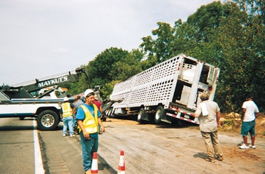
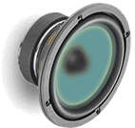
Safety Information
You cannot use the IVG to read or type messages while moving.
Exception: a logged in, non-driving co-driver may use the IVG without restriction.
You can listen to messages while driving.
Notes:
Review safety procedures.
Text-to-speech improves the driver’s productivity and safety as they can safely listen to all or part of the message and determine its importance. They only need to pull off the road if it needs immediate response.
The team’s non-driver can safely operate the IVG while the truck is moving.

Slide 5
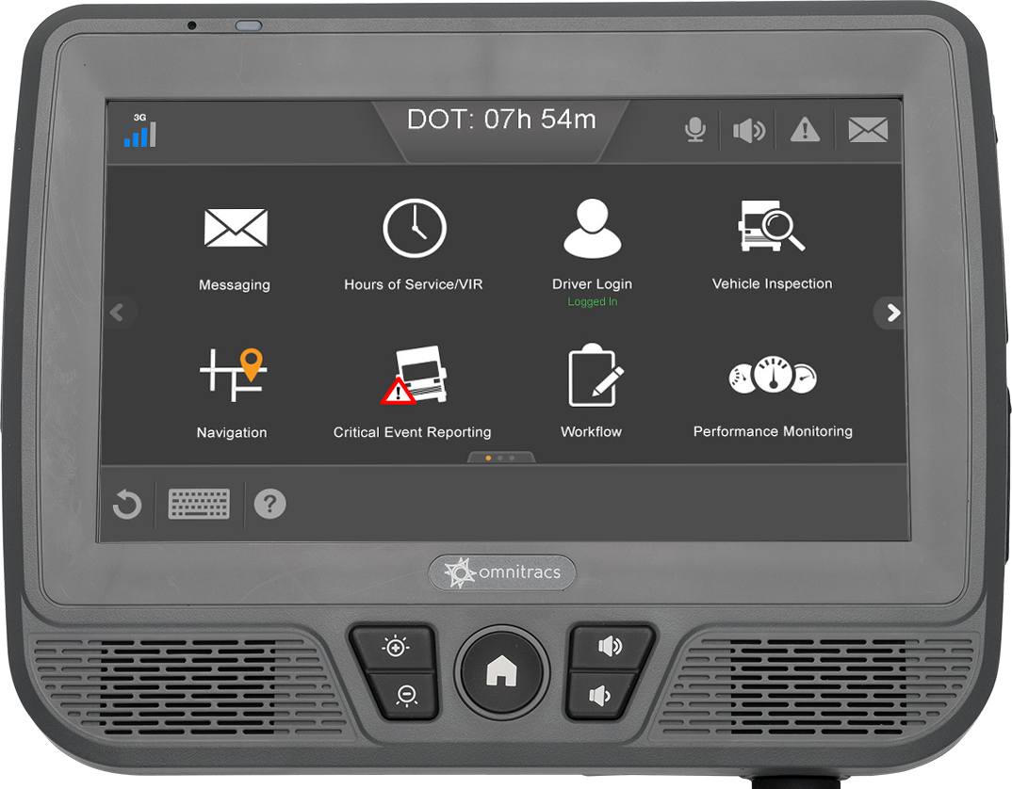
Goals
This presentation covers how to:
Request/view a trip plan
Fill our forms
Send messages
View history
Complete trips
Notes:
Each goal above corresponds to an IVG application covered in this presentation. Each application section has an instructor training checklist (found at the beginning of this presentation) to help you train the application in detail. If your company doesn’t use all of the applications in this presentation, remove the section slides and adjust the goal statements. Add your own goals if desired.

Slide 6
Workflow
Driver Productivity Enhancement Services

Slide 7
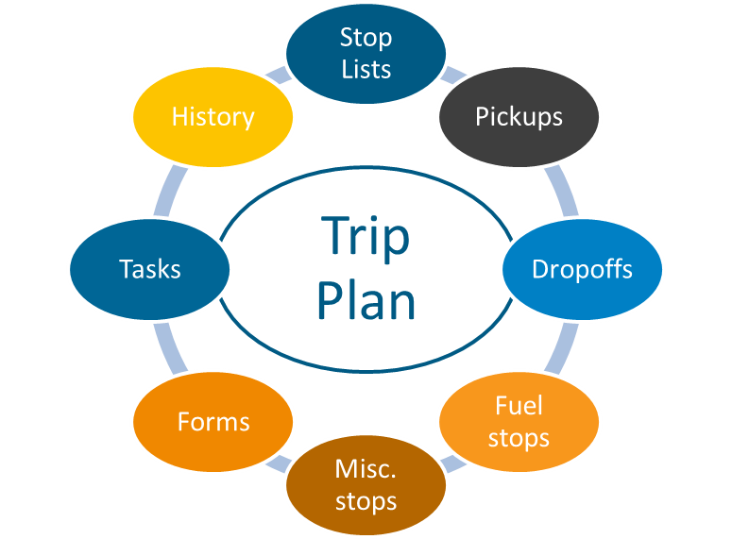
Workflow
Workflow simplifies your job by replacing paper checklists and forms and prompting you to perform tasks at appropriate times.
Stop lists are sent to you in a trip plan and contain your pickups, drop offs, refueling stops, and miscellaneous stops.

Slide 8
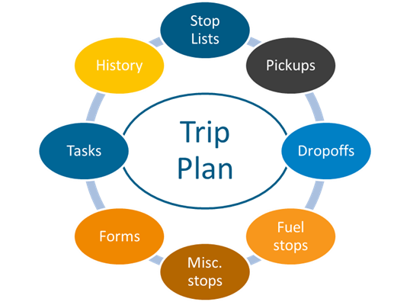
Workflow
Workflow provides you with electronic forms, and tasks are shown in the order in which you preform them.
As you complete tasks, you and your dispatcher know they’re finished.
You can see your history at the stop level and at the trip level.
Notes:
Important: Some of the screens in this lesson are representative (not actual screens), and do not look the same as the screens seen when Workflow is opened on a unit. If possible, replace the screens in this presentation with screen shots from units that have your Workflow templates.]

Slide 9
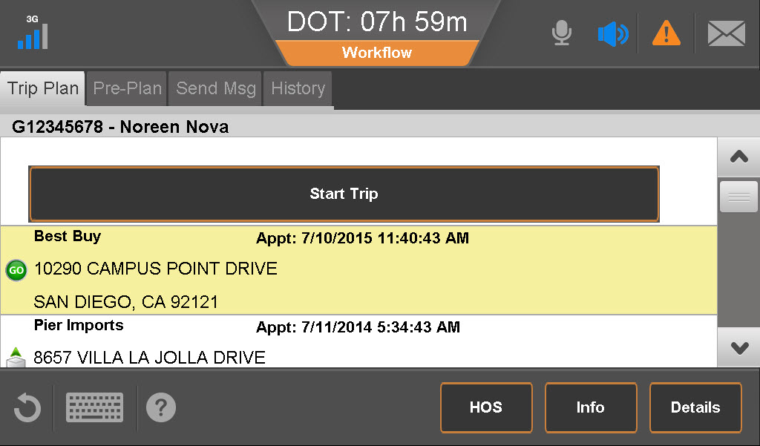
Trip Plan
Every trip starts with a trip plan with a list of stops. Stops have details; the kind of detail depends on the type of stop.
Stop types include:
Pickup Misc.
Fuel stop Start
Drop off End
Status indicators include:
In progress
Done
Incomplete
To see the details of a stop:
Tap it to select it.
Tap Details.

Slide 10
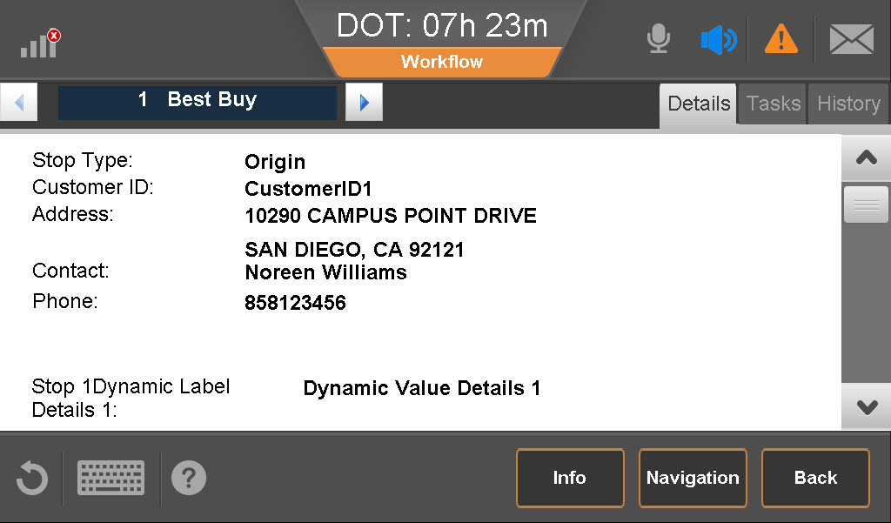
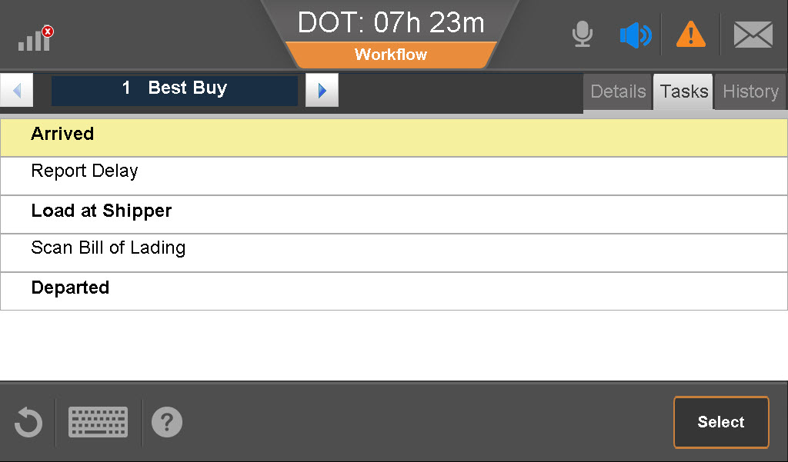
Stop Details and Tasks
The details include, for example:
Name, address, contact
Comments
Other information you normally receive from your company to service the stop
Stops also have tasks. Bold tasks are mandatory.
Some tasks are usually completed automatically, such as arrivals and departures.
Many tasks have forms you fill out.
Notes:
Arrivals and departures are usually detected by the GPS service when you arrive at or leave the stop. Notification is sent automatically to Dispatch. If it is not sent automatically, you can tap to select the task, then tap the Select button. This sends the notification and the task is marked as done.

Slide 11
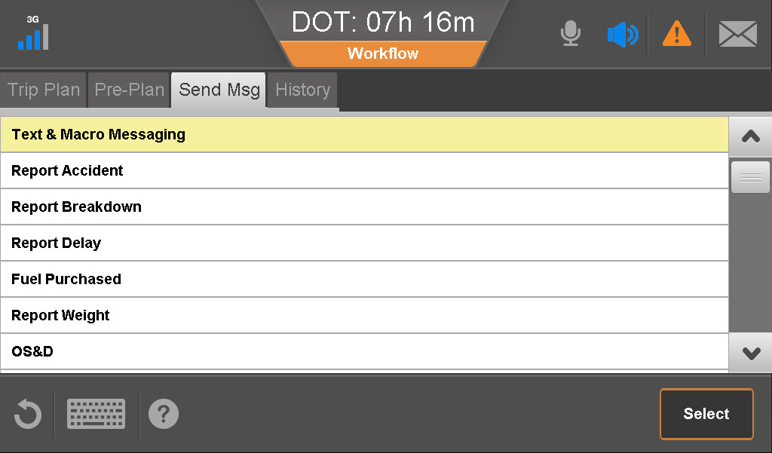
Forms
Workflow forms are similar to your company’s paper forms, and they replace the paper forms.
Fields in the forms can be mandatory or optional. Some fields are filled out for you.
You may have to scroll down or click next to fill out the entire form.

Slide 12
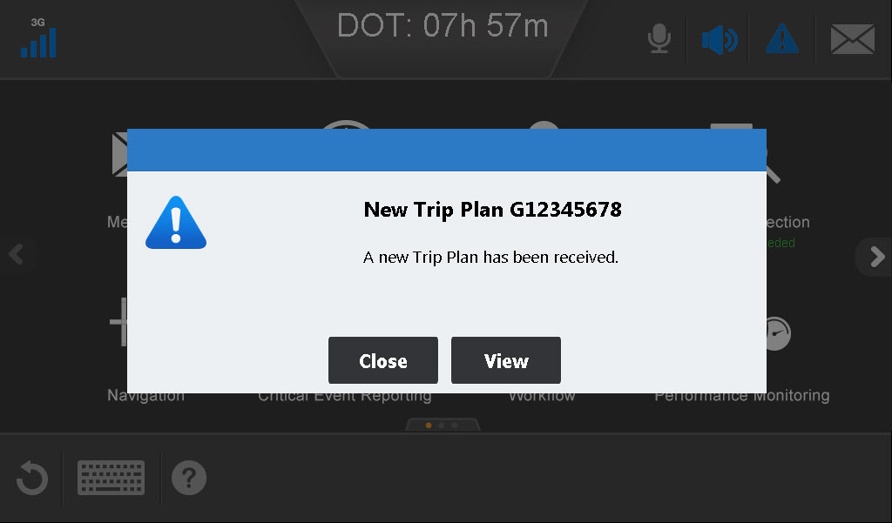
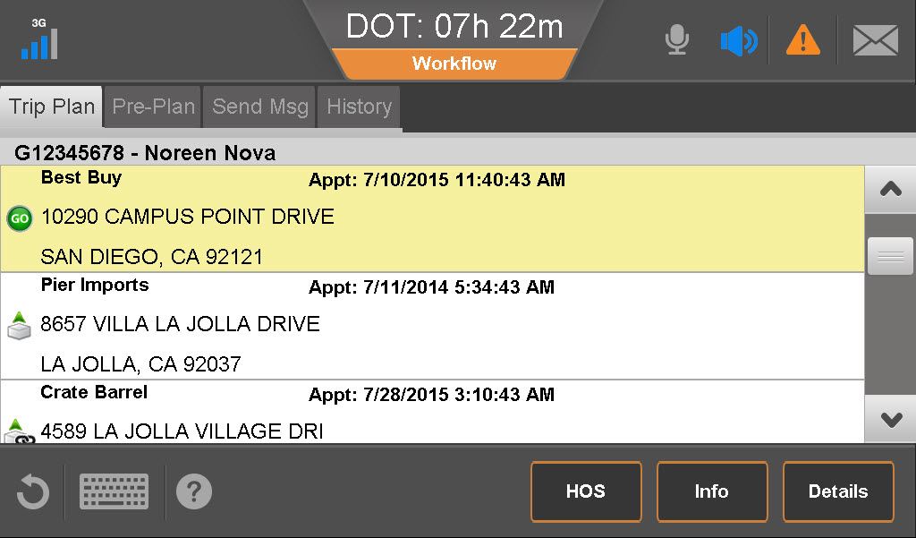
A Day in the Life Using Workflow
You’ve just logged in for the day when you receive an alert that a new trip plan is available. The notice appears over whatever screen you’re viewing.
Tap the alert icon, then tap Workflow. OR Scroll to the right and tap the Workflow button.
Review the stops and associated tasks by selecting each stop and tapping Details.
Notes:
If you want to finish what you are doing, tap Ignore and view the trip plan later by tapping Workflow from the home page.
Your company may allow you to accept or reject a trip plan. If so, you receive a pop-up prompt asking if the trip is accepted.

Slide 13
A Day in the Life Using Workflow
Review the details of the first stop. Tap Tasks to view the associated tasks for each stop.
When finished looking at the details, tap the back arrow to return to the Trip Plan.

Slide 14
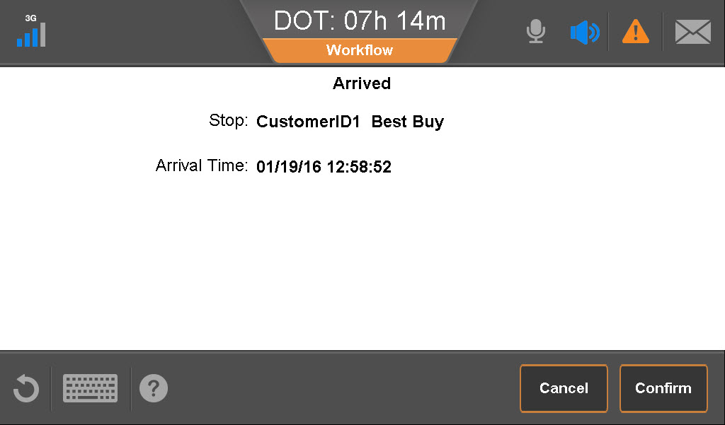
A Day in the Life: Trip Plan
You drive to your first stop. The arrival is usually detected by your GPS system, and you are notified.*
Tap OK. After closing the arrival notice, the task list for that stop appears. Required tasks are in bold. Other tasks are available if you need them.
To perform a task that isn’t a form, tap it to highlight it, and tap Select.
*If not, manually select Arrived from the task list when you get there.
Notes:
These are example pick up tasks. Drop off tasks are often different. Explain the tasks you expect of your drivers. These screens and tasks are representations of the types of tasks performed by any company.
In this example, the arrival was automatically detected. This is based on the “GPS” prefix on the task.
When the driver selects a non-form task, the notification is automatically sent. In this example, Dispatch receives a Hook notification with a time stamp.

Slide 15
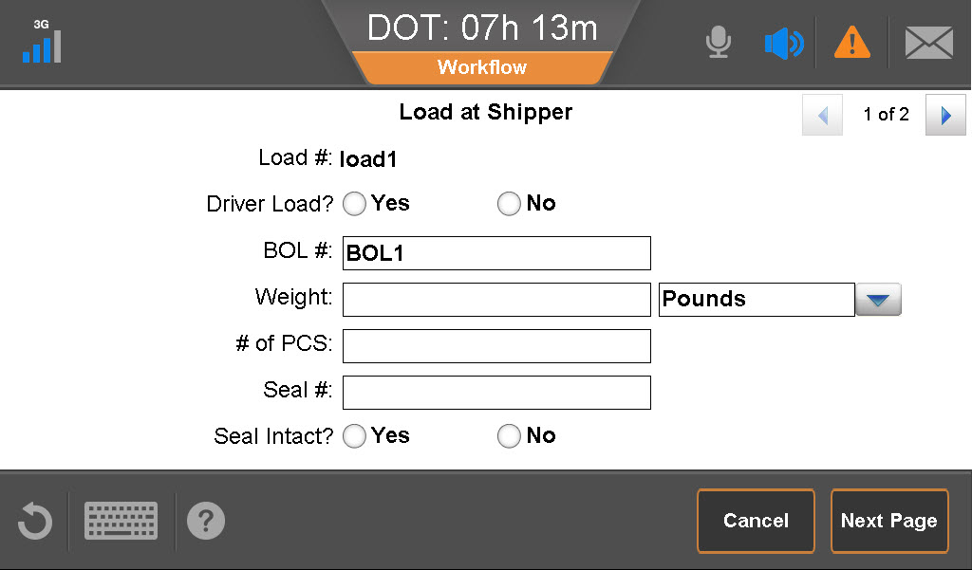
A Day in the Life: Trip Plan
To fill out a form, tap it.
Fill out the form. Some forms require you to press direction arrows or click Next Page to fill out all of the fields.
Notes:
Important: Some fields are mandatory, but the system does not enforce that the driver fill everything out. Be sure to explain what you need to have filled out, and instruct them always to type as much information as they have.

Slide 16
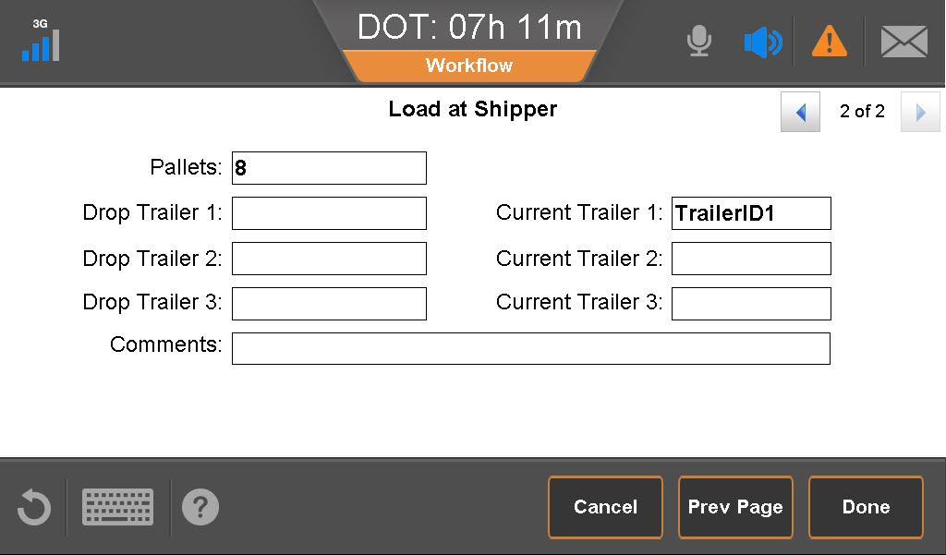
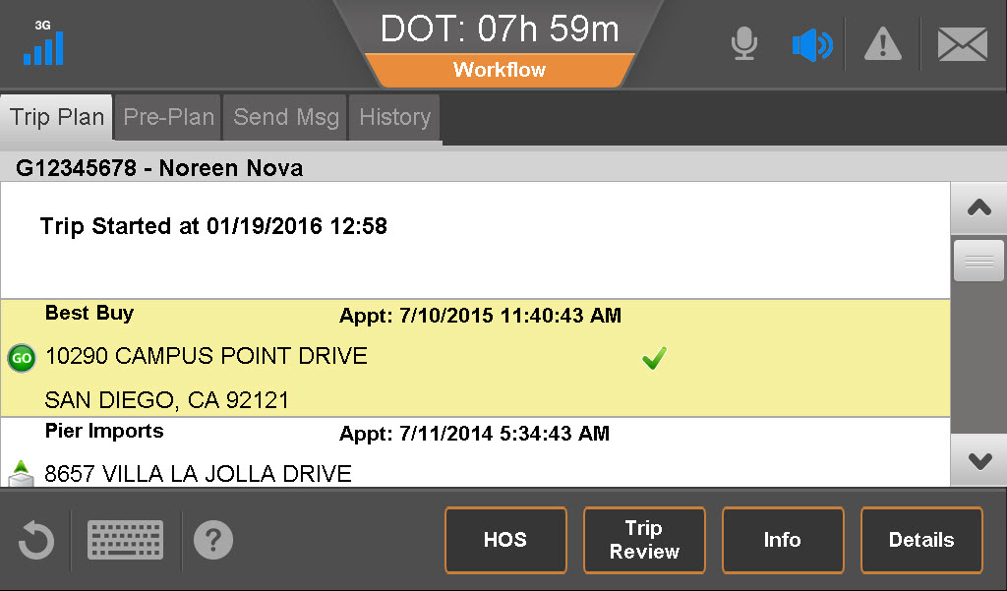
A Day in the Life: Trip Plan
When finished, tap Done.
Continue the trip, completing tasks for each stop in the Trip Plan.

Slide 17
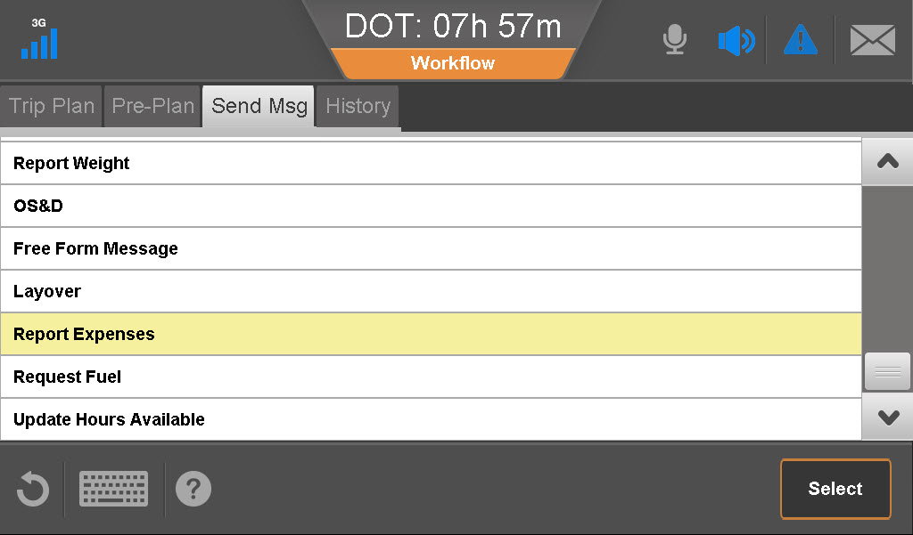
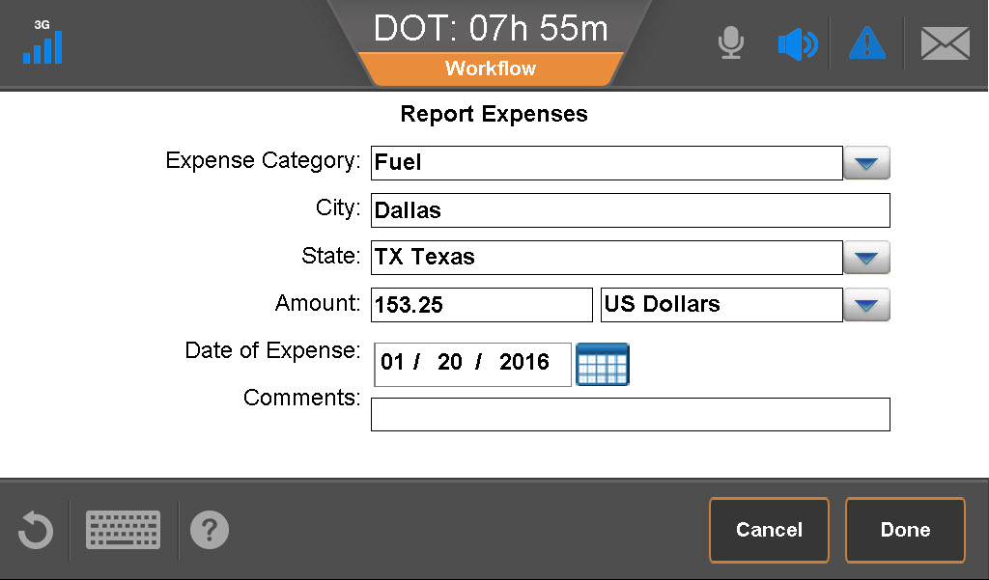
A Day in the Life: Workflow Messages
Sometimes you need to inform Dispatch of a task not associated with a trip plan.
Tap Send Msg.
Tap the message.
Tap Select.
Complete the form.
Tap Done.
Notes:
Describe the situations in which your drivers will be entering other tasks, and what those tasks are.

Slide 18
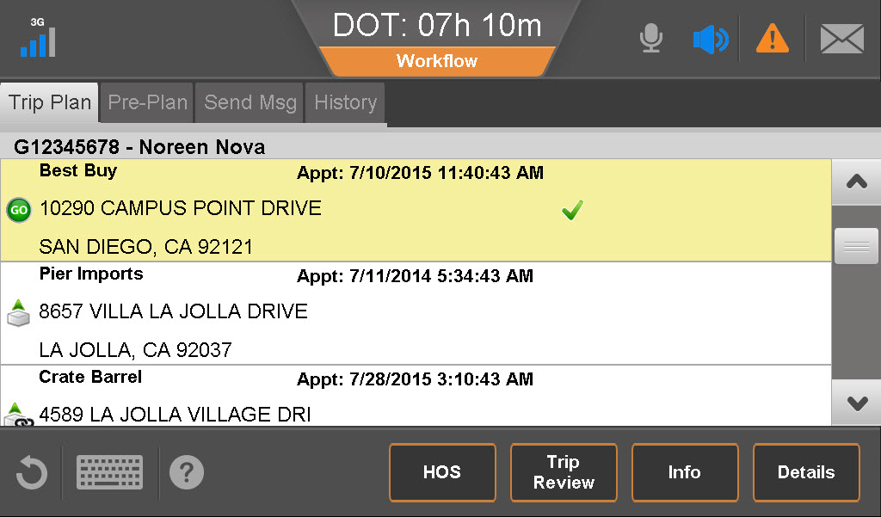
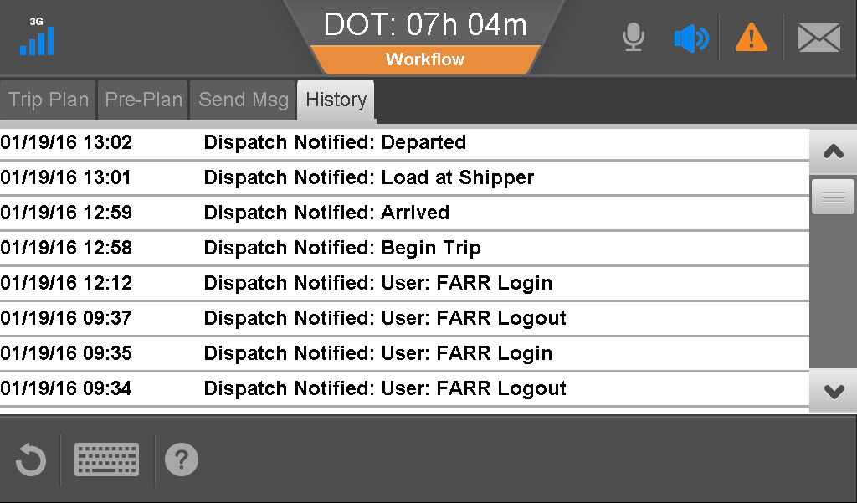
A Day in the Life: History
During a trip, you can view a history of tasks and events that occurred at both the trip and stop levels.
From the Trip Plan, tap History.
When finished looking at history, return to the Trip Plan.
Notes:
The History tab lists the date and time when the trip plan was received, and each notification sent to or from dispatch.

Slide 19
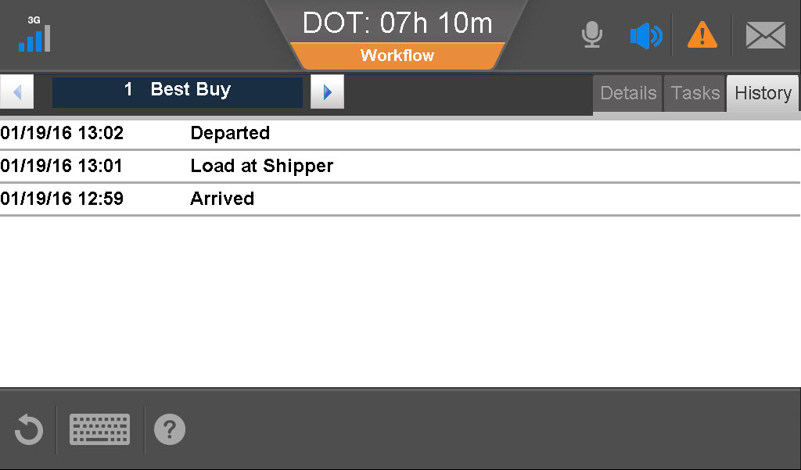
A Day in the Life: History
To view stop history, tap Details to view the stop, then tap History.
When finished looking at history, tap another tab or return to the Trip Plan by tapping the back arrow.
Notes:
The stop History tab lists the tasks completed for the stop with the date and time of completion.

Slide 20
IVG Driver Training
This concludes the Driver Workflow training.

